Slide 1
RESOURCES - www.emergencypedia.com/NearPeer
Near Peer
Cost
Simulation
Faculty
Motivation
Short presentation
Dr Andrew Coggins
AMEE 2025

Slide 2
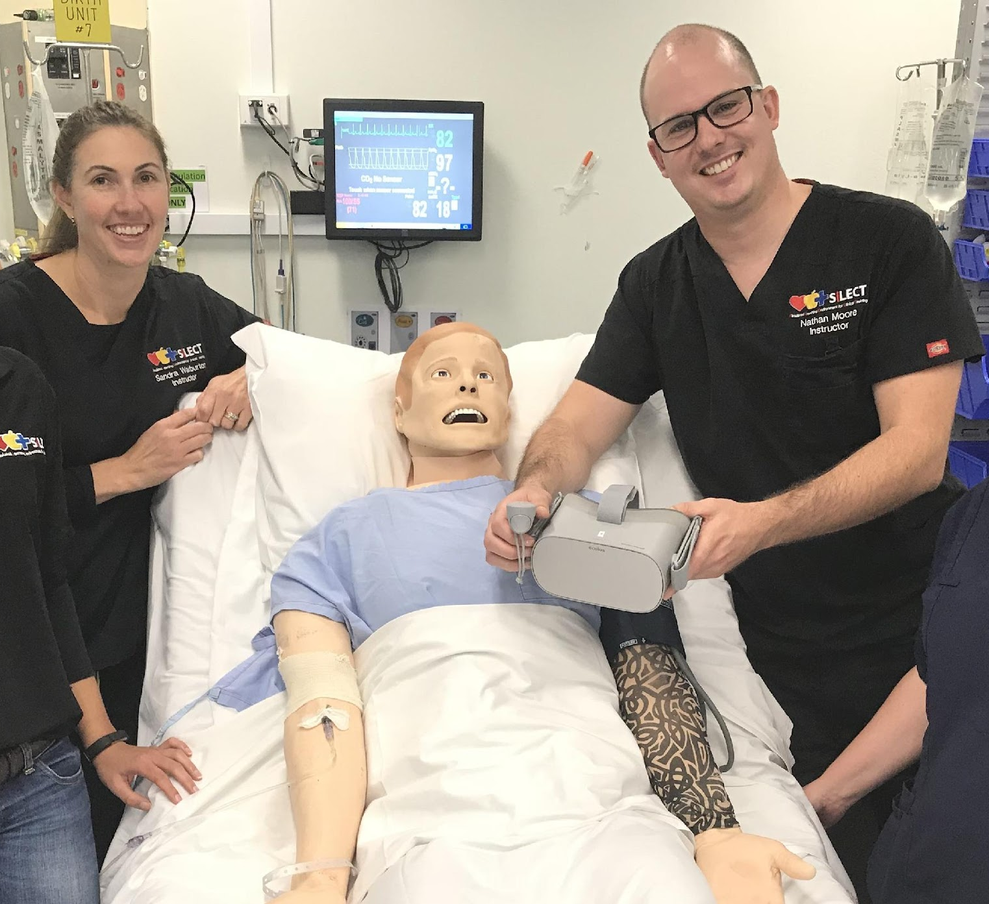
Welcome
Examining the Contribution of Early-Career Health Professionals in Simulation-Based Education

Slide 3
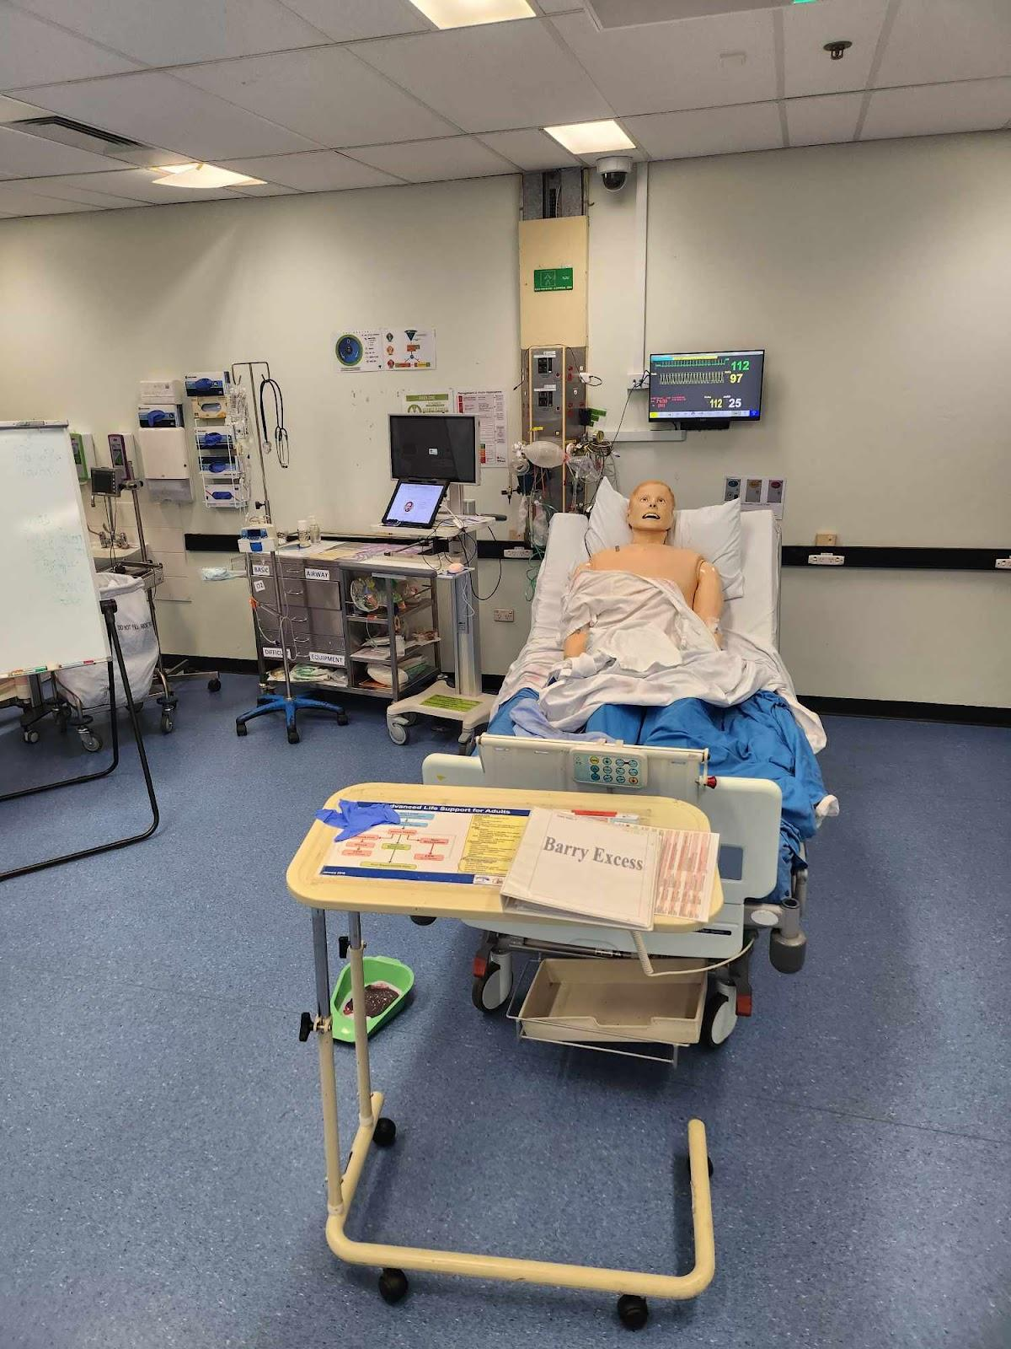
How can a simulation faculty development program that includes Junior Doctors
fail, work, assist, hinder the simulation centre operations?

Slide 4
Agenda
Overview
Theory
Paradigm
Background
Methods
Results

Slide 5
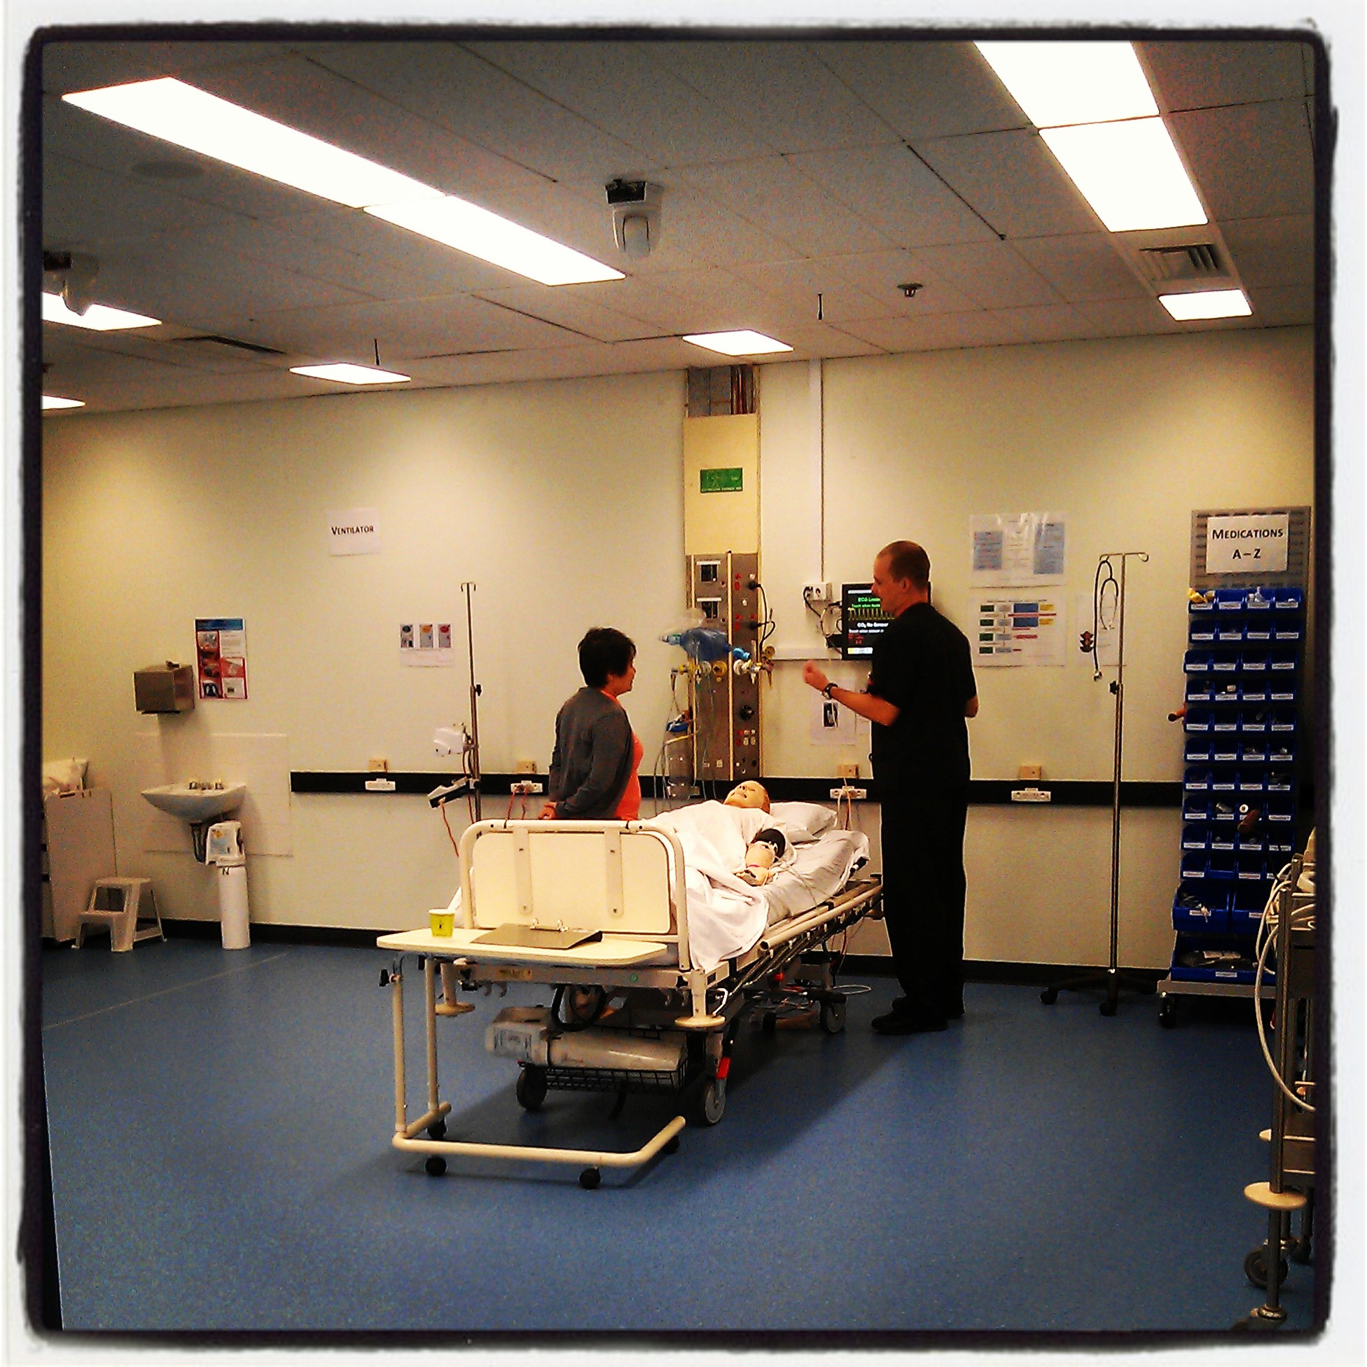
Ratios
in Simulation

Slide 6


Slide 7
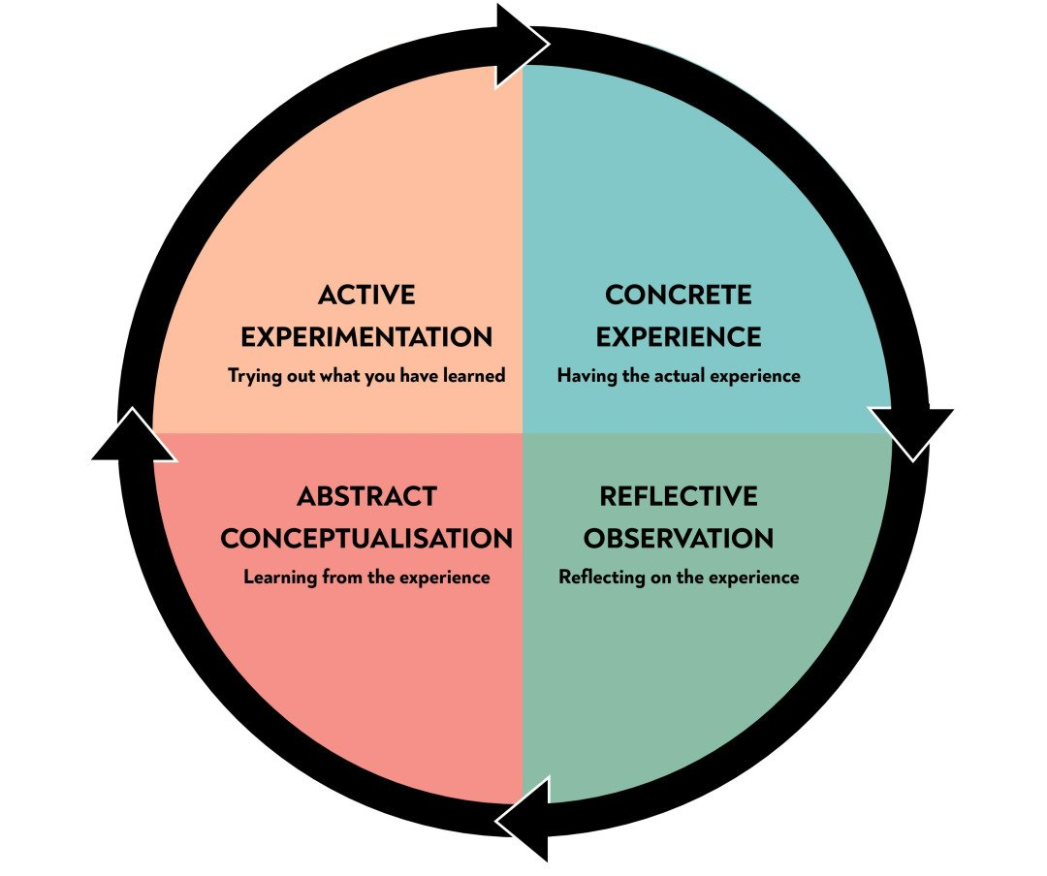

Slide 8
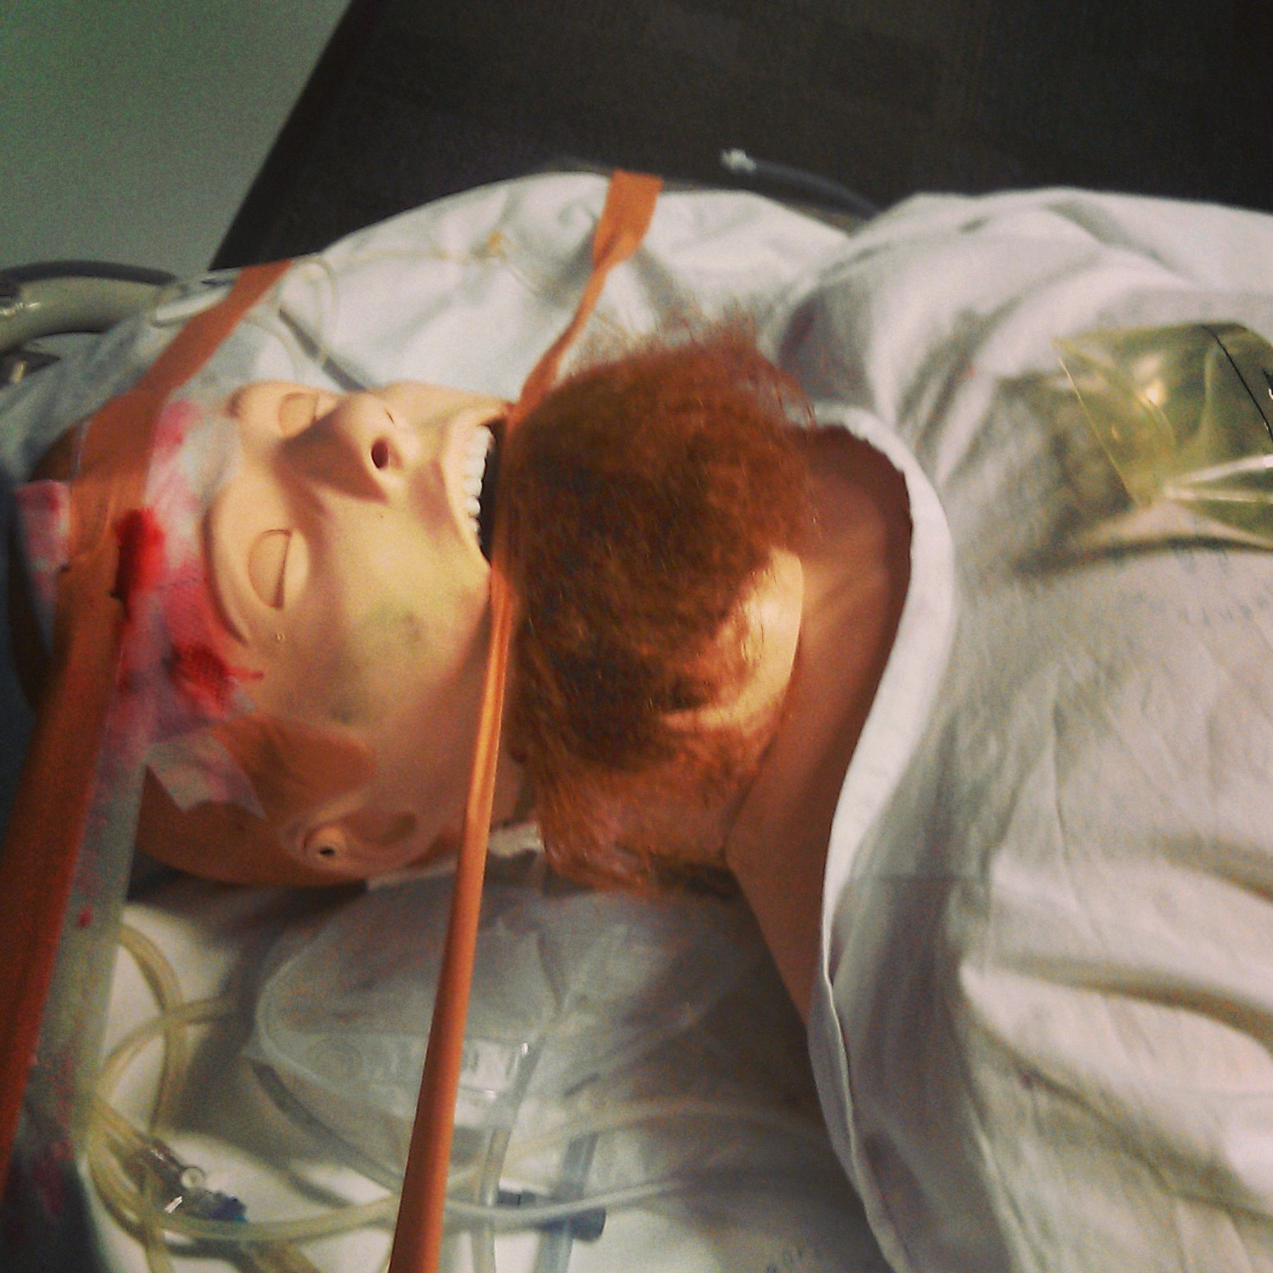
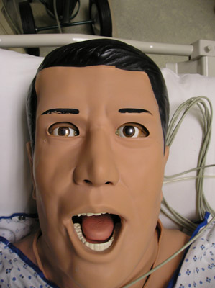
Problem
Need to Support:
Scalability
Quality
Authenticity
Not Fidelity!

Slide 9
Gaps
High demand for simulation education, limited trained faculty
Traditional faculty development is resource-intensive
Near-peer teaching (NPT) is an emerging educational approach

Slide 10
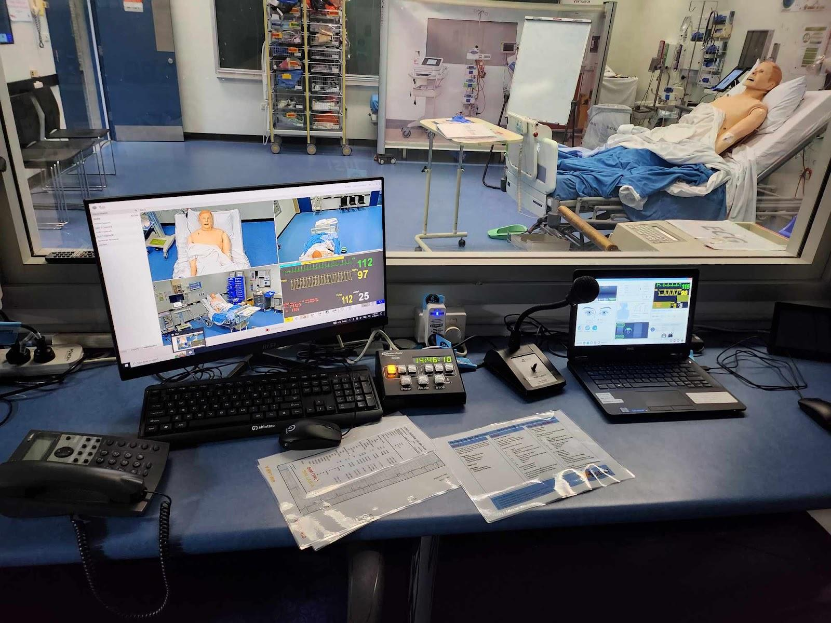

Slide 11
Leverage of Faculty Development to include Near peer learning
  Work in context
  Support Sustainability of Simulation
  Enhance Learners’ and Faculty Experience

Slide 12

Near-Peer Teaching (NPT)
Teachers are 0–2 years senior to learners
Limited description in Sim
Near Peer Programmes - Bridge
  Knowledge
  Empathy
  Relatability
  ?Risks
? use in simulation - some programmes paid (Viggers et al 2022)

Slide 13
Programme Rationale & Setting
Simulation in our Context
  Rapid demand growth without new funding (Global North setting)
Aim - scalability and educational excellence
Basis of Design(s) and Use was Grounded in:
- Vygotsky's Social Constructivism
- Cheng’s debriefing frameworks

Slide 14
Methods
Programme Report
Engagement
Experience
2 Simulation
Centres
Self-Reported Data
Motivation

Slide 15
Programme Structure
Targeted early-career health professionals (ECHPs)
Voluntary entry
Tiered progression
Levels of completion (Cheng et al):
  “Discovery” (entry-level)
    “Growth” (mid-level)
      Maturity (faculty)

Slide 16
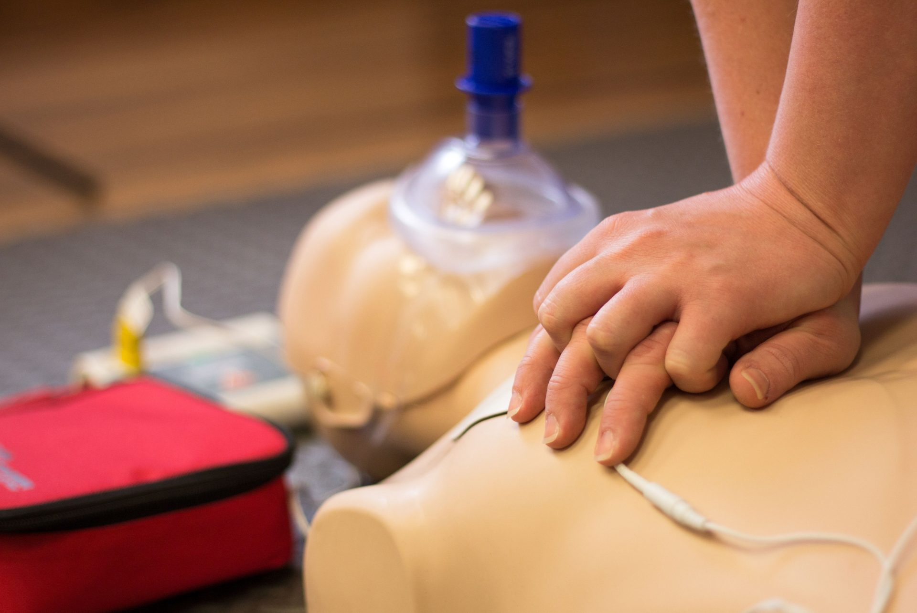
176 junior doctors + 2 pharmacists
• Largest group: future anaesthetists

Slide 17
Summary of Programme 2018-2025
Learner Registrations via EOI (QR code in Sim centre)
176
Completions
Level 1- 61 // Level 2 - 16 // 5 Fellows
Notes:
Determine level of learner and faculty as both must be considered in making a choice
Determine objectives and available resources
Balance need for effort, cognitive load, distraction, realism and scaling

Slide 18
Pros
High Number of Sign-ups over 7 years
Big Portion of Faculty …. Seeding
>15 Came Back as Senior Faculty

Slide 19
Challenges
Medical Dominance // Need IPL component ?
Assessment Needed? // Unpaid, Variable Buy-in
Mentorship // Retention

Slide 20
Expanded faculty pool
Near-peer mentorship for learners
(Supported) debriefing by ECHPs
Created a new culture in simulation centre
Caution: Potential opportunity costs (e.g. bedside teaching)

Slide 21
Motivation & Reflection
“I want to develop my teaching skills and I like sim.”
Intrinsic motivation(s) to engage and grow
Faculty described positive local cultural and educational impact

Slide 22
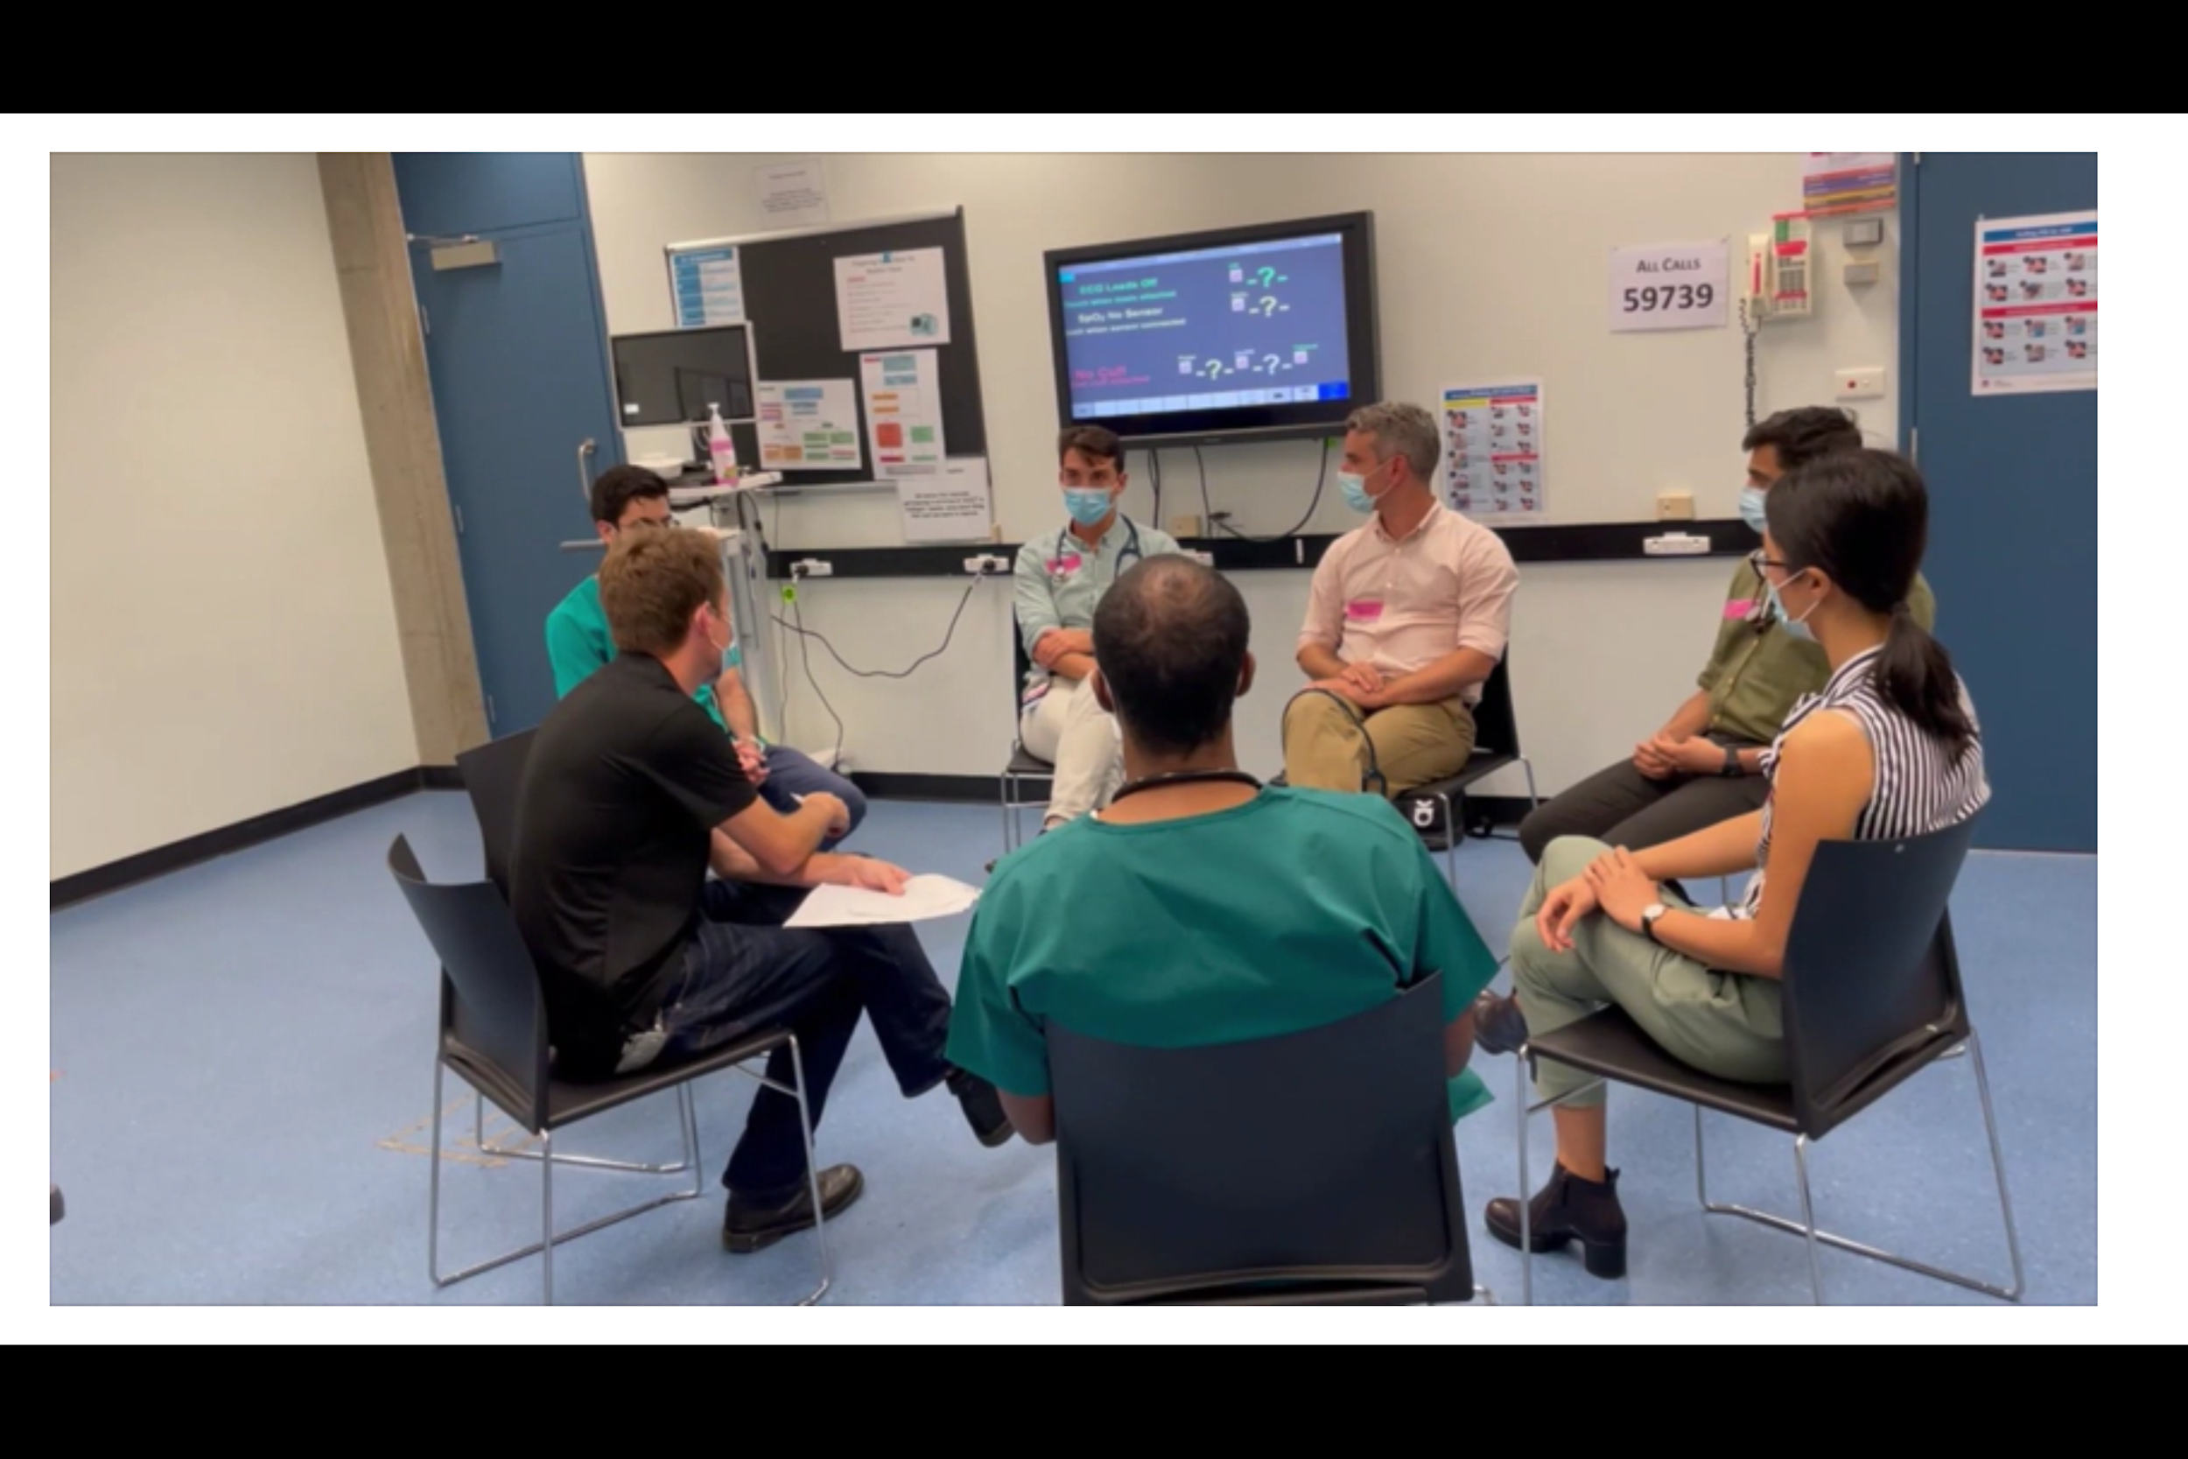
Conclusion & Implications
Take Homes
ECHPs can be meaningfully integrated into simulation roles
Near peer inclusion offers scalable, engaging faculty development
Future directions: explore long-term outcomes and sustainability

