Slide 1
Welcome to the Simulated EMR!
How to use this software:
Click using the mouse. If nothing opens, there is no information there
Do NOT use the keyboard
Note only very basic documentation exists
Please check each box →

Slide 2

Welcome to the Simulated EMR!
How to use this software:
Click using the mouse. If nothing opens, there is no information there
Do NOT use the keyboard
Note only very basic documentation exists
Please check each box →

Slide 3
Welcome to the Simulated EMR!
How to use this software:
Click using the mouse. If nothing opens, there is no information there
Do NOT use the keyboard
Note only very basic documentation exists
Please check each box →

Slide 4
Welcome to the Simulated EMR!
How to use this software:
Click using the mouse. If nothing opens, there is no information there
Do NOT use the keyboard
Note only very basic documentation exists
Click to login to EMR

Slide 5
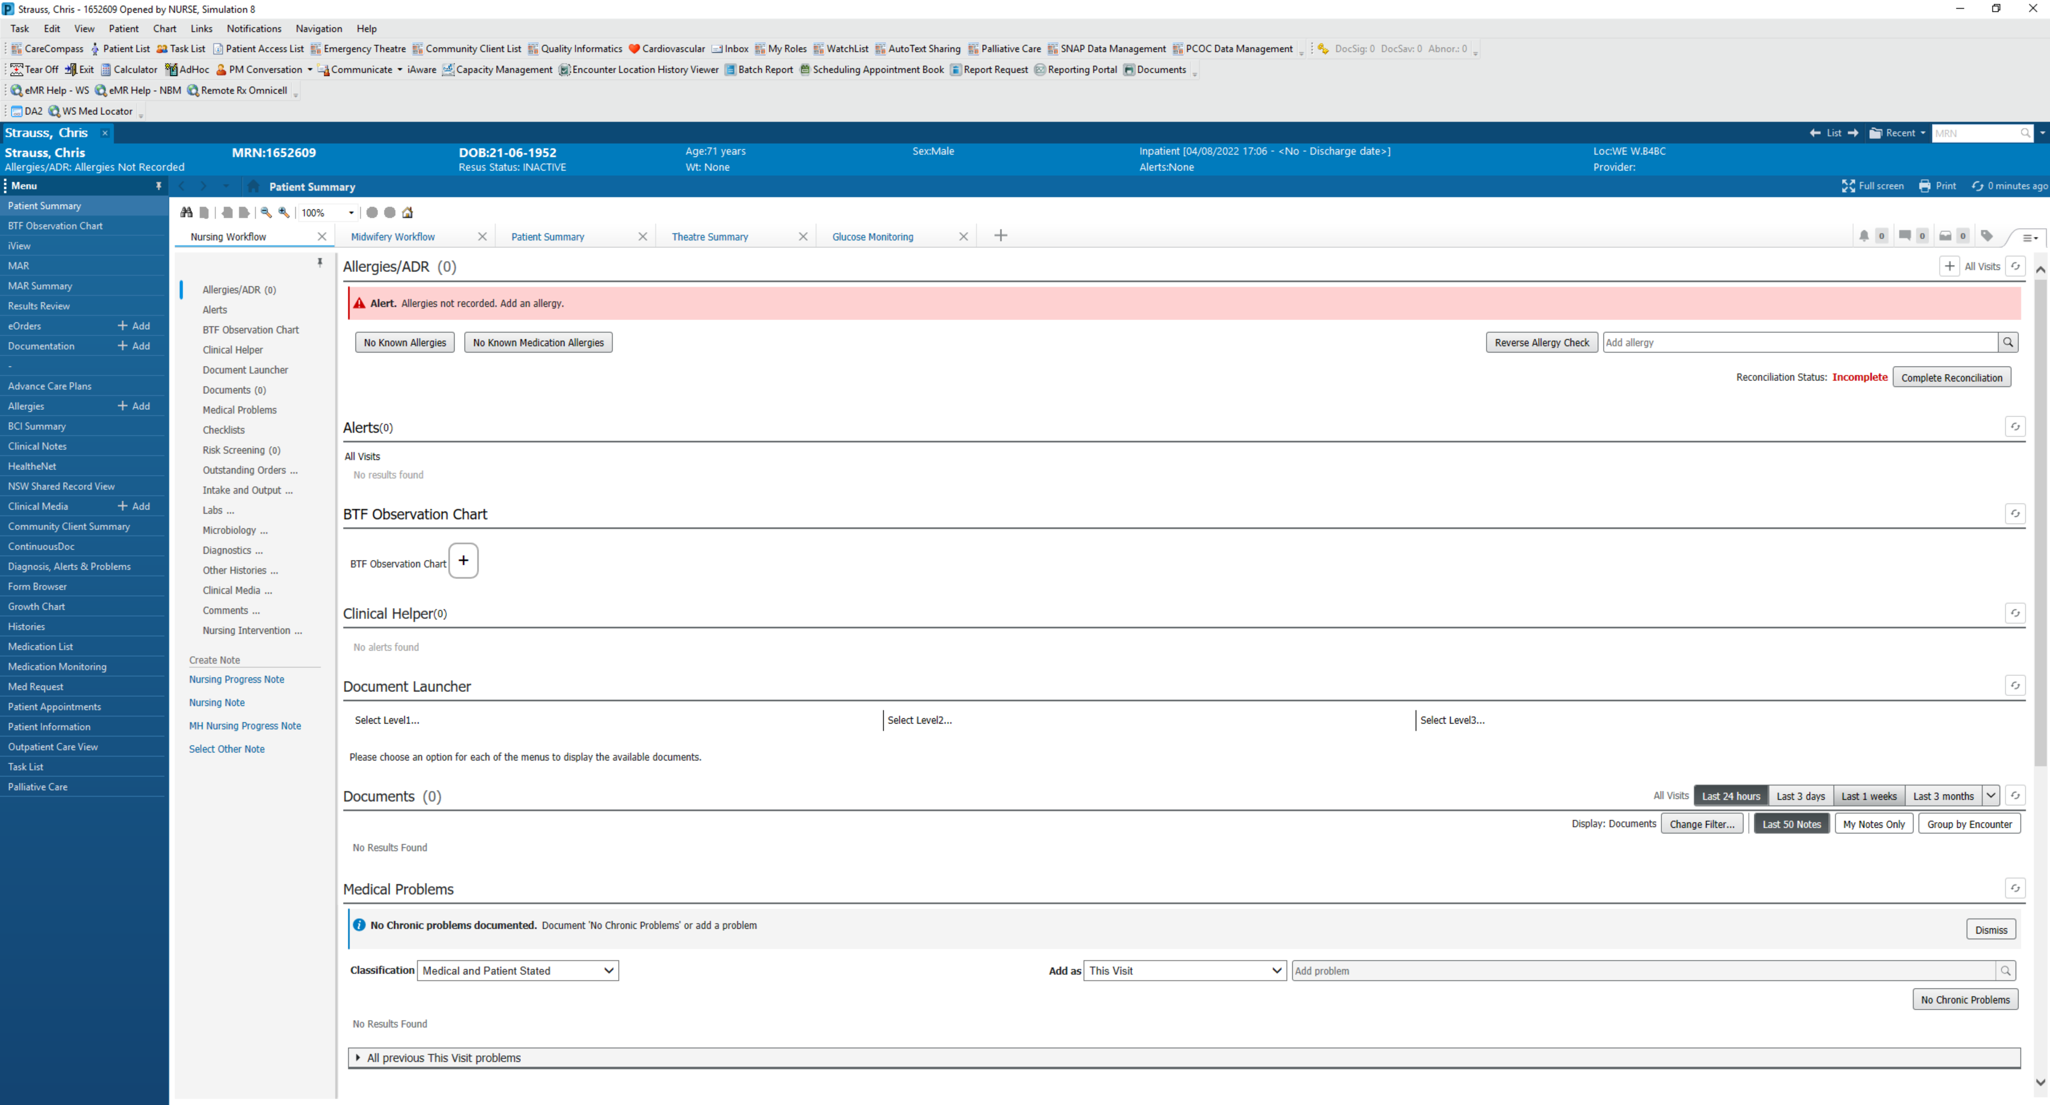

Slide 6
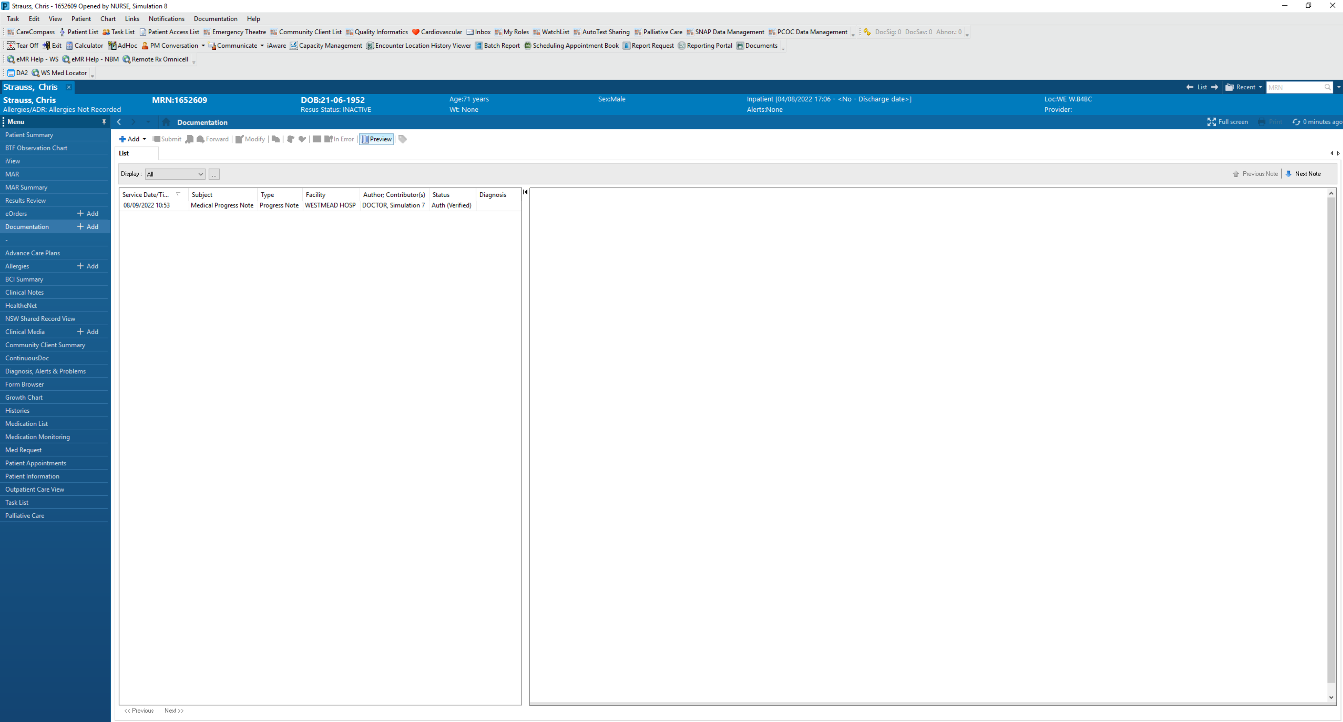

Slide 7
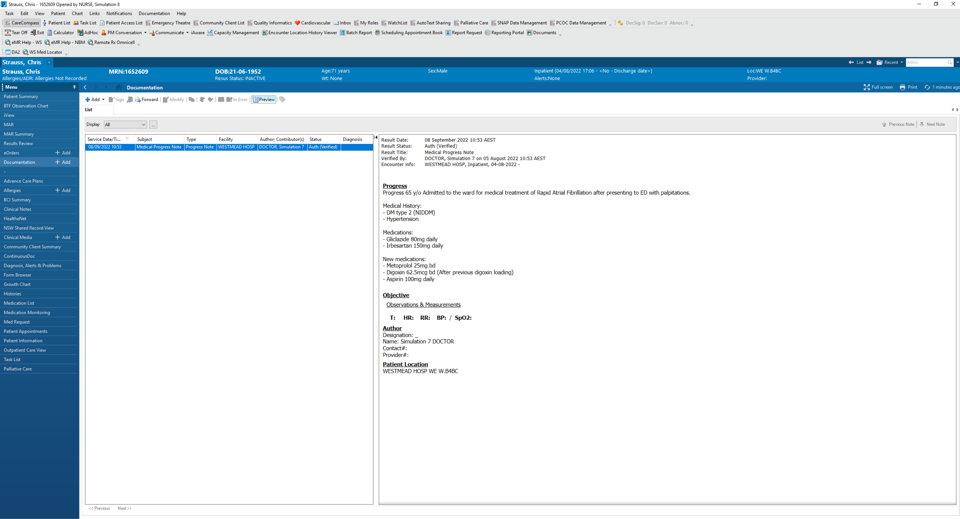

Slide 8
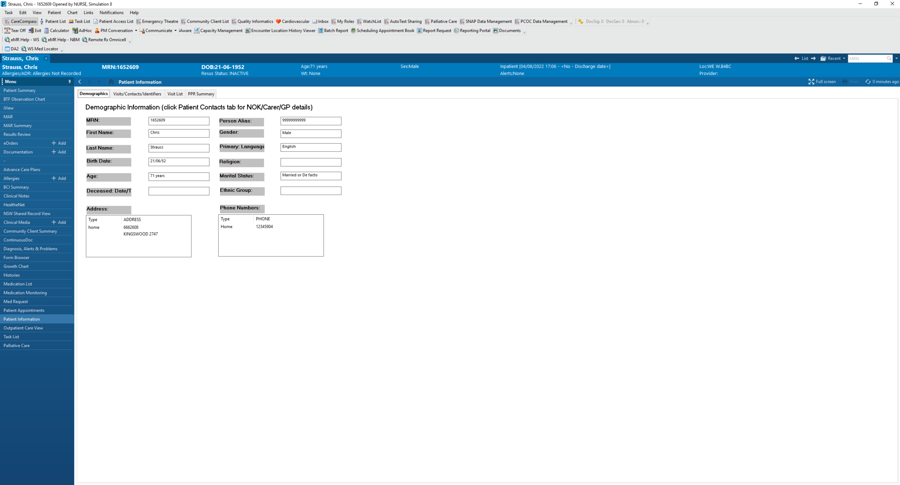

Slide 9
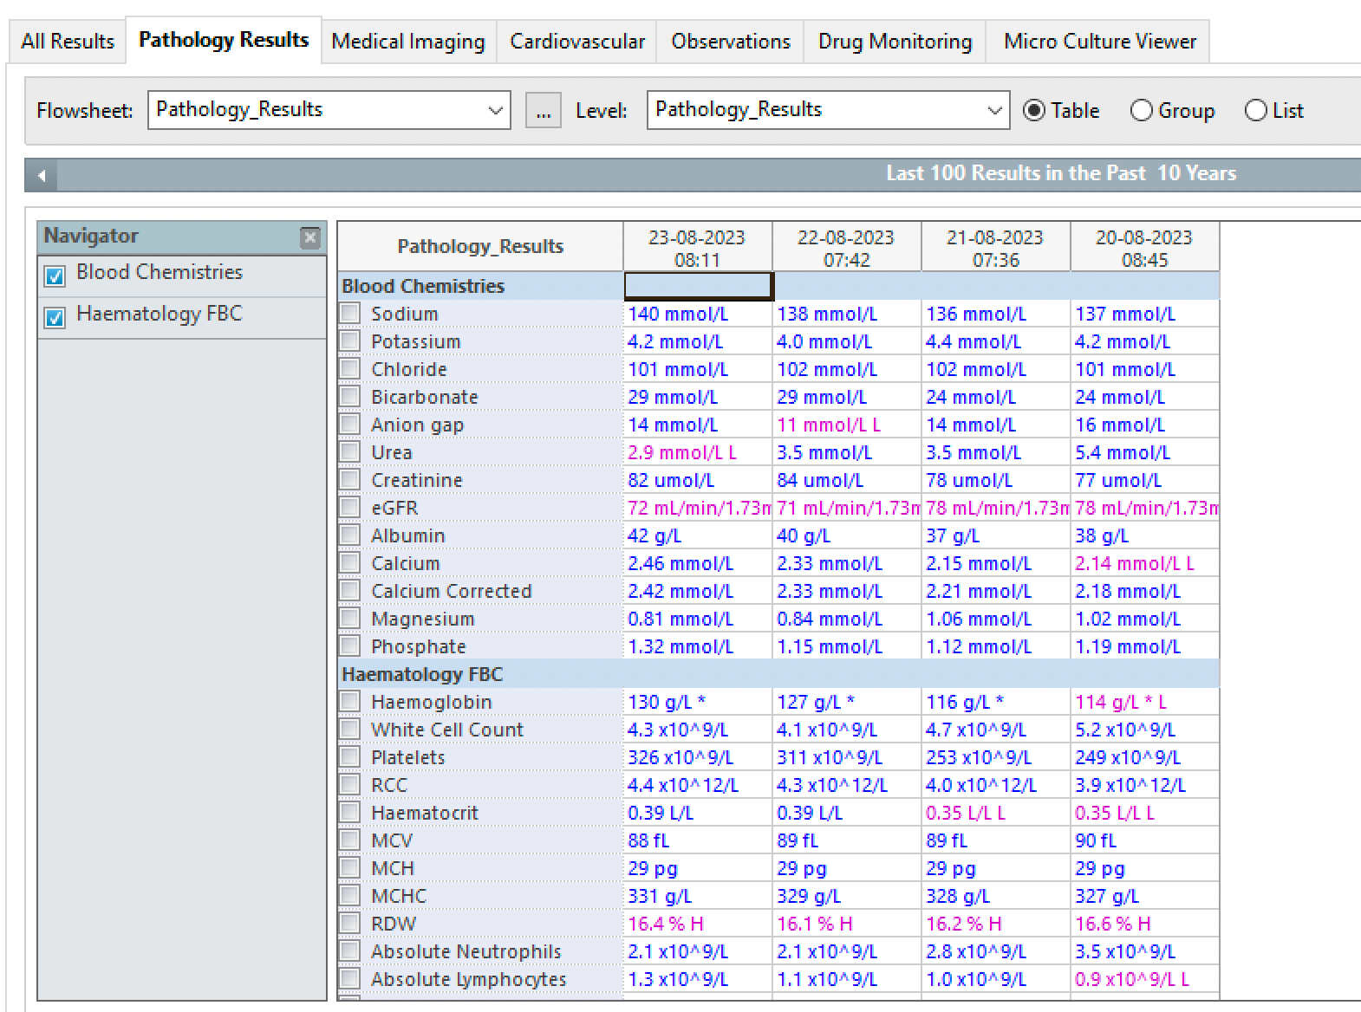
15.1 x 10^9/L

Slide 10
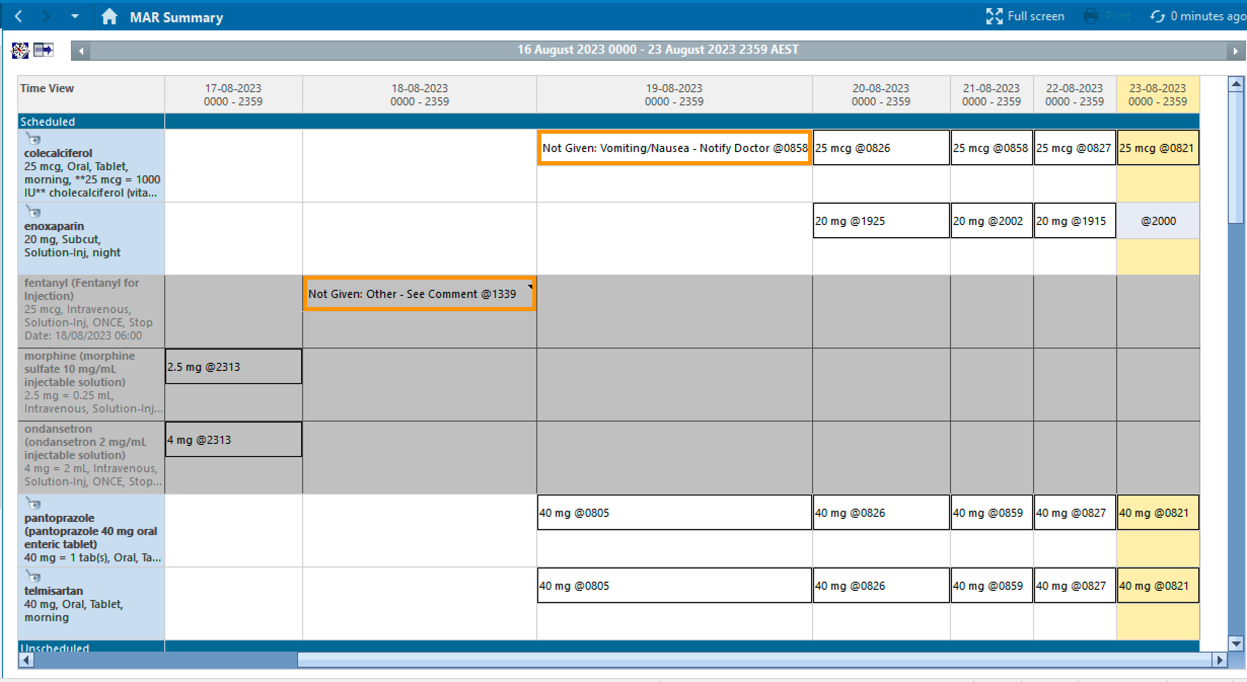

aspirin
100mg, Oral
100mg @ 0757
100mg @ 0757
100mg @ 0757
100mg @ 0757
digoxin
250mg, IV
250mg @ 2348
62.5mcg @ 0757
62.5mcg @ 0757
62.5mcg @ 0757
62.5mcg @ 0757
digoxin
62.5mcg, Oral, BD
62.5mcg @ 2003
62.5mcg @ 2003
62.5mcg @ 2003
gliclazide
60mg, Oral
60mg @ 0757
60mg @ 0757
60mg @ 0757
60mg @ 0757
irbesartan
20mg, Oral
20mg @ 0757
20mg @ 0757
20mg @ 0757
20mg @ 0757
metoprolol
25mg, Oral, BD
25mg @ 0757
25mg @ 0757
25mg @ 0757
25mg @ 0757
25mg @ 2003
25mg @ 2003
25mg @ 2003

Slide 11
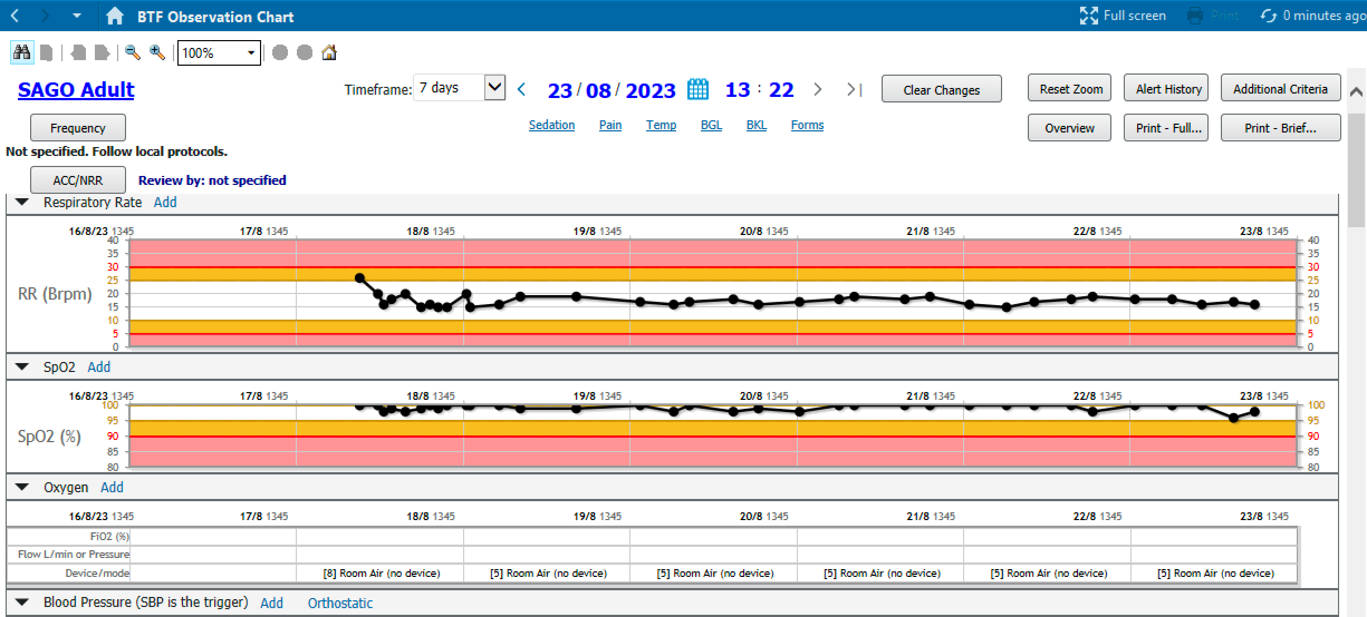
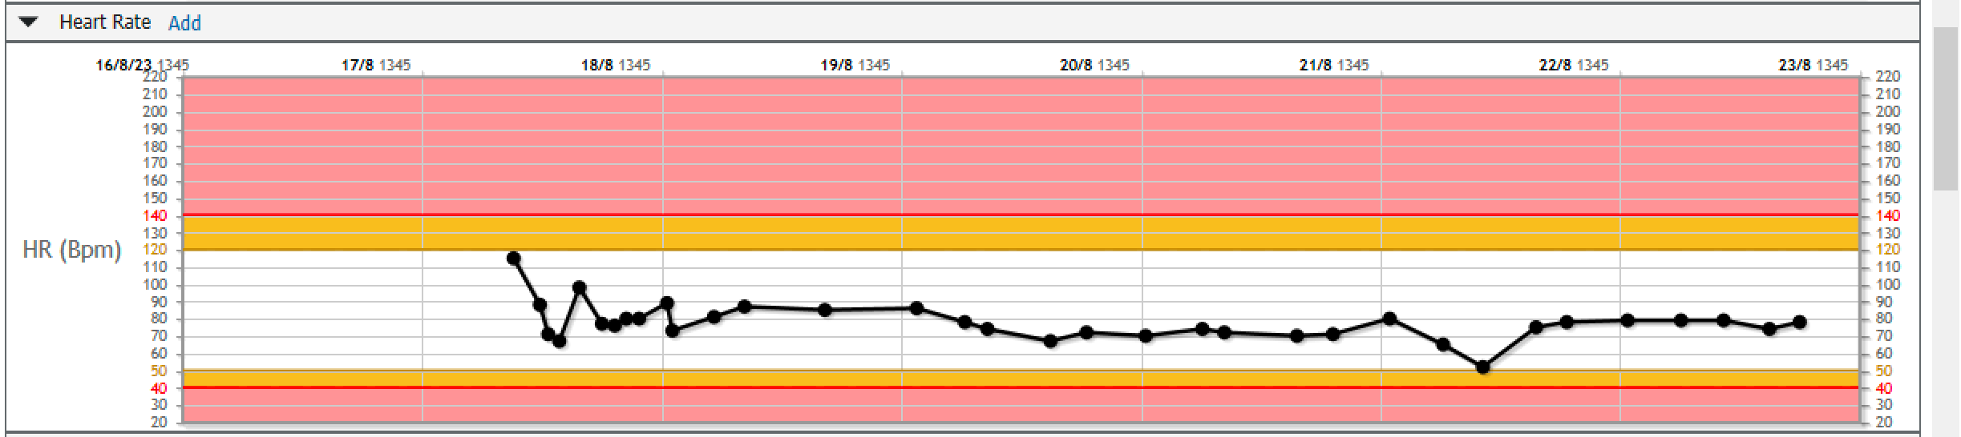
c
Scroll down

Slide 12
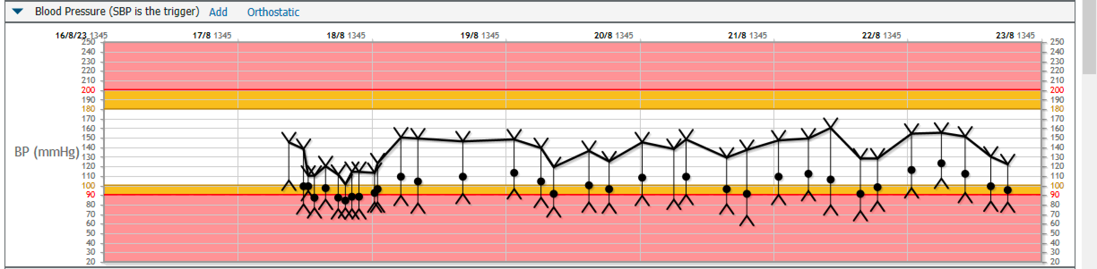
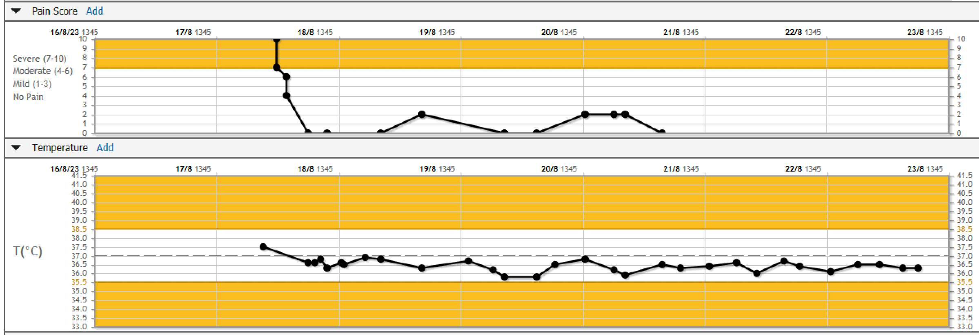
Scroll
up

