Slide 1
Welcome to the Simulated EMR!
How to use this software:
Click using the mouse. If nothing opens, there is no information there
Do NOT use the keyboard
Note only very basic documentation exists
Please check each box →

Slide 2

Welcome to the Simulated EMR!
How to use this software:
Click using the mouse. If nothing opens, there is no information there
Do NOT use the keyboard
Note only very basic documentation exists
Please check each box →

Slide 3
Welcome to the Simulated EMR!
How to use this software:
Click using the mouse. If nothing opens, there is no information there
Do NOT use the keyboard
Note only very basic documentation exists
Please check each box →

Slide 4
Welcome to the Simulated EMR!
How to use this software:
Click using the mouse. If nothing opens, there is no information there
Do NOT use the keyboard
Note only very basic documentation exists
Click to login to EMR

Slide 5
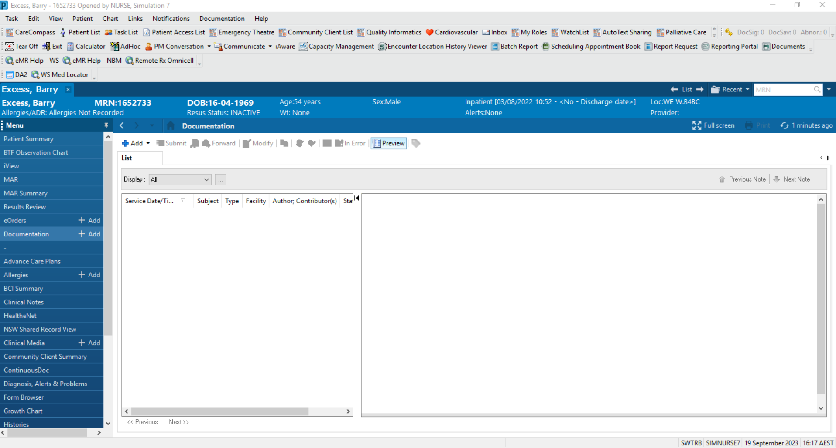
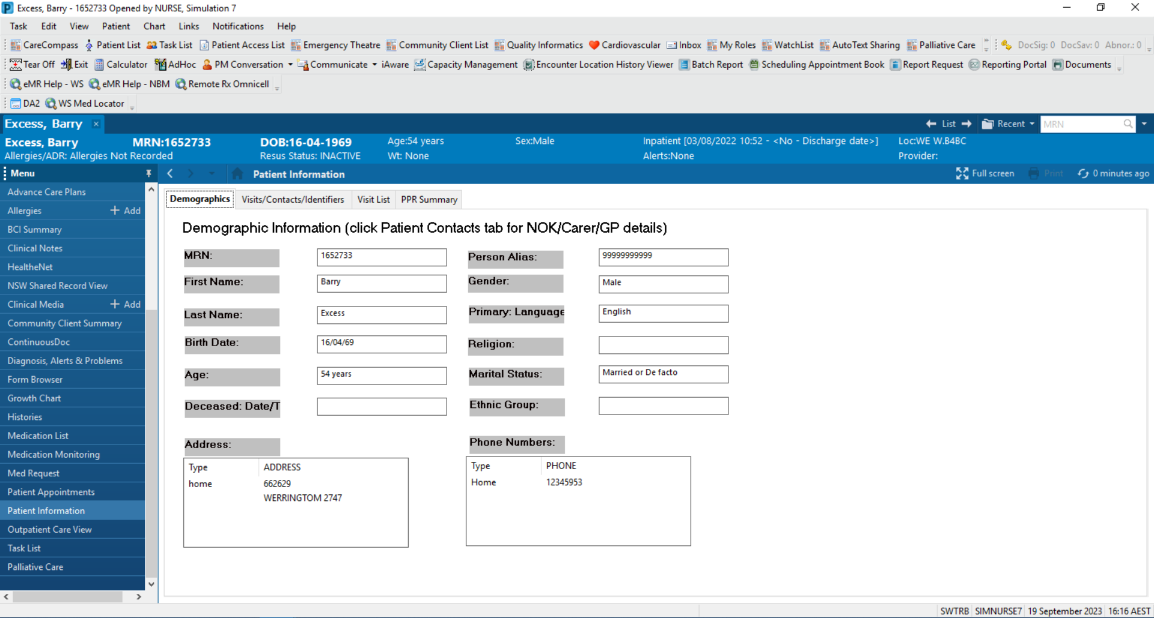

Slide 6
18/9/2023 10:30 Cardiology Progress Note WMH

Slide 7
95kg
18/9/2023 10:30 Cardiology Progress Note WMH
Cardiology
51M STEMI, D0 post PCI and RCA stent
Minimal history, post-procedure
Inferior STEMI → PCI and RCA stent
O/E
HT 95, BP 120/80, 95%RA, T 36.7
Alert
Chest clear
HSD - systolic murmur
JVPNE
Mild epigastric tenderness, nil peritonism, BS present
CSNT, nil pitting oedema
Ix
ECG: resolved STEMI with TWI inferiorly and Q waves
CXR: NAD
Plan
TTE
Education of cardiac risk factors
Commence beta-blocker, ACEI, statin
Fasting bloods
Continue DAPT
PMHx
PVD
HTN
Hypercholesterolaemia
Peptic ulcer disease
Meds
Aspirin 100mg daily
Clopidogrel 75mg
NKDA
SHx
Ex-smoker, quit 2 weeks ago, 40 pack years
Non-drinker
Works in an office
Lives with family
iADLs

Slide 8
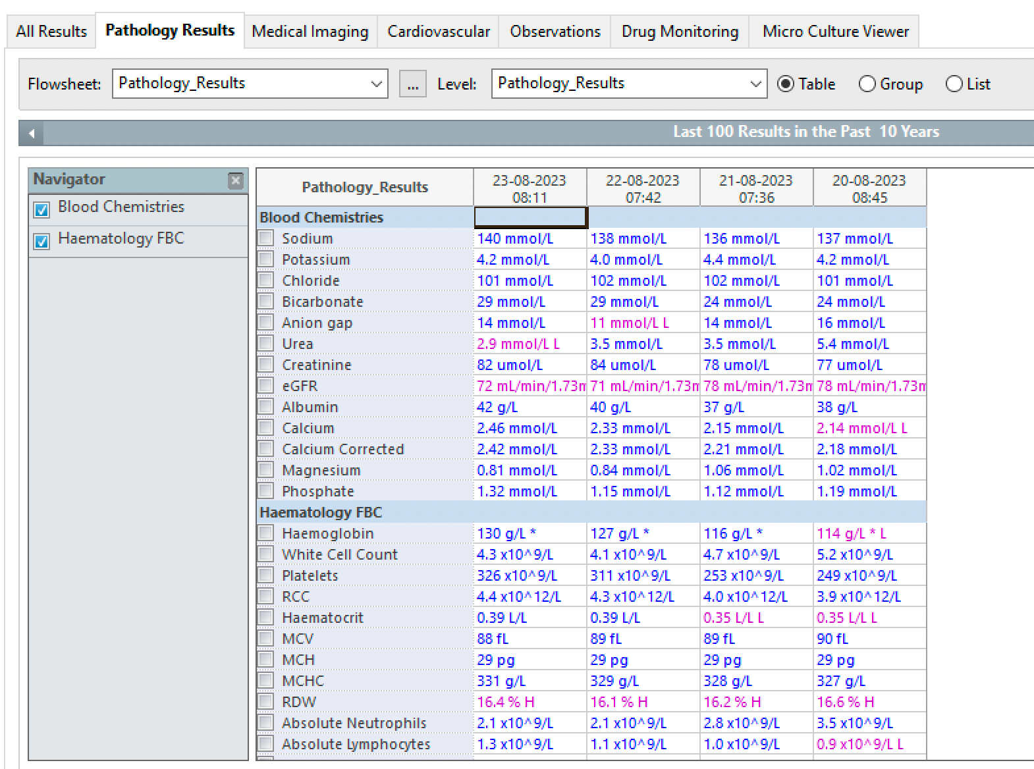
33

Slide 9
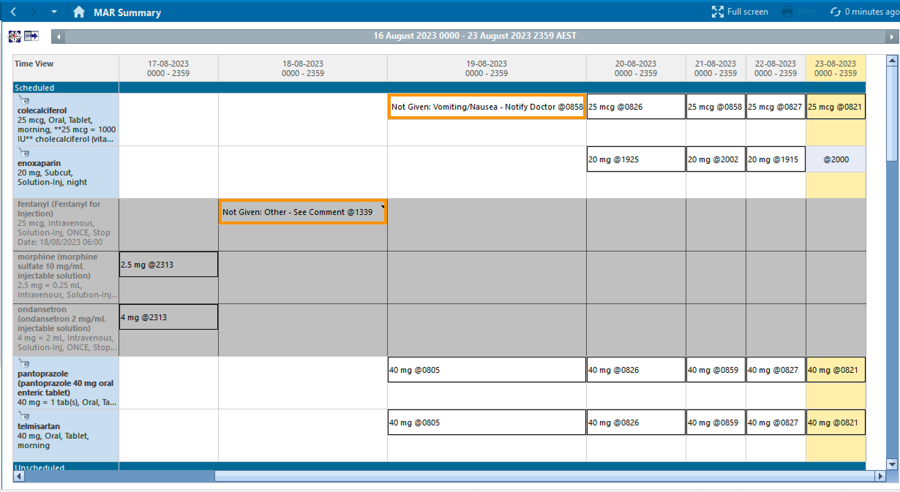
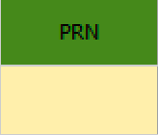
19-08-2023
0000-2359
aspirin
100mg, PO, daily
100mg @ 0731
morphine
1mg, IV, ONCE
clopidogrel
75mg, PO, daily
75mg @ 0731
glyceryl trinitrate
1-2 sprays, SL, 5min

Slide 10
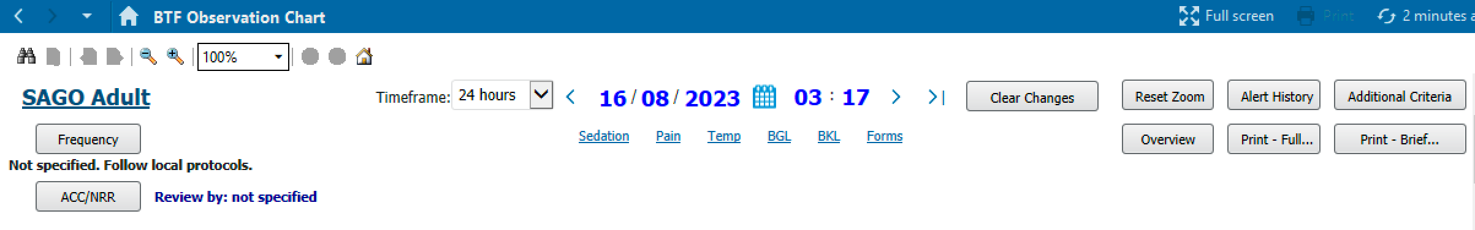
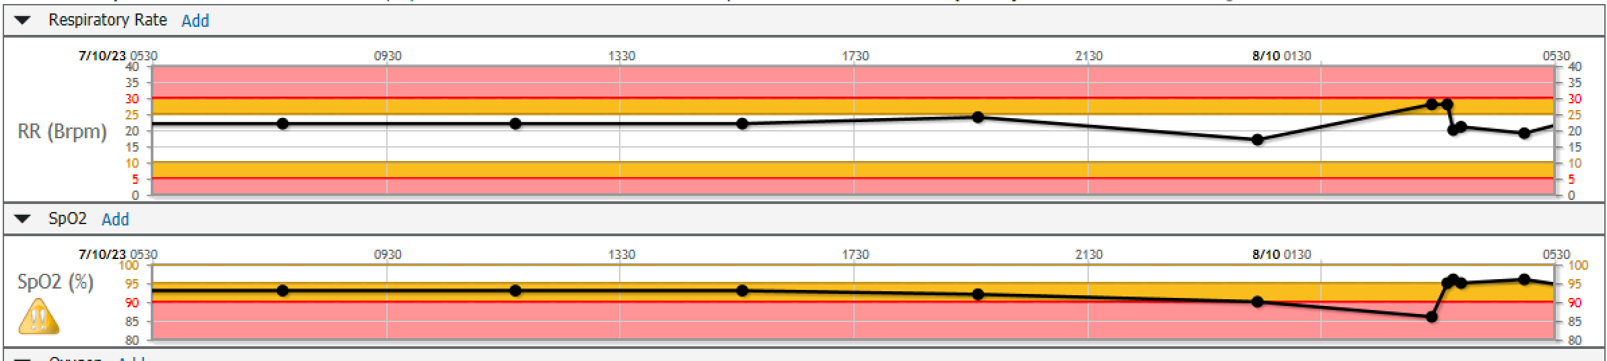
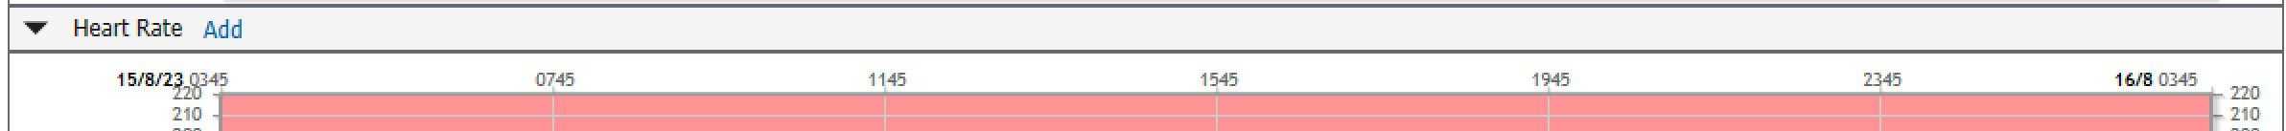
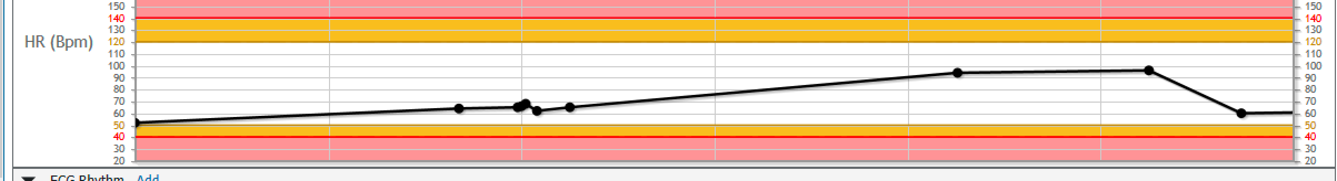
Scroll down

Slide 11
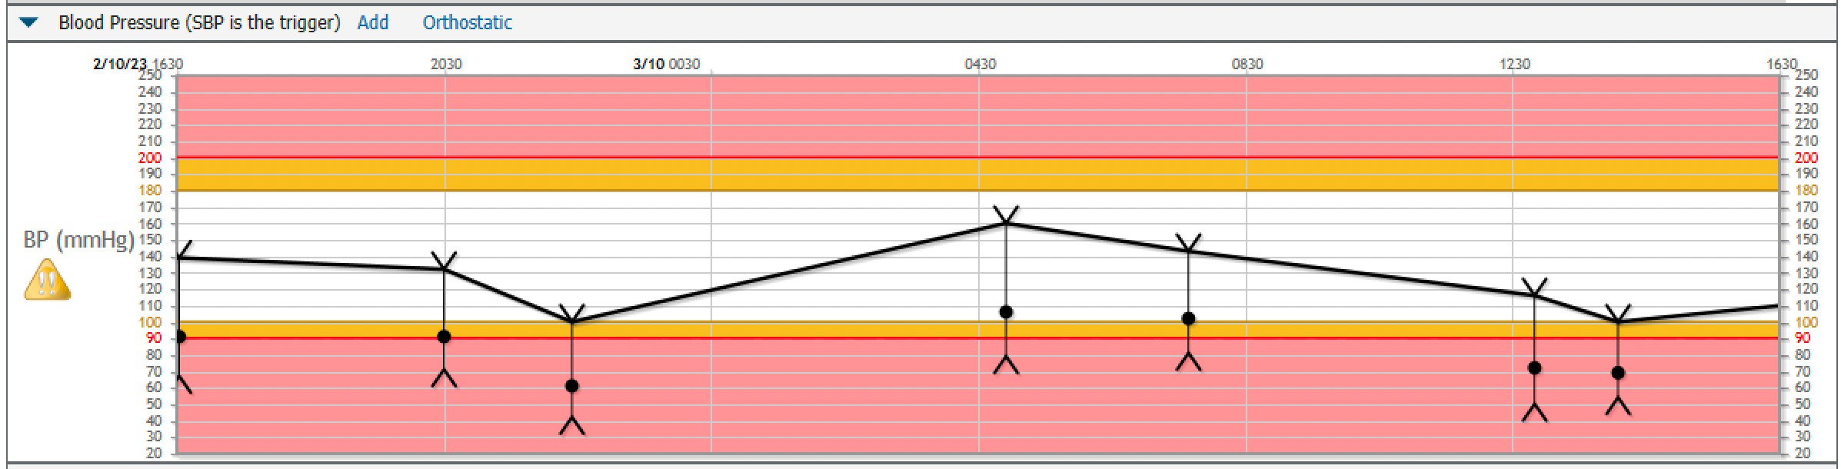
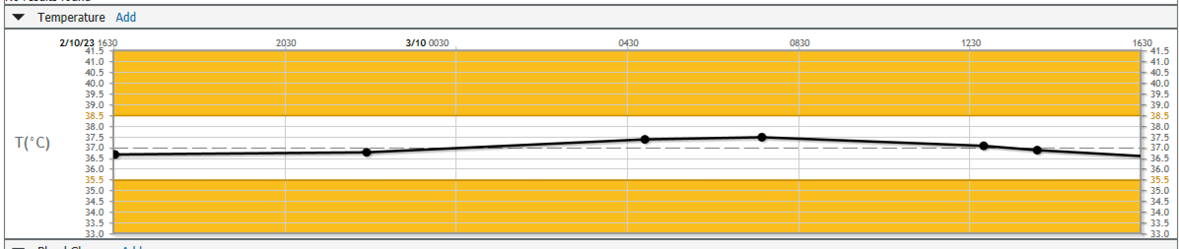
Scroll
up

Slide 12
