Slide 1
Welcome to the Simulated EMR!
How to use this software:
Click using the mouse. If nothing opens, there is no information there
Do NOT use the keyboard
Note only very basic documentation exists
Please check each box →

Slide 2

Welcome to the Simulated EMR!
How to use this software:
Click using the mouse. If nothing opens, there is no information there
Do NOT use the keyboard
Note only very basic documentation exists
Please check each box →

Slide 3
Welcome to the Simulated EMR!
How to use this software:
Click using the mouse. If nothing opens, there is no information there
Do NOT use the keyboard
Note only very basic documentation exists
Please check each box →

Slide 4
Welcome to the Simulated EMR!
How to use this software:
Click using the mouse. If nothing opens, there is no information there
Do NOT use the keyboard
Note only very basic documentation exists
Click to login to EMR

Slide 5
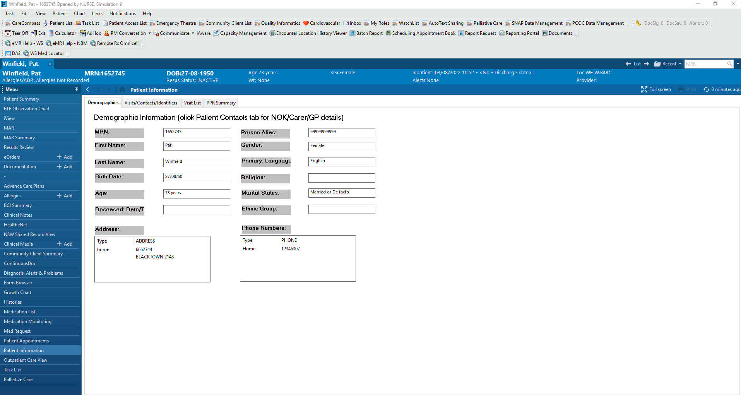

Slide 6
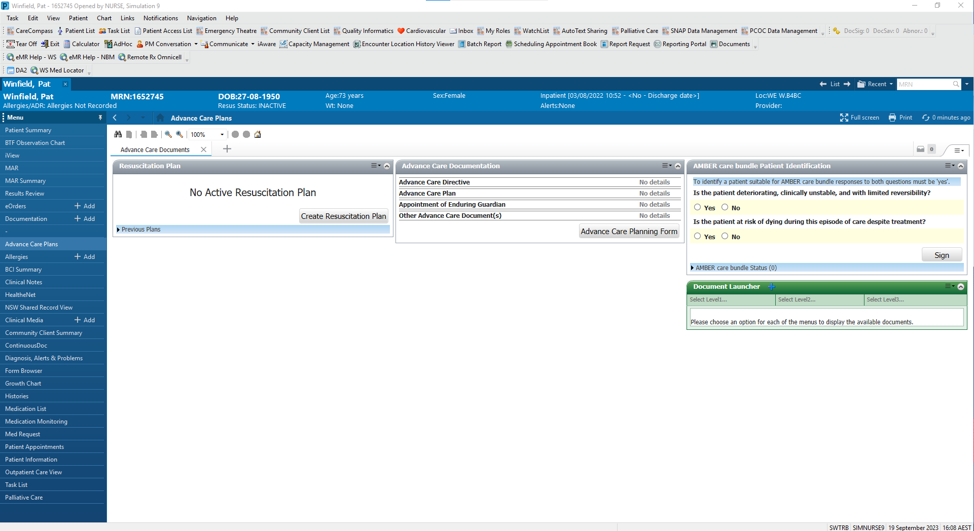

Slide 7
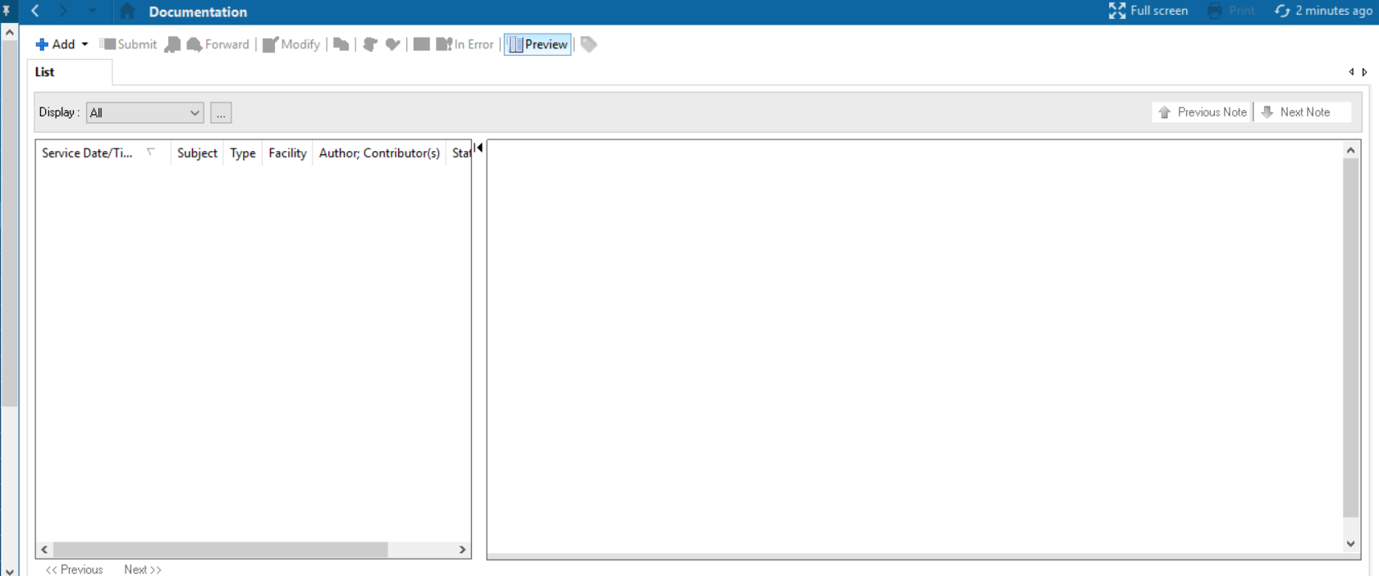
18/9/2023 10:30 ED Medical Assessment Progress Note WESTMEAD HOSP

Slide 8
ED Medical Assessment
70F with dysuria
History
3 days of dysuria – burning and stinging
Associated frequency
Lower abdominal pain
Fevers ++
Nil cough/coryza/diarrhoea
PMHx
COPD
- managed by GP, nil previous admissions
HTN
Ex-smoker – 20 pack years
Meds
Salbutamol PRN
Symbicort 2 puffs daily
Prazocin 2mg BD
O/E
BP 122/75, HR 95, RR 27, SpO2 94%, T 38.1
Warm and well-perfused
Chest clear
HSDNM
AS – tender in lower abdomen
Nil renal angle tenderness
CSNT, nil pitting oedema
Ix
WCC 19
CRP 102
eGFR 33
Impression
Severe UTI, with associated AKI
Plan
Admit
IV Abx
18/9/2023 10:30 ED Medical Assessment Progress Note WESTMEAD HOSP

Slide 9
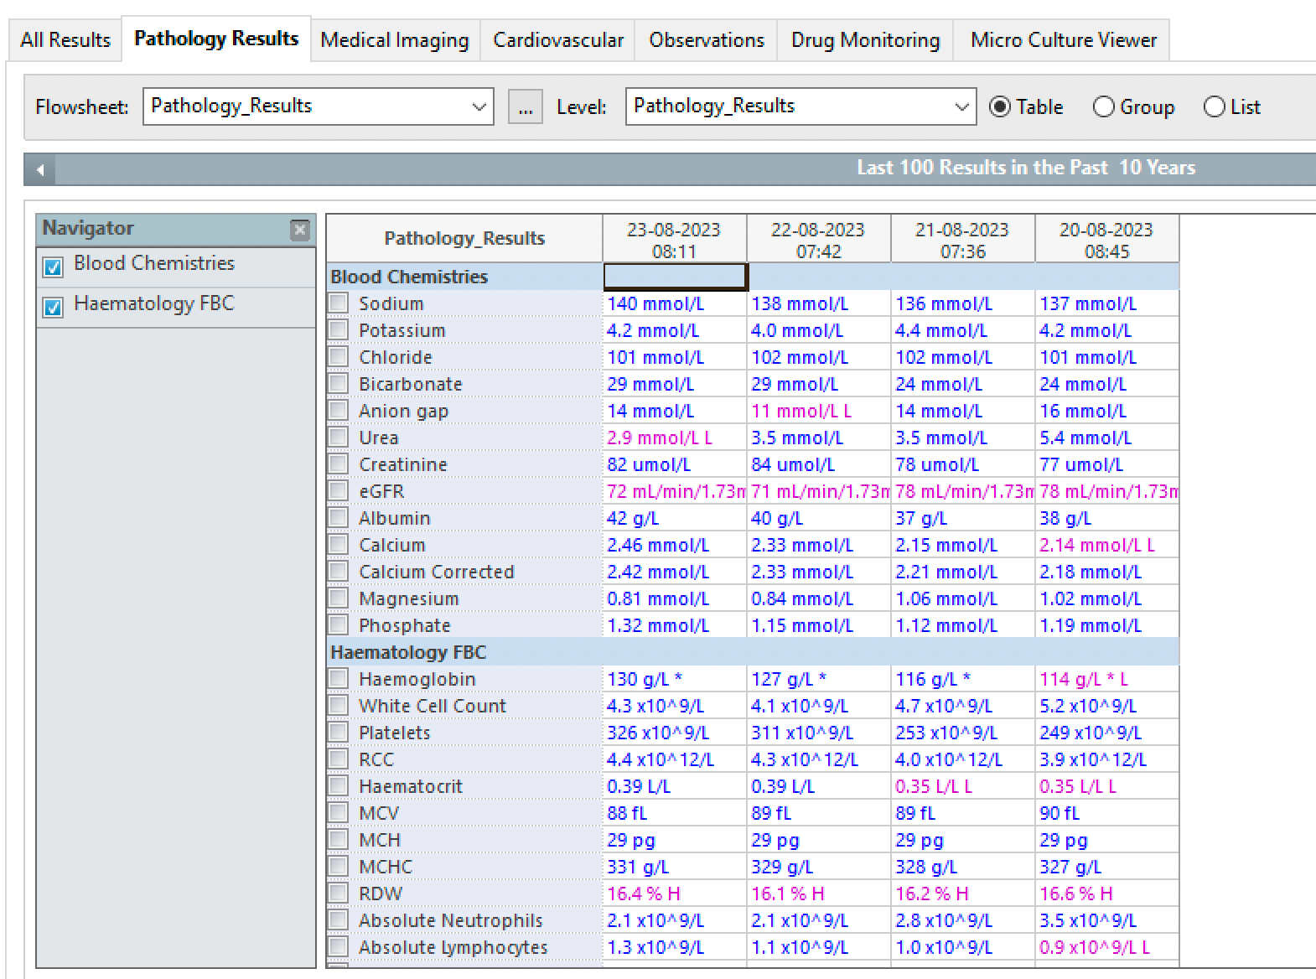
33
19.2 x 10^9/L H

Slide 10
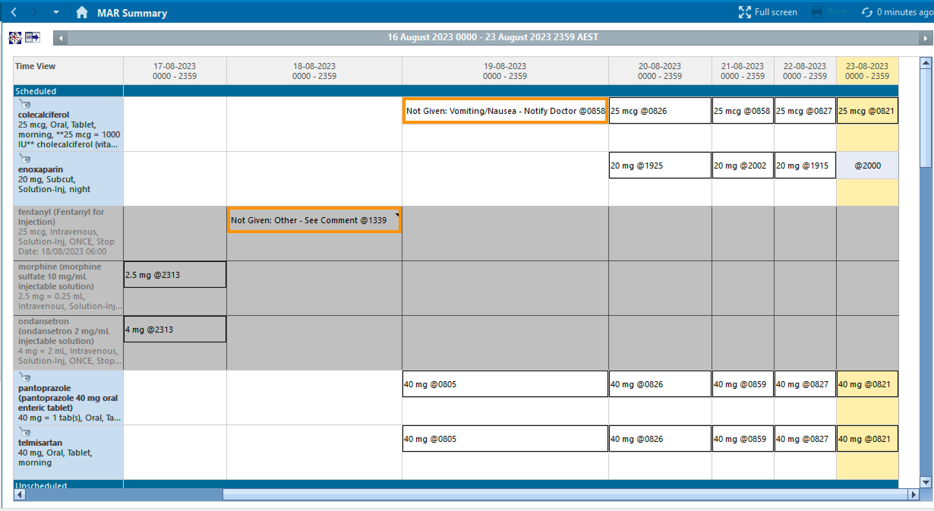
ceftriaxone
1g, IV, daily
1g @ 1431
1g @ 0731
morphine
1mg, IV, ONCE
4 puffs @ 1431
4 puffs @ 2202
4 puffs @ 0731
ipratropium
4 puffs, inhaled, QID
paracetamol
1g, Oral, QID
1g @ 0811
1g @ 1422
1g @ 2202
1g @ 0731
prazocin
2mg, Oral, BD
2mg @ 2002
2mg @ 0731
50mg @ 1432
50mg @ 0731
prednisone
50mg, Oral, daily
salbutamol
12 puffs,inhaled, QID
12 puffs @ 1431
12 puffs @ 2202
12 puffs @ 0731

Slide 11
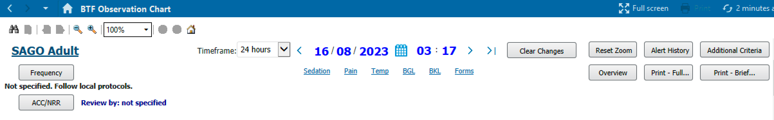
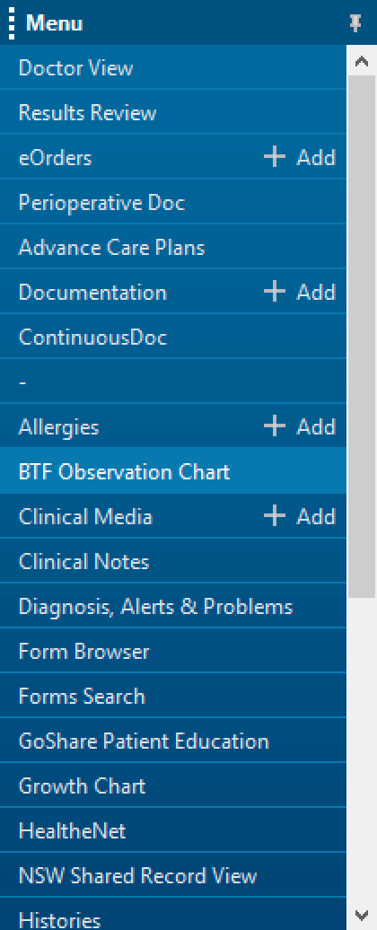
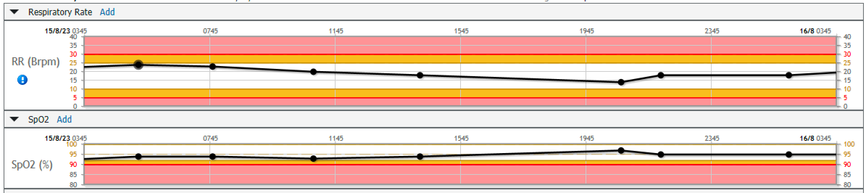
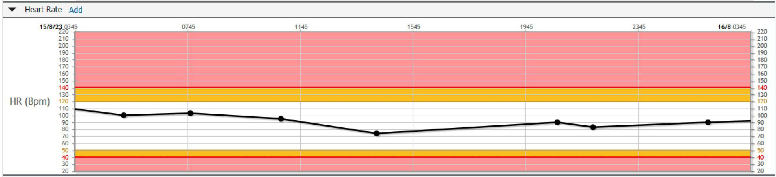
Scroll down

Slide 12
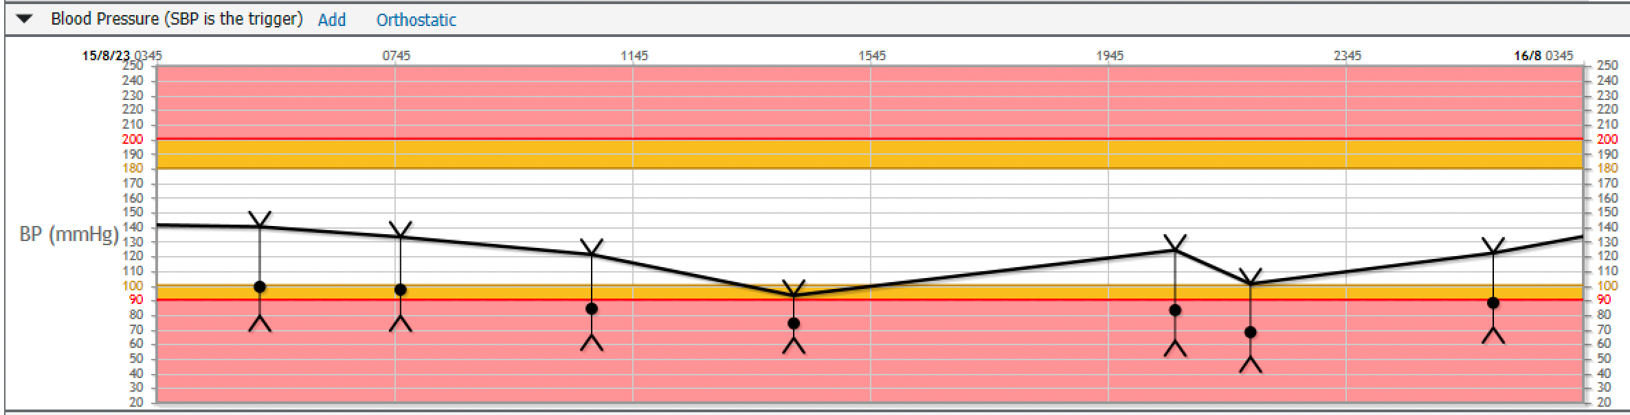
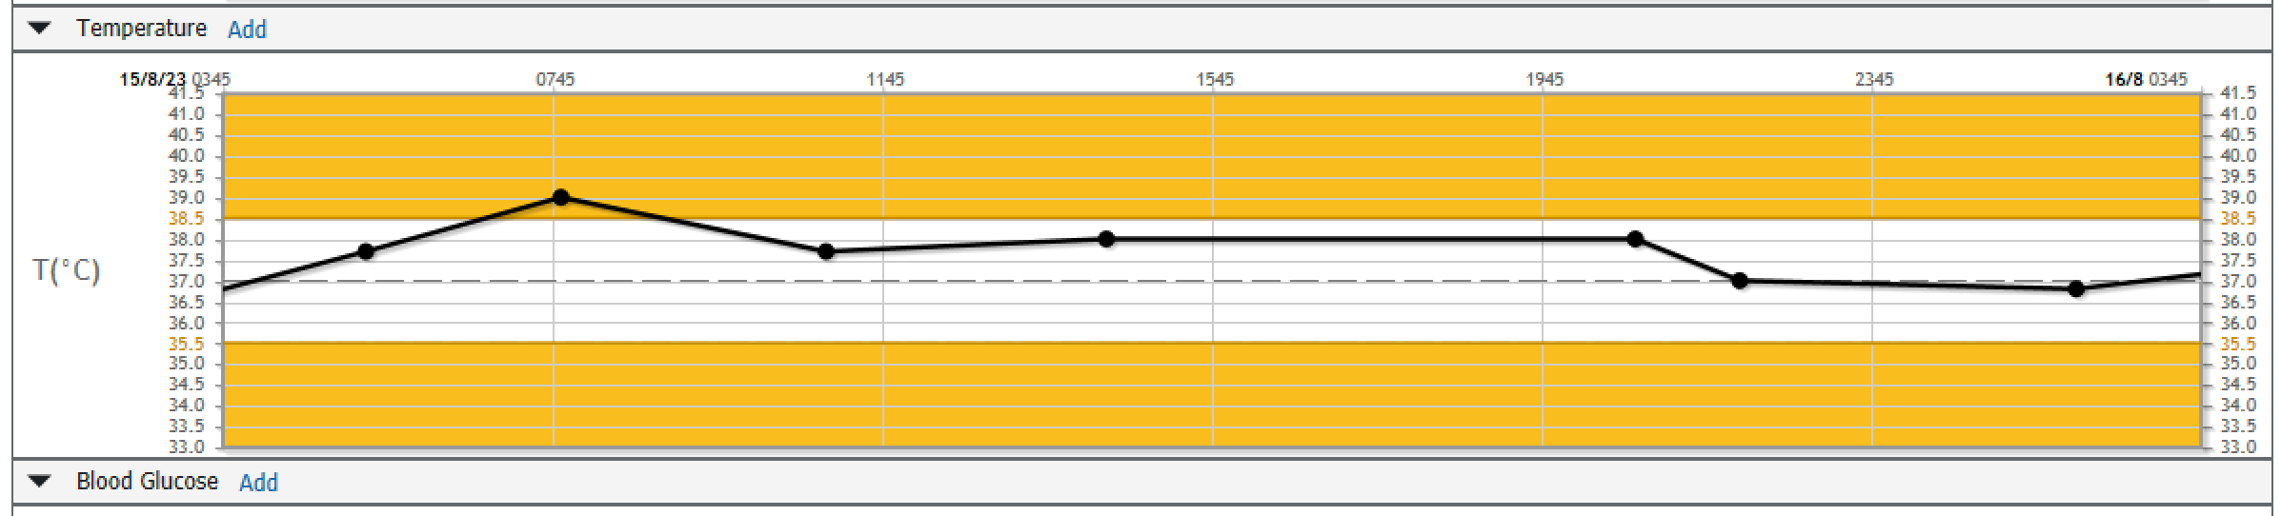
Scroll
up

