Slide 1
Welcome to the Simulated EMR!
How to use this software:
Click using the mouse. If nothing opens, there is no information there
Do NOT use the keyboard
Note only very basic documentation exists
Please check each box →

Slide 2

Welcome to the Simulated EMR!
How to use this software:
Click using the mouse. If nothing opens, there is no information there
Do NOT use the keyboard
Note only very basic documentation exists
Please check each box →

Slide 3
Welcome to the Simulated EMR!
How to use this software:
Click using the mouse. If nothing opens, there is no information there
Do NOT use the keyboard
Note only very basic documentation exists
Please check each box →

Slide 4
Welcome to the Simulated EMR!
How to use this software:
Click using the mouse. If nothing opens, there is no information there
Do NOT use the keyboard
Note only very basic documentation exists
Click to login to EMR

Slide 5
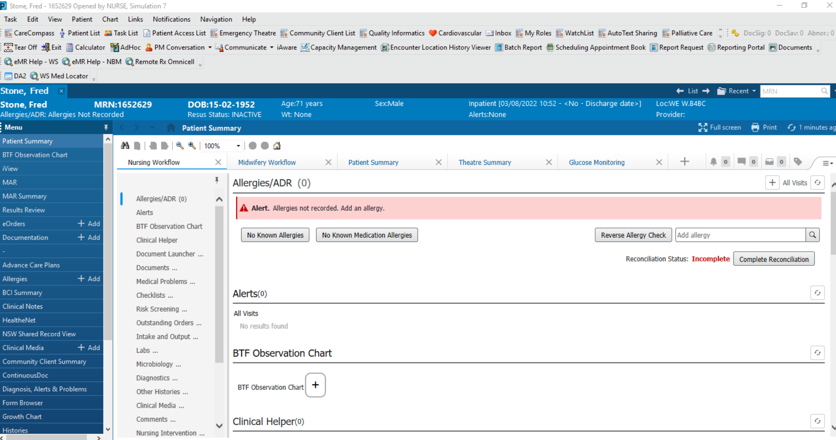

Slide 6
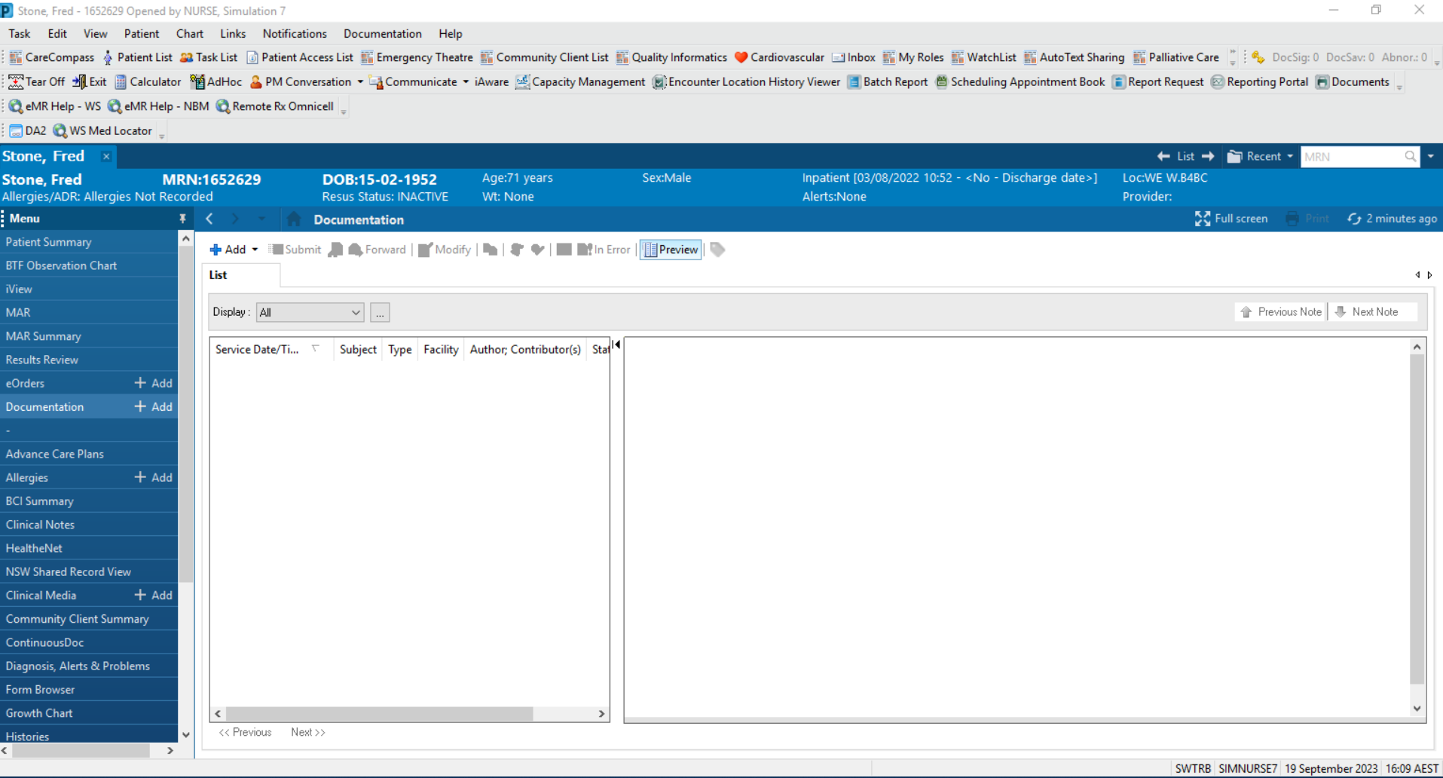
18/9/2023 8:30 ASU Admission Progress Note WESTMEAD HOSP
18/9/2023 8:30 ED Medical Assessment Progress Note WESTMEAD HOSP

Slide 7
ASU Admission
68M with gallstone pancreatitis
Progress
4/10 pain, Improved from previous
PMHx/Meds as per ED note
SHx
From home with wife, iADLs
Ex-smoker, 3-4 standard EtOH per week
O/E
BP 180/100, HR 60, RR 18, SpO2 98%, T 36.8
Alert, looks well
AS – tender in epigastrium, non-peritonitic
Ix
Lipase 10000, bili 20, WCC 6.2
Plan
Admit ASU
Keep NBM
18/9/2023 8:30 ASU Admission Progress Note WESTMEAD HOSP
18/9/2023 8:30 ED Medical Assessment Progress Note WESTMEAD HOSP

Slide 8
ED Medical Assessment
68M with severe abdominal pain
History
10/10 abdominal/epigastric pain
Associated nausea and vomiting
Short history due to pain
O/E
Obs BTF
Alert, in severe pain
Chest clear
HSD - mild systolic murmur 2/6 (mitral), LV heave
JVPNE
Mild pitting oedema
Abdomen: mildly tender RUQ, nil hepatosplenomegaly
Nil jaundice
Ix
CXR NAD
WCC 6.2
LFTs: AST 48, ALT 58, Bilirubin 20
Lipase: 30
Plan
US abdomen
ASU review
18/9/2023 8:30 ASU Admission Progress Note WESTMEAD HOSP
18/9/2023 8:30 ED Medical Assessment Progress Note WESTMEAD HOSP
PMHx
HTN
T2DM
Dyslipidaemia
IHD
Known to Dr Heart
Nil previous stents or CABG
+ stress test 2 years ago
Nil previous surgeries
Meds
Metoprolol 50mg BD
Ramipril 5mg daily
Crestor 10mg daily
Metformin 1g BD

Slide 9
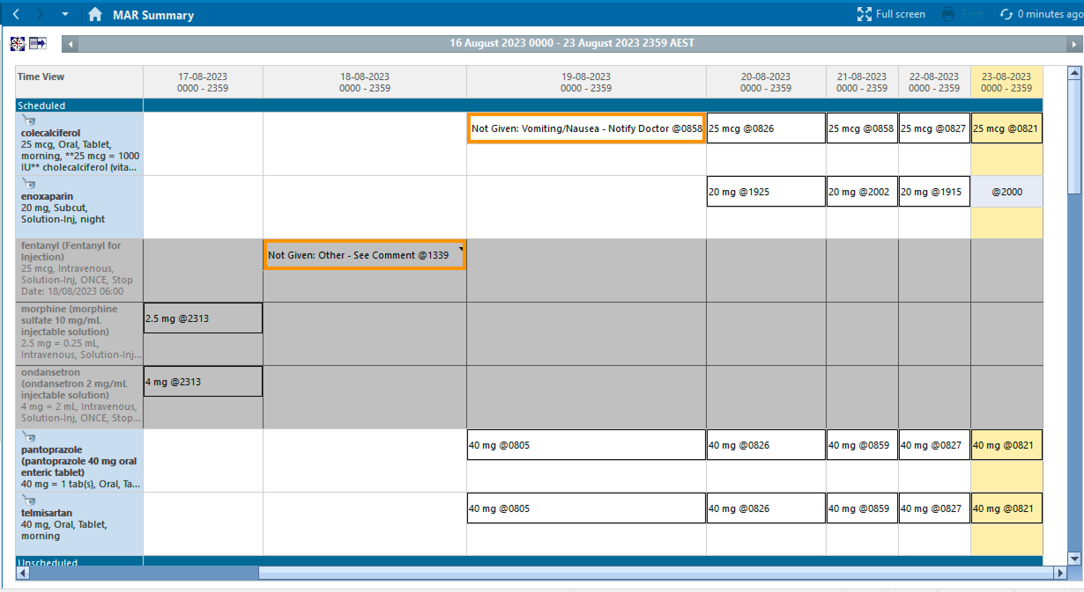
metformin
1g, Oral, BD
1g @ 1031
1g @2002
1g @ 0731
morphine
1mg, IV, ONCE
50mg @ 1031
50mg @2002
50mg @ 0731
metoprolol
50mg, Oral, BD
morphine
2.5mg, IV, q5minly
2.5mg @ 0841
2.5mg @0930
ramipril
5mg, Oral, OD
5mg @ 1031
5mg @ 0731
1g @ 0811
1g @ 1422
1g @ 2202
1g @ 0605
paracetamol
1g, Oral, QID
10mg @2002
rosuvastatin
10mg, Oral, nocte

Slide 10
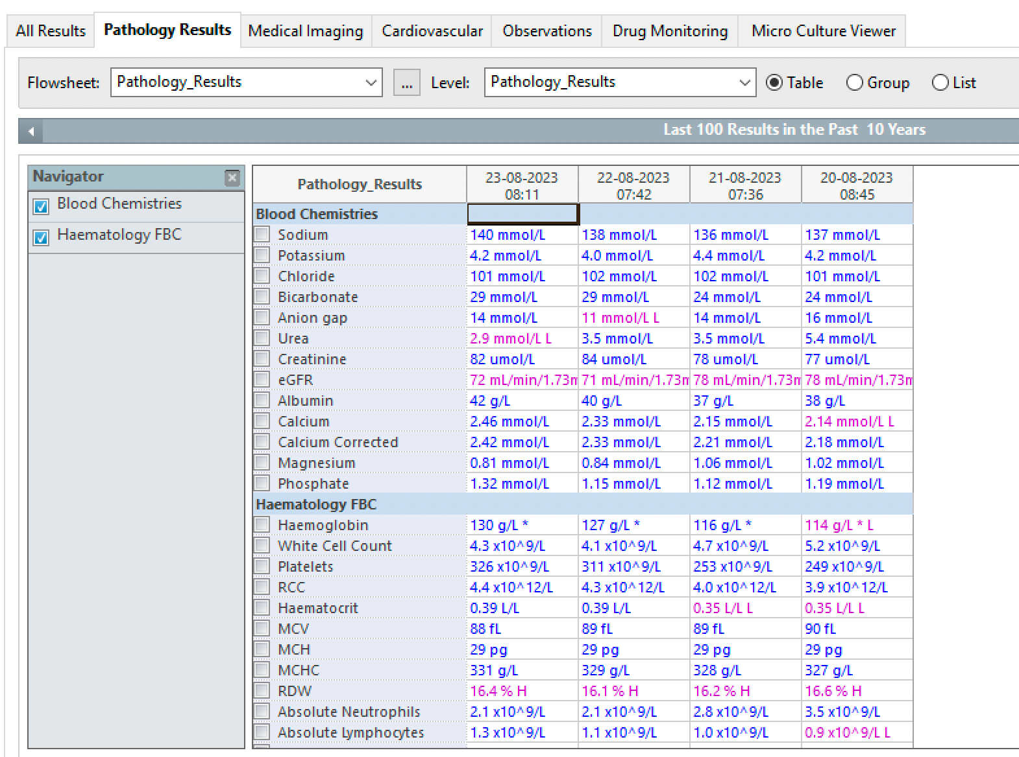
Lipase
10,012 U/L C
15.1 x 10^9/L

Slide 11
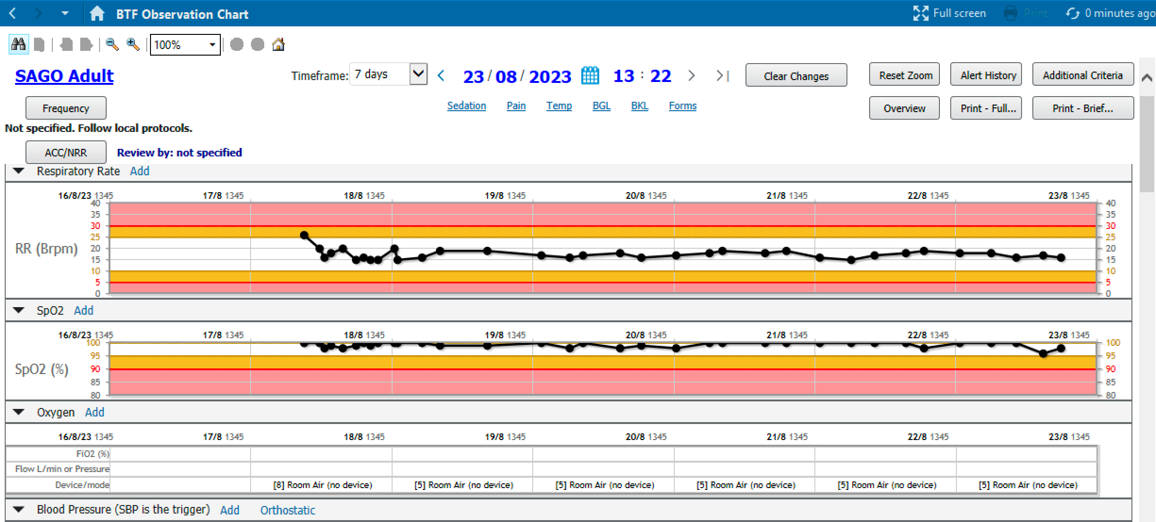
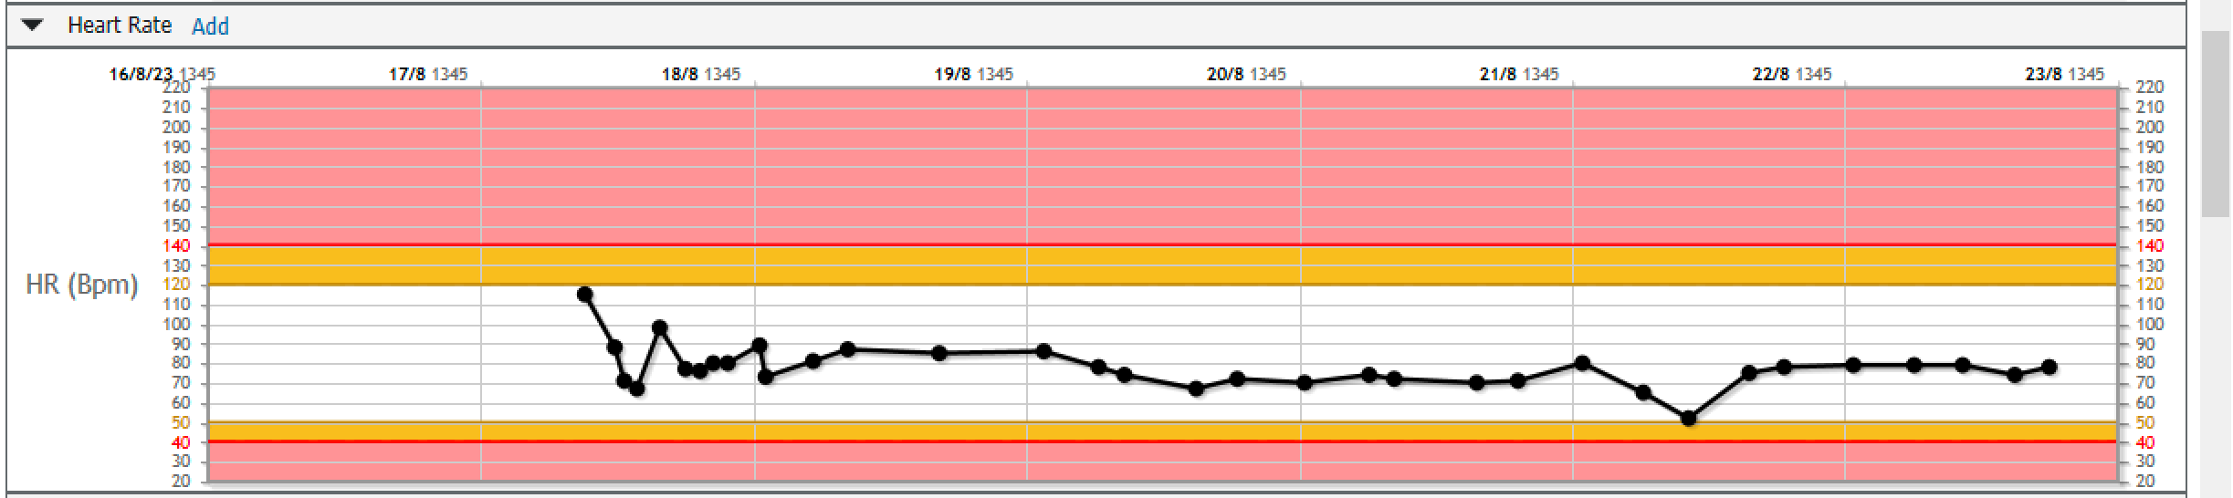
Scroll down

Slide 12
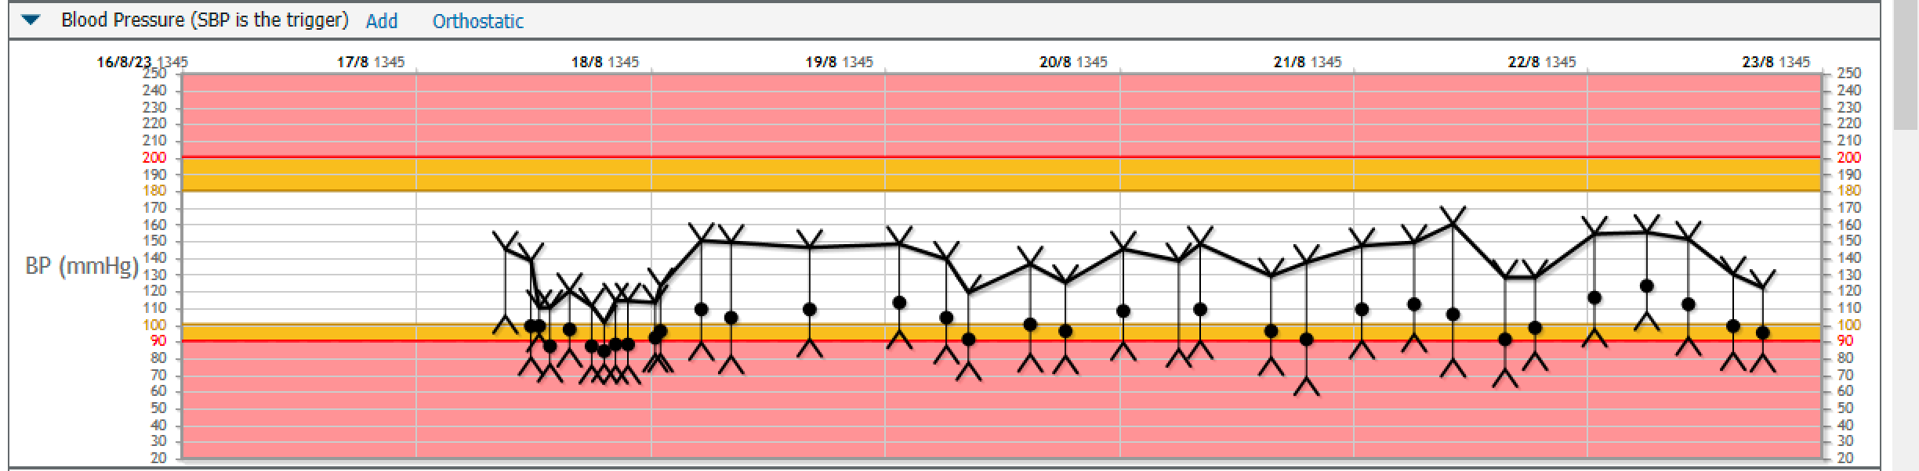
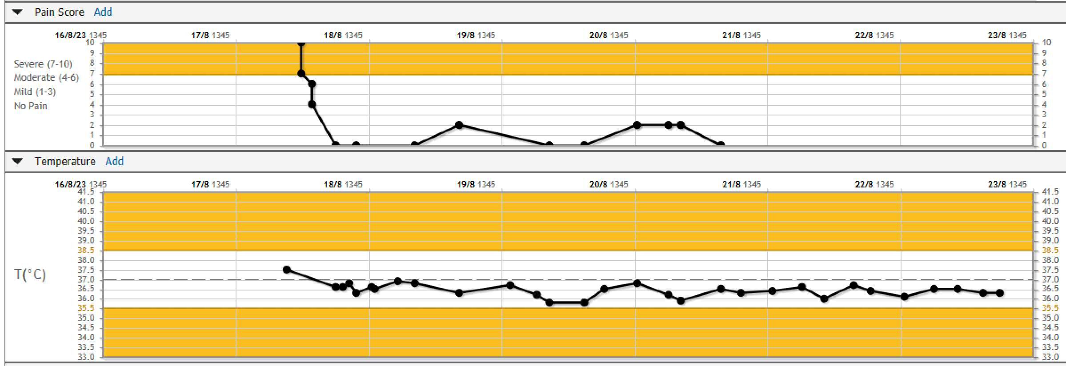
Scroll
up

Slide 13
