Slide 1
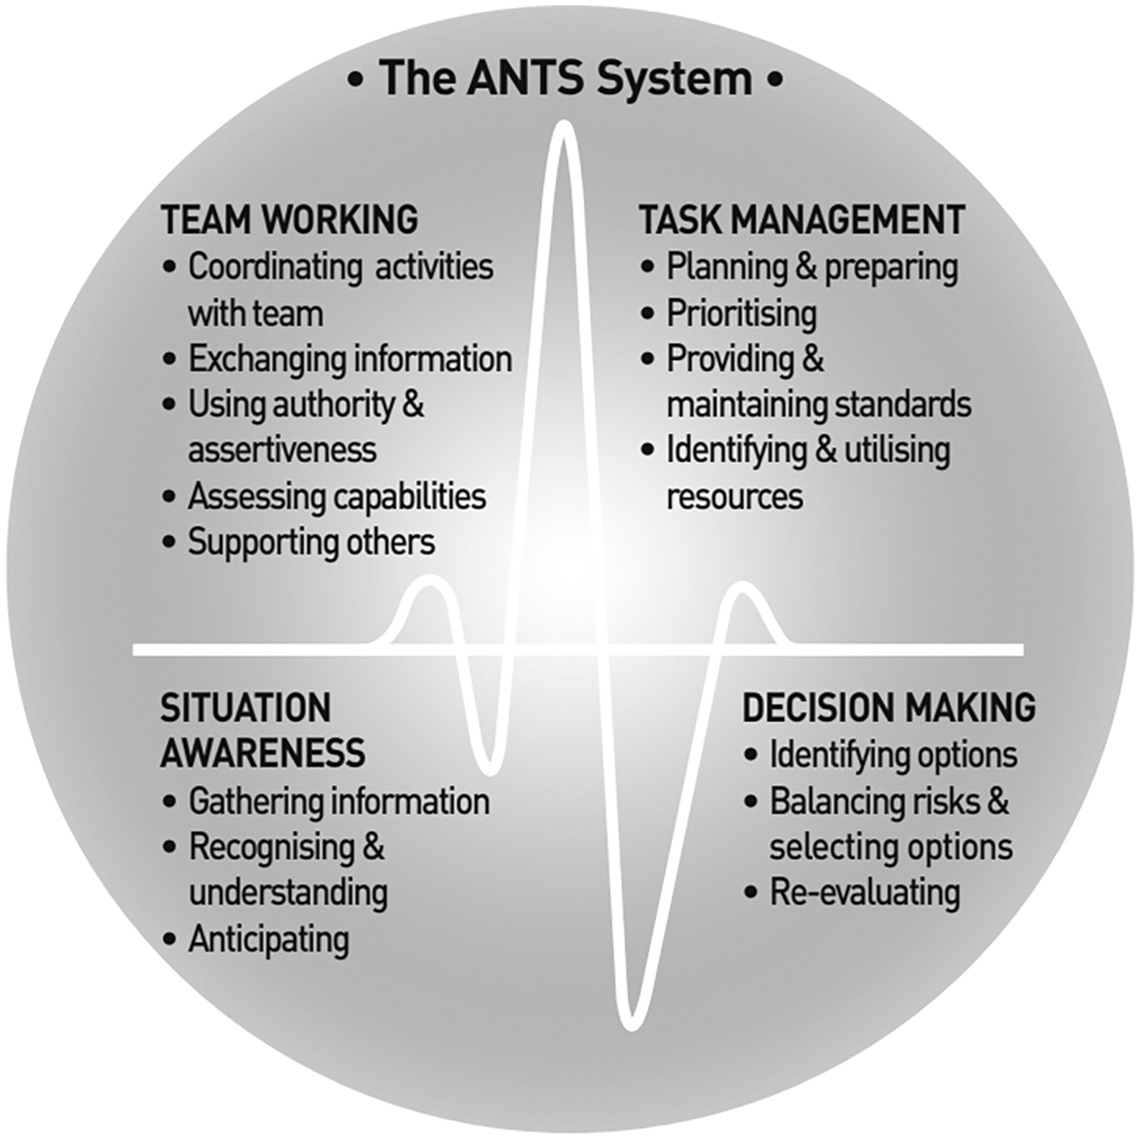
Human factors in anaesthesia: a narrative review
Anaesthesia, Volume: 78, Issue: 4, Pages: 479-490, First published: 11 January 2023, DOI: (10.1111/anae.15920)
Notes:
Anaesthetists Non‐Technical Skills (ANTS) system (reproduced with permission from [71]).
IF THIS IMAGE HAS BEEN PROVIDED BY OR IS OWNED BY A THIRD PARTY, AS INDICATED IN THE CAPTION LINE, THEN FURTHER PERMISSION MAY BE NEEDED BEFORE ANY FURTHER USE. PLEASE CONTACT WILEY'S PERMISSIONS DEPARTMENT ON PERMISSIONS@WILEY.COM OR USE THE RIGHTSLINK SERVICE BY CLICKING ON THE 'REQUEST PERMISSIONS' LINK ACCOMPANYING THIS ARTICLE. WILEY OR AUTHOR OWNED IMAGES MAY BE USED FOR NON-COMMERCIAL PURPOSES, SUBJECT TO PROPER CITATION OF THE ARTICLE, AUTHOR, AND PUBLISHER.

