Slide 1




Immediate debriefer feedback – use of timing data and conversational diagrams
Brief Abstract Presentation - ASC

Slide 2



Slides: www.emergencypedia.com/debrief
A/Prof Andrew Coggins – Westmead, NSW
Notes:
Welcome.
Debrieing has become a relatively common event in medicine, especially in EM
However, teaching how to debrief an event is still not common in either undergrad or post grad environement
Debriefing, is a relatively complex skill. Although like many skills, have a spectrum of complexity, which means it can be done from fairly simple to a very complex level.
Debriefing is not without risks. We will have a little appreciation of that in a little while.
Therefore it is important to have an understanding of some of the basic principles behind the science of debriefing.

Slide 3
Content and Objectives
Background
Existing Assessment Tools
Potential Alternatives
Methods and Results
Discussion and Questions

Slide 4

Debriefing is an essential skill for simulation and clinical educators
Feedback (aimed at improving facilitation) is recognised as important in progressing to mastery.
Various tools, such as the Debriefing Assessment for Simulation in Healthcare (DASH) may help “assess” but they have some limitations
Ref - Cheng A, Grant V, Dieckmann P, Arora S, Robinson T, Eppich W. Faculty Development for Simulation Programs: Five Issues for the Future of Debriefing Training. Simul Healthc. 2015 Aug;10(4):217-22
Notes:
The essential part of the Kolby Cycle is the reflective process after an concrete experience, to scrutinize the paradigms, assumptions, current practices.
Debriefing is the key process in facilitating this Reflective Practice, that is, for the debriefer to help the colleague, student, learner, to understand the inner drive of their actions.
Jenny Ruldoph and her colleagues came up with this 3 components of “reflective practice”
Actions are driven by invisible frames (mental models, frame of reference)
What ever frames we have, are justifiable to ourselves, at least at the time of action.
Therefore, all actions, whether right or wrong, are driven by active frames, that the person perceived to be necessary, or correct, at the time of action.
To an observer, a debriefer, what we can see are the actions, and the results of the learner.
What our job is, to uncover the underlying frames that has driven the learner into their actions.
This brings up the analogy of being a cognitive detective.
As a debriefer, we need to actively uncover frames, look deeper into the actions of the learner. Addressing the frames rather than actions of the learner will lead to much deeper understanding and effective changes of behaviour, rather than addressing the action alone.

Slide 5

What debriefing is…
Multiple Definitions – “guide” “facilitation”
“SIC - A social practice’ during which people interact with each other…reflecting on the common experience they made during a scenario.” – Medical Teacher 2009
Notes:
After you’ve done your research, it’s time to put your presentation together. The first step in the process is to introduce the topic. This is a great time to connect your topic to something that your audience can relate. In other words, why should they listen to all the information you will be sharing in your research presentation? What is in it for them? You may also want to include a graphic or image to grab their attention.
Feel free to duplicate this slide by right-clicking on this slide in the slides pane to the left and select Duplicate Slide.
The next step in your presentation is to state your claim or topic clearly. Your teacher may even call this your thesis. As you state your thesis, you may find that this layout is not the best layout for your claim or topic. You can change the layout by clicking the drop-down menu next to the Layout in the Slides menu section. You can choose Two Content, Comparison, or Picture with Caption. Note: A different layout might change the look of the icons on this page.
You will also want to state your facts. You have done the research now share some of the interesting facts with your audience. Facts do not have to be boring; you can communicate facts in a variety of ways by going to the Insert Tab. In the Insert tab you can:
Insert pictures from your computer or online.
Add a chart
Create some SmartArt
Insert a variety of icons to help your facts come to life. Note: You can change the color of the icons by selecting the icon and then click on the Format tab and then Graphics Fill. From there, you will choose a color from the list or choose More Fill Colors to give you more options.
Since this research presentation is a result of your hard work and searching, you want to make sure you support the claims or points in your presentation with facts from your research findings. Make sure you give the author proper credit for helping you share your ideas. If one of your sources has a video that is relevant to your topic, you can add the video as added support. Keep in mind the length of the video and the amount of time you have for your presentation. For a 5 minute speech, the video should be no longer than 30 seconds.
Questions to consider:
How will you state the author of the source?
Will you need to cite the source on the slide?
What are some ways you can engage your audience so they feel like they are a part of the presentation? Some ideas to consider is by taking a quick poll like: by a show of hands, how many of you think school uniforms are a way to cut down on bullying? Another suggestion is to have them hold up a certain number of fingers to see if they agree or disagree. Finally, you can share a story that the audience can relate to that makes them laugh.
After all the applause, your audience may have some questions. Be prepared to answer some of their questions by making a list of questions you think they might ask. You may also want to share the presentation with them by providing the link to your presentation, if they want more information.

Slide 6



Slide 7

What debriefing is not intended to be…
Notes:
After you’ve done your research, it’s time to put your presentation together. The first step in the process is to introduce the topic. This is a great time to connect your topic to something that your audience can relate. In other words, why should they listen to all the information you will be sharing in your research presentation? What is in it for them? You may also want to include a graphic or image to grab their attention.
Feel free to duplicate this slide by right-clicking on this slide in the slides pane to the left and select Duplicate Slide.
The next step in your presentation is to state your claim or topic clearly. Your teacher may even call this your thesis. As you state your thesis, you may find that this layout is not the best layout for your claim or topic. You can change the layout by clicking the drop-down menu next to the Layout in the Slides menu section. You can choose Two Content, Comparison, or Picture with Caption. Note: A different layout might change the look of the icons on this page.
You will also want to state your facts. You have done the research now share some of the interesting facts with your audience. Facts do not have to be boring; you can communicate facts in a variety of ways by going to the Insert Tab. In the Insert tab you can:
Insert pictures from your computer or online.
Add a chart
Create some SmartArt
Insert a variety of icons to help your facts come to life. Note: You can change the color of the icons by selecting the icon and then click on the Format tab and then Graphics Fill. From there, you will choose a color from the list or choose More Fill Colors to give you more options.
Since this research presentation is a result of your hard work and searching, you want to make sure you support the claims or points in your presentation with facts from your research findings. Make sure you give the author proper credit for helping you share your ideas. If one of your sources has a video that is relevant to your topic, you can add the video as added support. Keep in mind the length of the video and the amount of time you have for your presentation. For a 5 minute speech, the video should be no longer than 30 seconds.
Questions to consider:
How will you state the author of the source?
Will you need to cite the source on the slide?
What are some ways you can engage your audience so they feel like they are a part of the presentation? Some ideas to consider is by taking a quick poll like: by a show of hands, how many of you think school uniforms are a way to cut down on bullying? Another suggestion is to have them hold up a certain number of fingers to see if they agree or disagree. Finally, you can share a story that the audience can relate to that makes them laugh.
After all the applause, your audience may have some questions. Be prepared to answer some of their questions by making a list of questions you think they might ask. You may also want to share the presentation with them by providing the link to your presentation, if they want more information.

Slide 8
Examples of Existing assessment “tools” available
- DASH (1), SHORT (2), OSAD (3)
References -
Brett-Fleegler M, Rudolph J, Eppich W, Monuteaux M, Fleegler E, Cheng A, et al. Debriefing assessment for simulation in healthcare (DASH): development and psychometric proper-ties. Simul Healthc. 2012;7(5):288–94.
Rivière E, Aubin E, Tremblay SL, Lortie G, Chiniara G. A new tool for assessing short debriefings after immersive simulation: validity of the SHORT scale. BMC Med Educ. 2019 Mar 12;19(1):82.
Arora S, Ahmed M, Paige J, Nestel D, Runnacles J, Hull L, Darzi A, Sevdalis N. Objective structured assessment of debriefing: bringing science to the art of debriefing in surgery. Ann Surg. 2012 Dec;256(6):982-8.
Notes:
After you’ve done your research, it’s time to put your presentation together. The first step in the process is to introduce the topic. This is a great time to connect your topic to something that your audience can relate. In other words, why should they listen to all the information you will be sharing in your research presentation? What is in it for them? You may also want to include a graphic or image to grab their attention.
Feel free to duplicate this slide by right-clicking on this slide in the slides pane to the left and select Duplicate Slide.
The next step in your presentation is to state your claim or topic clearly. Your teacher may even call this your thesis. As you state your thesis, you may find that this layout is not the best layout for your claim or topic. You can change the layout by clicking the drop-down menu next to the Layout in the Slides menu section. You can choose Two Content, Comparison, or Picture with Caption. Note: A different layout might change the look of the icons on this page.
You will also want to state your facts. You have done the research now share some of the interesting facts with your audience. Facts do not have to be boring; you can communicate facts in a variety of ways by going to the Insert Tab. In the Insert tab you can:
Insert pictures from your computer or online.
Add a chart
Create some SmartArt
Insert a variety of icons to help your facts come to life. Note: You can change the color of the icons by selecting the icon and then click on the Format tab and then Graphics Fill. From there, you will choose a color from the list or choose More Fill Colors to give you more options.
Since this research presentation is a result of your hard work and searching, you want to make sure you support the claims or points in your presentation with facts from your research findings. Make sure you give the author proper credit for helping you share your ideas. If one of your sources has a video that is relevant to your topic, you can add the video as added support. Keep in mind the length of the video and the amount of time you have for your presentation. For a 5 minute speech, the video should be no longer than 30 seconds.
Questions to consider:
How will you state the author of the source?
Will you need to cite the source on the slide?
What are some ways you can engage your audience so they feel like they are a part of the presentation? Some ideas to consider is by taking a quick poll like: by a show of hands, how many of you think school uniforms are a way to cut down on bullying? Another suggestion is to have them hold up a certain number of fingers to see if they agree or disagree. Finally, you can share a story that the audience can relate to that makes them laugh.
After all the applause, your audience may have some questions. Be prepared to answer some of their questions by making a list of questions you think they might ask. You may also want to share the presentation with them by providing the link to your presentation, if they want more information.

Slide 9
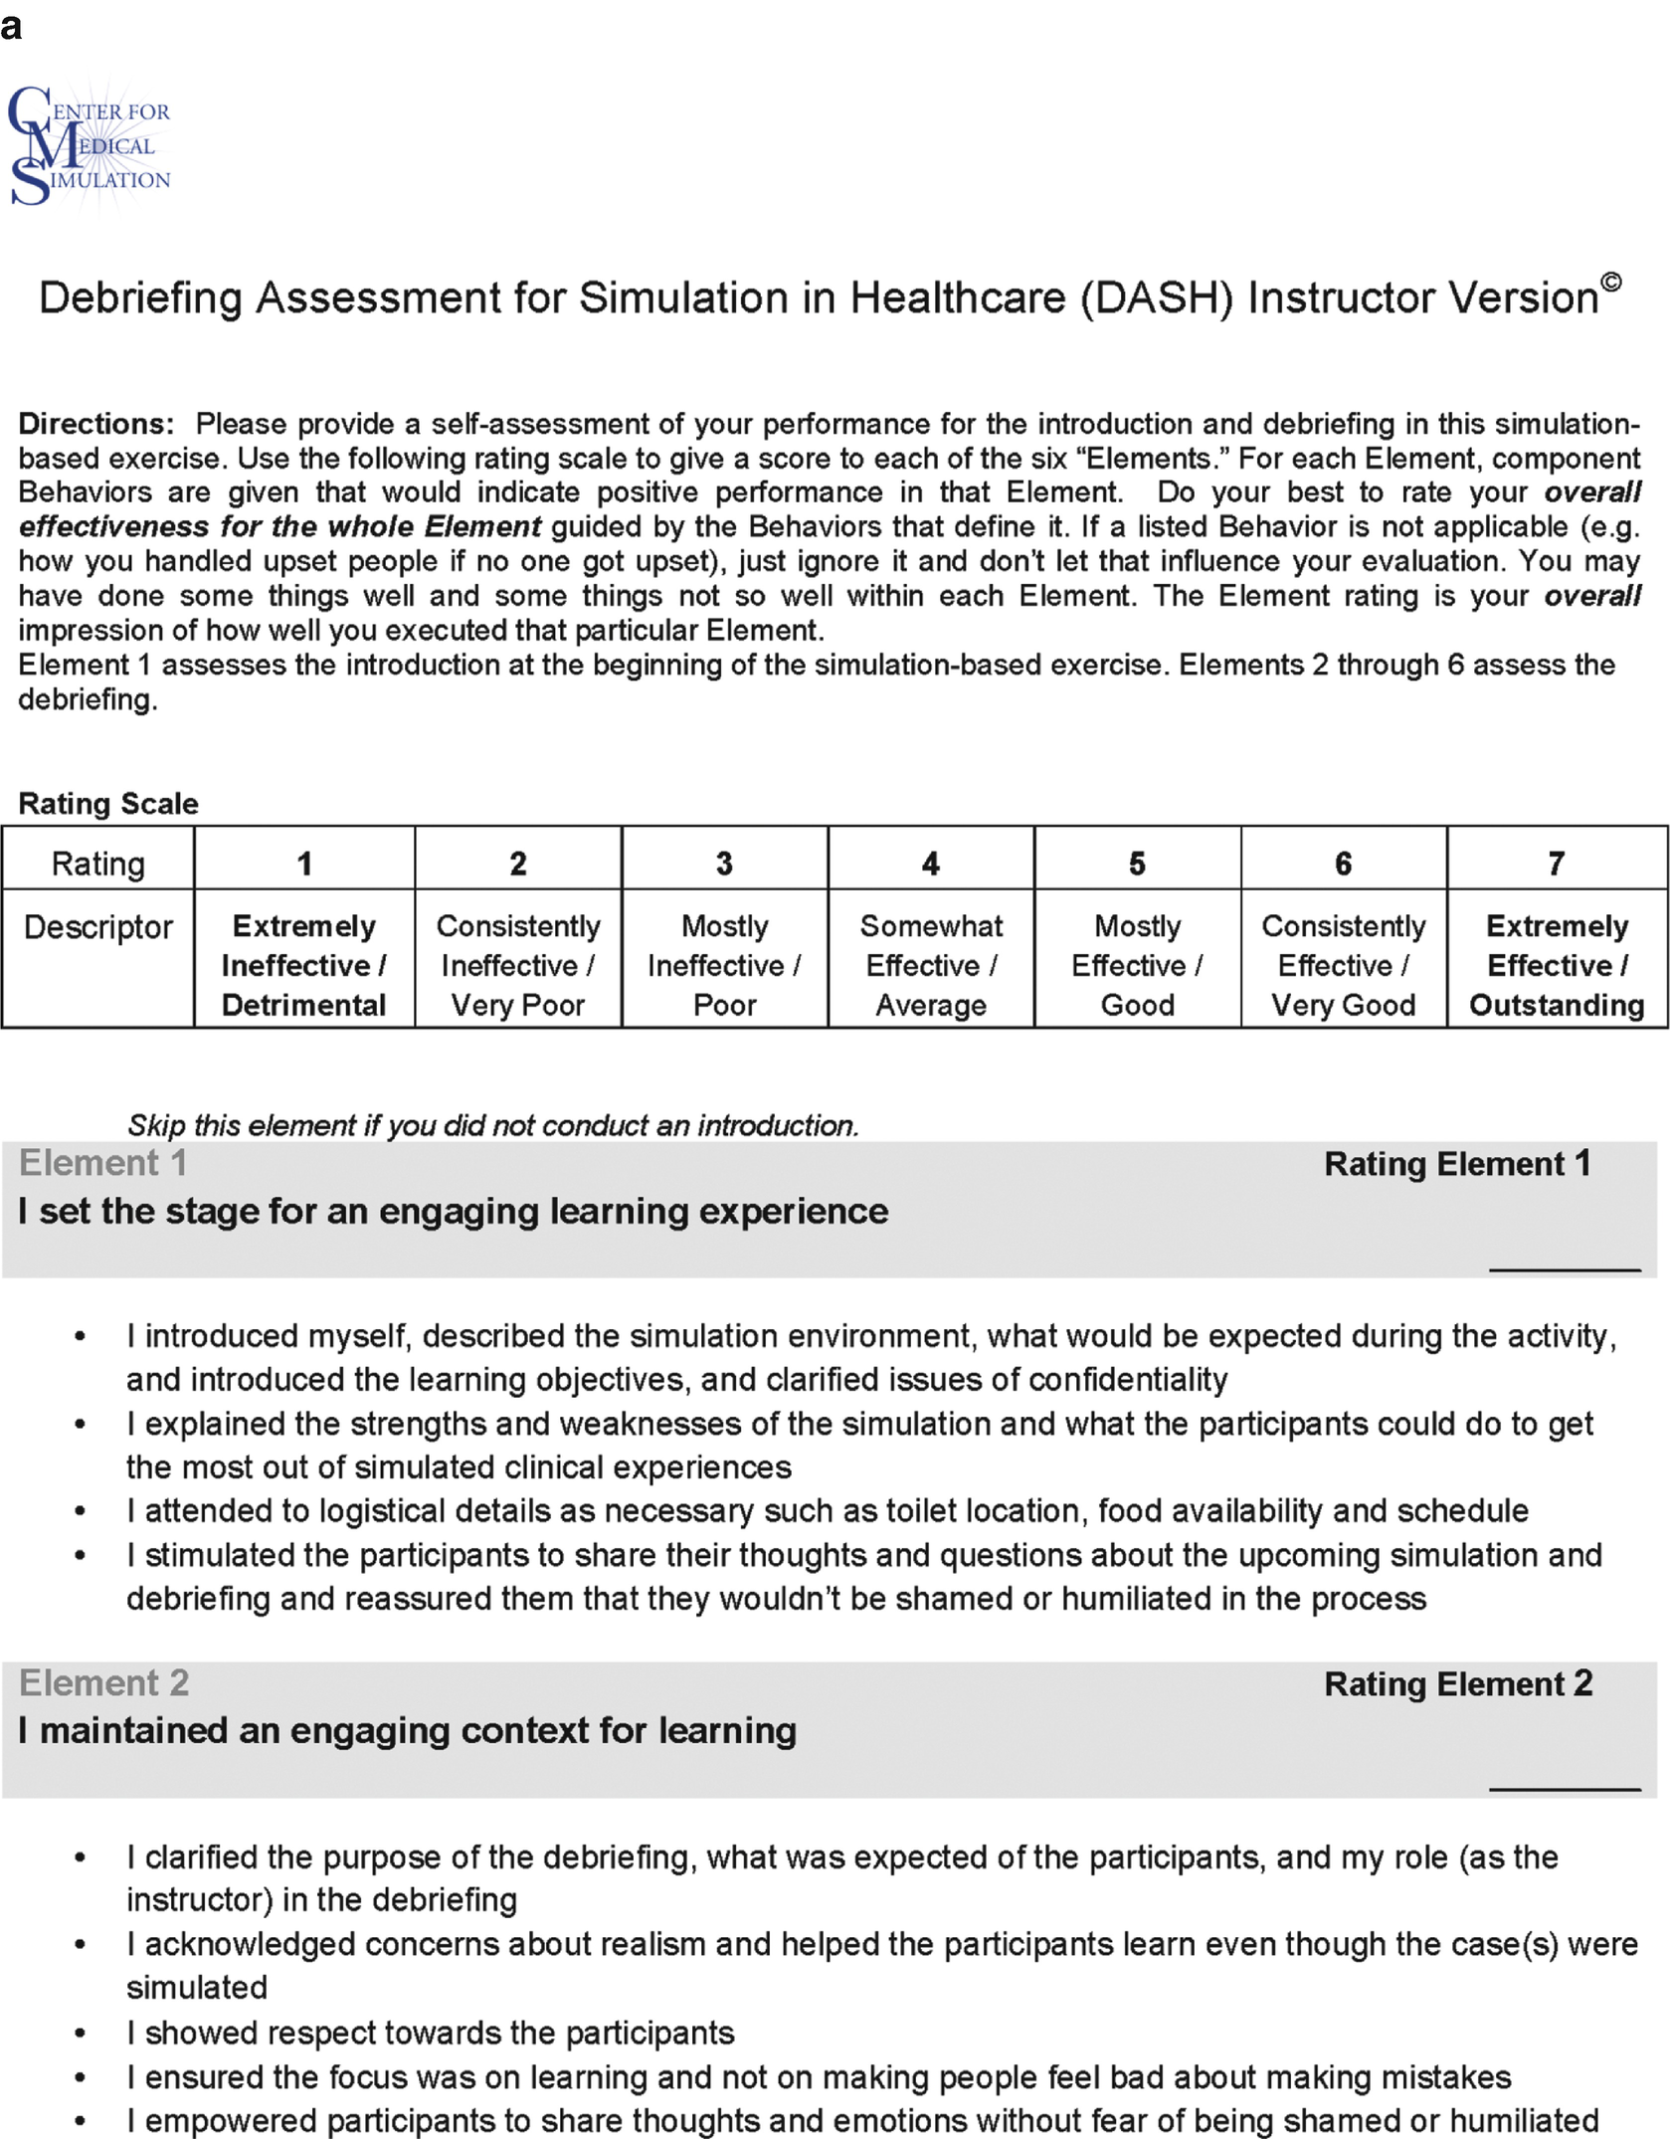
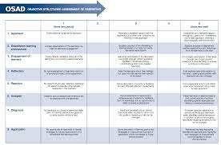

Slide 10
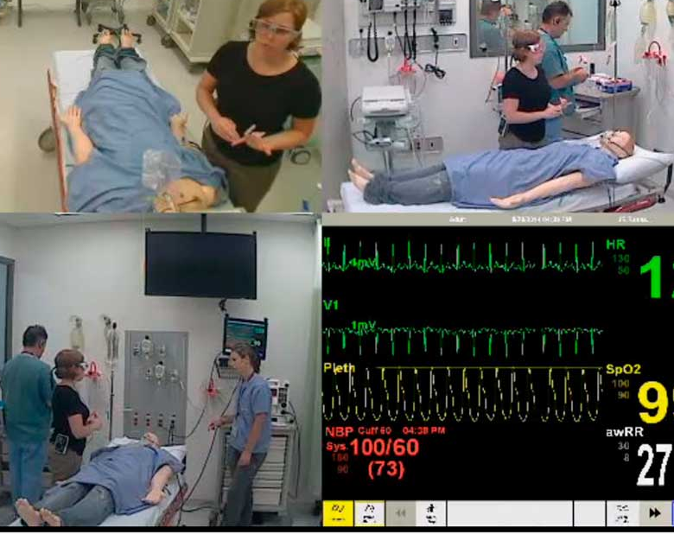
DASH, OSAD, SHORT
Clearly Useful….
BUT
Limitations are significant
  Scoring (‘tick tick tick’)
  What does a “5” mean to a learner?
  How can you improve based on a score?
  Limited validation?
Notes:
After you’ve done your research, it’s time to put your presentation together. The first step in the process is to introduce the topic. This is a great time to connect your topic to something that your audience can relate. In other words, why should they listen to all the information you will be sharing in your research presentation? What is in it for them? You may also want to include a graphic or image to grab their attention.
Feel free to duplicate this slide by right-clicking on this slide in the slides pane to the left and select Duplicate Slide.
The next step in your presentation is to state your claim or topic clearly. Your teacher may even call this your thesis. As you state your thesis, you may find that this layout is not the best layout for your claim or topic. You can change the layout by clicking the drop-down menu next to the Layout in the Slides menu section. You can choose Two Content, Comparison, or Picture with Caption. Note: A different layout might change the look of the icons on this page.
You will also want to state your facts. You have done the research now share some of the interesting facts with your audience. Facts do not have to be boring; you can communicate facts in a variety of ways by going to the Insert Tab. In the Insert tab you can:
Insert pictures from your computer or online.
Add a chart
Create some SmartArt
Insert a variety of icons to help your facts come to life. Note: You can change the color of the icons by selecting the icon and then click on the Format tab and then Graphics Fill. From there, you will choose a color from the list or choose More Fill Colors to give you more options.
Since this research presentation is a result of your hard work and searching, you want to make sure you support the claims or points in your presentation with facts from your research findings. Make sure you give the author proper credit for helping you share your ideas. If one of your sources has a video that is relevant to your topic, you can add the video as added support. Keep in mind the length of the video and the amount of time you have for your presentation. For a 5 minute speech, the video should be no longer than 30 seconds.
Questions to consider:
How will you state the author of the source?
Will you need to cite the source on the slide?
What are some ways you can engage your audience so they feel like they are a part of the presentation? Some ideas to consider is by taking a quick poll like: by a show of hands, how many of you think school uniforms are a way to cut down on bullying? Another suggestion is to have them hold up a certain number of fingers to see if they agree or disagree. Finally, you can share a story that the audience can relate to that makes them laugh.
After all the applause, your audience may have some questions. Be prepared to answer some of their questions by making a list of questions you think they might ask. You may also want to share the presentation with them by providing the link to your presentation, if they want more information.

Slide 11

Are there alternatives?
Notes:
After you’ve done your research, it’s time to put your presentation together. The first step in the process is to introduce the topic. This is a great time to connect your topic to something that your audience can relate. In other words, why should they listen to all the information you will be sharing in your research presentation? What is in it for them? You may also want to include a graphic or image to grab their attention.
Feel free to duplicate this slide by right-clicking on this slide in the slides pane to the left and select Duplicate Slide.
The next step in your presentation is to state your claim or topic clearly. Your teacher may even call this your thesis. As you state your thesis, you may find that this layout is not the best layout for your claim or topic. You can change the layout by clicking the drop-down menu next to the Layout in the Slides menu section. You can choose Two Content, Comparison, or Picture with Caption. Note: A different layout might change the look of the icons on this page.
You will also want to state your facts. You have done the research now share some of the interesting facts with your audience. Facts do not have to be boring; you can communicate facts in a variety of ways by going to the Insert Tab. In the Insert tab you can:
Insert pictures from your computer or online.
Add a chart
Create some SmartArt
Insert a variety of icons to help your facts come to life. Note: You can change the color of the icons by selecting the icon and then click on the Format tab and then Graphics Fill. From there, you will choose a color from the list or choose More Fill Colors to give you more options.
Since this research presentation is a result of your hard work and searching, you want to make sure you support the claims or points in your presentation with facts from your research findings. Make sure you give the author proper credit for helping you share your ideas. If one of your sources has a video that is relevant to your topic, you can add the video as added support. Keep in mind the length of the video and the amount of time you have for your presentation. For a 5 minute speech, the video should be no longer than 30 seconds.
Questions to consider:
How will you state the author of the source?
Will you need to cite the source on the slide?
What are some ways you can engage your audience so they feel like they are a part of the presentation? Some ideas to consider is by taking a quick poll like: by a show of hands, how many of you think school uniforms are a way to cut down on bullying? Another suggestion is to have them hold up a certain number of fingers to see if they agree or disagree. Finally, you can share a story that the audience can relate to that makes them laugh.
After all the applause, your audience may have some questions. Be prepared to answer some of their questions by making a list of questions you think they might ask. You may also want to share the presentation with them by providing the link to your presentation, if they want more information.

Slide 12
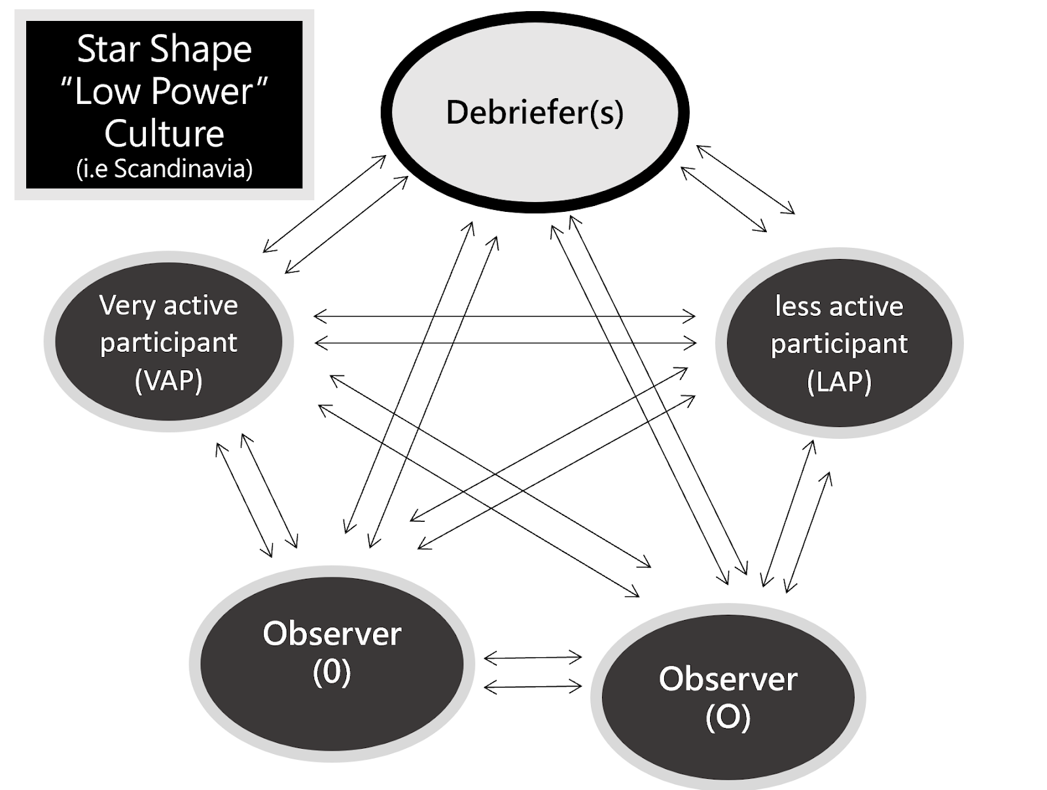
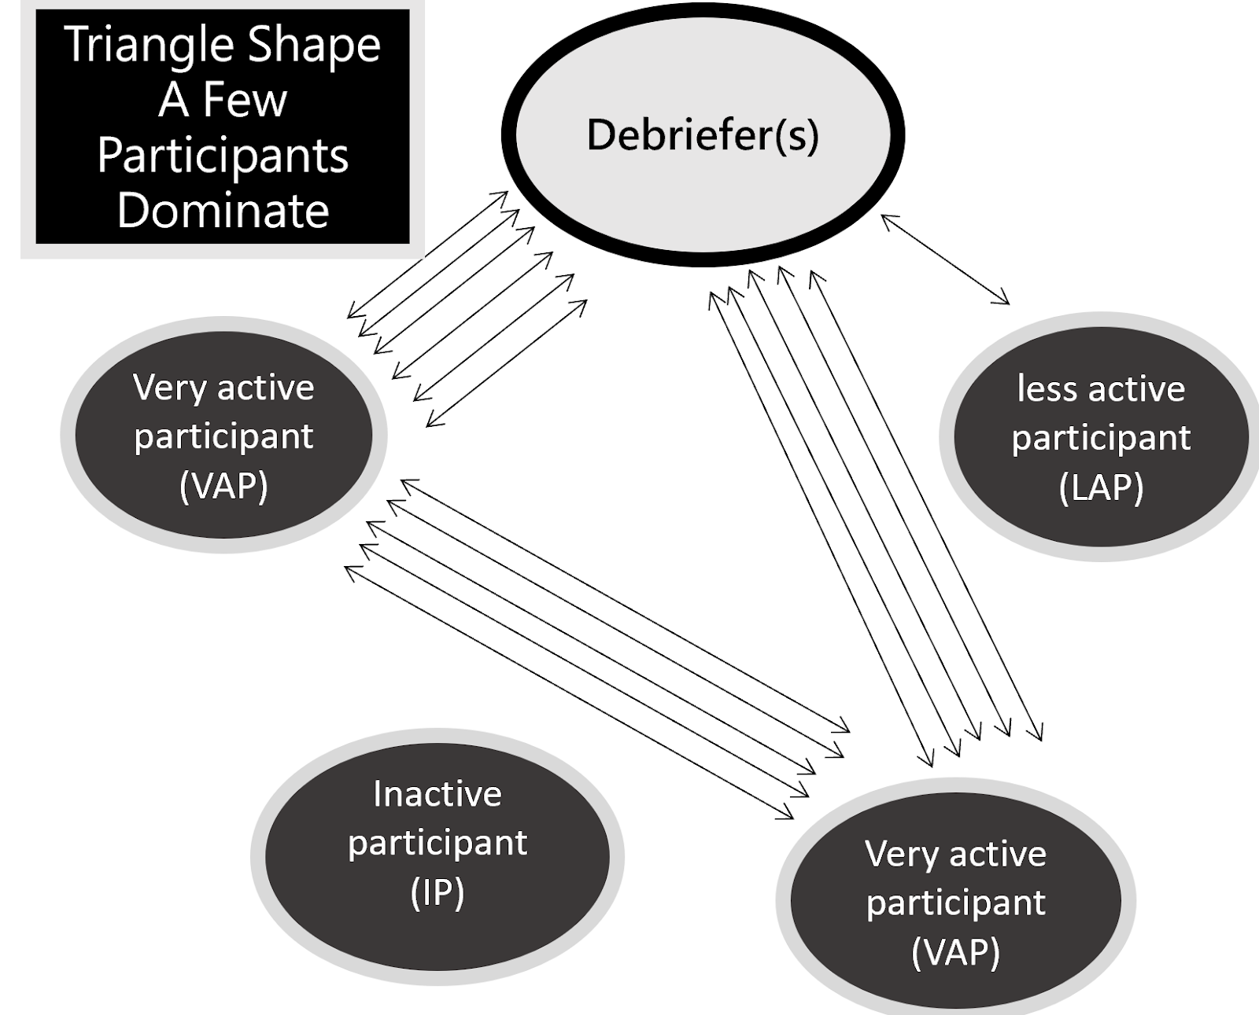
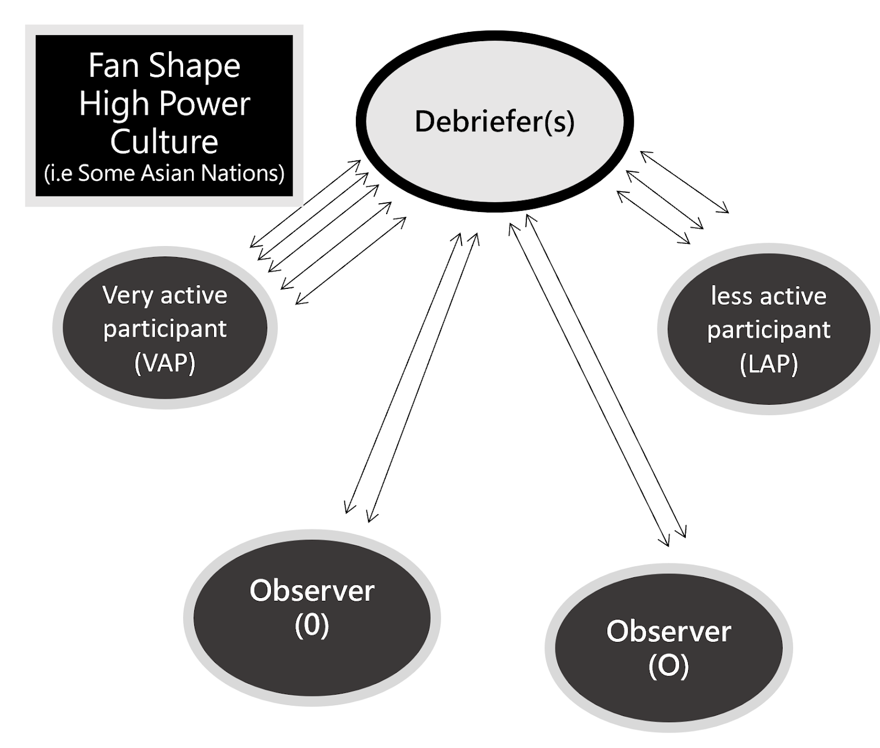
Interaction Pattern 2 - Fan Shape
(debriefer led or “High Power” culture)
Interaction Pattern 1 - Star Shape
(inclusive or “Low Power” culture)
Interaction Pattern 3 - Triangle Shape
(only a few people talk in the debrief)
Refs –
Dieckmann P, Molin Friis S, Lippert A, Ostergaard D. The art and science of debriefing in simulation: Ideal and practice. Med Teach. 2009 Jul;31(7):e287-94.
Ulmer FF, Sharara-Chami R, Lakissian Z, Stocker M, Scott E, Dieckmann P. Cultural Prototypes and Differences in Simulation Debriefing. Simul Healthc. 2018 Aug;13(4):239-246.
Notes:
After you’ve done your research, it’s time to put your presentation together. The first step in the process is to introduce the topic. This is a great time to connect your topic to something that your audience can relate. In other words, why should they listen to all the information you will be sharing in your research presentation? What is in it for them? You may also want to include a graphic or image to grab their attention.
Feel free to duplicate this slide by right-clicking on this slide in the slides pane to the left and select Duplicate Slide.
The next step in your presentation is to state your claim or topic clearly. Your teacher may even call this your thesis. As you state your thesis, you may find that this layout is not the best layout for your claim or topic. You can change the layout by clicking the drop-down menu next to the Layout in the Slides menu section. You can choose Two Content, Comparison, or Picture with Caption. Note: A different layout might change the look of the icons on this page.
You will also want to state your facts. You have done the research now share some of the interesting facts with your audience. Facts do not have to be boring; you can communicate facts in a variety of ways by going to the Insert Tab. In the Insert tab you can:
Insert pictures from your computer or online.
Add a chart
Create some SmartArt
Insert a variety of icons to help your facts come to life. Note: You can change the color of the icons by selecting the icon and then click on the Format tab and then Graphics Fill. From there, you will choose a color from the list or choose More Fill Colors to give you more options.
Since this research presentation is a result of your hard work and searching, you want to make sure you support the claims or points in your presentation with facts from your research findings. Make sure you give the author proper credit for helping you share your ideas. If one of your sources has a video that is relevant to your topic, you can add the video as added support. Keep in mind the length of the video and the amount of time you have for your presentation. For a 5 minute speech, the video should be no longer than 30 seconds.
Questions to consider:
How will you state the author of the source?
Will you need to cite the source on the slide?
What are some ways you can engage your audience so they feel like they are a part of the presentation? Some ideas to consider is by taking a quick poll like: by a show of hands, how many of you think school uniforms are a way to cut down on bullying? Another suggestion is to have them hold up a certain number of fingers to see if they agree or disagree. Finally, you can share a story that the audience can relate to that makes them laugh.
After all the applause, your audience may have some questions. Be prepared to answer some of their questions by making a list of questions you think they might ask. You may also want to share the presentation with them by providing the link to your presentation, if they want more information.

Slide 13
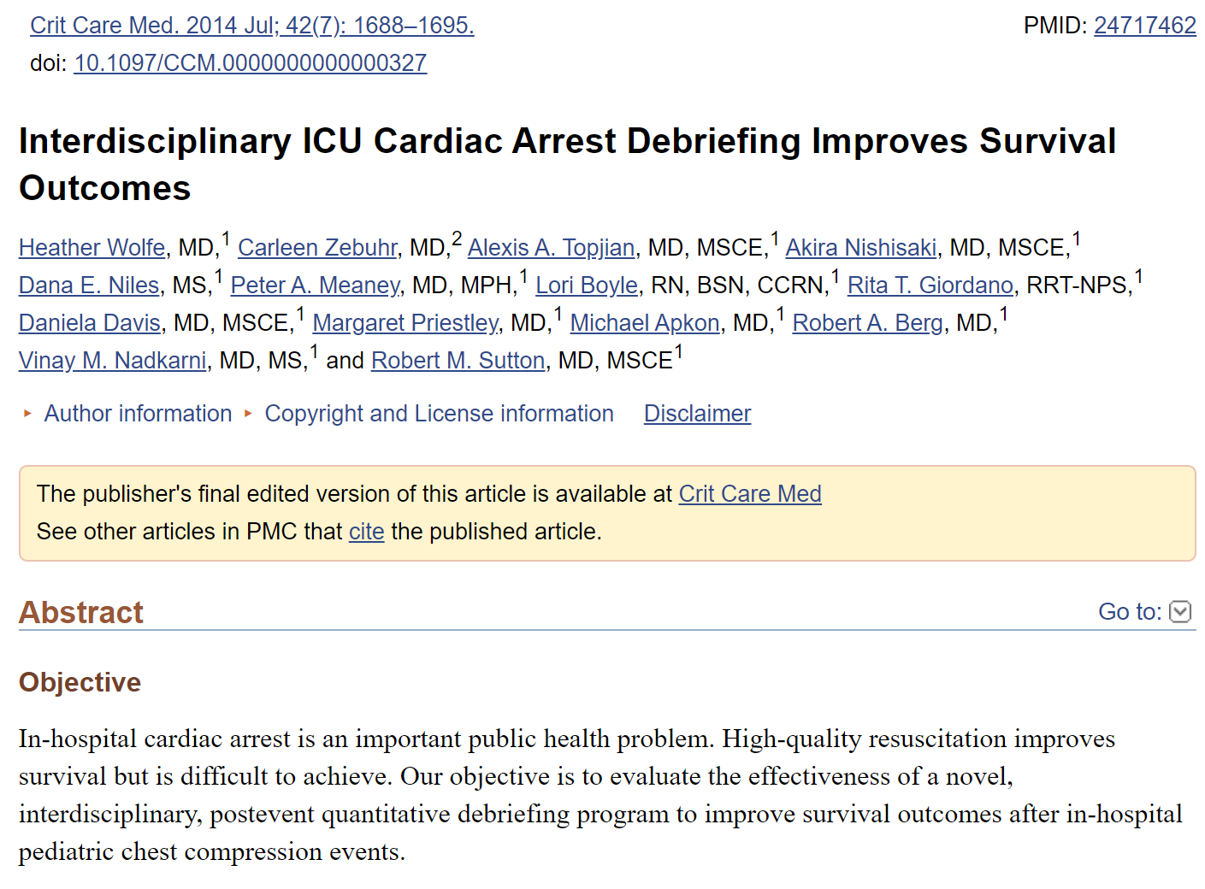

Slide 14
Implementation of an interdisciplinary, post event quantitative debriefing program was significantly associated with improved cardiopulmonary resuscitation quality and survival with favourable neurologic outcome

Slide 15


Study Background
Using quantitative data as a feedback tool has been shown to improve performance of learners (1)
“Quantitative” data feedback tools are not widely studied for debriefer feedback of faculty Development.
Ref - Wolfe H, Zebuhr C, Topjian AA, Nishisaki A, Niles DE, Meaney PA, Boyle L, Giordano RT, Davis D, Priestley M, Apkon M, Berg RA, Nadkarni VM, Sutton RM. Interdisciplinary ICU cardiac arrest debriefing improves survival outcomes*. Crit Care Med. 2014 Jul;42(7):1688-95.

Slide 16
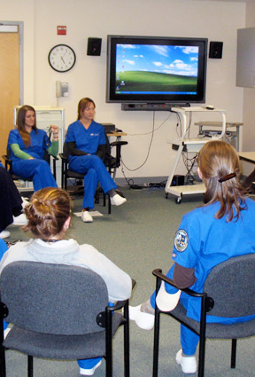
Methods
Small observational study (2019)
Multi-centre sample of interdisciplinary debriefings were observed
Convenience sample (cut by COVID-19)
Notes:
After you’ve done your research, it’s time to put your presentation together. The first step in the process is to introduce the topic. This is a great time to connect your topic to something that your audience can relate. In other words, why should they listen to all the information you will be sharing in your research presentation? What is in it for them? You may also want to include a graphic or image to grab their attention.
Feel free to duplicate this slide by right-clicking on this slide in the slides pane to the left and select Duplicate Slide.
The next step in your presentation is to state your claim or topic clearly. Your teacher may even call this your thesis. As you state your thesis, you may find that this layout is not the best layout for your claim or topic. You can change the layout by clicking the drop-down menu next to the Layout in the Slides menu section. You can choose Two Content, Comparison, or Picture with Caption. Note: A different layout might change the look of the icons on this page.
You will also want to state your facts. You have done the research now share some of the interesting facts with your audience. Facts do not have to be boring; you can communicate facts in a variety of ways by going to the Insert Tab. In the Insert tab you can:
Insert pictures from your computer or online.
Add a chart
Create some SmartArt
Insert a variety of icons to help your facts come to life. Note: You can change the color of the icons by selecting the icon and then click on the Format tab and then Graphics Fill. From there, you will choose a color from the list or choose More Fill Colors to give you more options.
Since this research presentation is a result of your hard work and searching, you want to make sure you support the claims or points in your presentation with facts from your research findings. Make sure you give the author proper credit for helping you share your ideas. If one of your sources has a video that is relevant to your topic, you can add the video as added support. Keep in mind the length of the video and the amount of time you have for your presentation. For a 5 minute speech, the video should be no longer than 30 seconds.
Questions to consider:
How will you state the author of the source?
Will you need to cite the source on the slide?
What are some ways you can engage your audience so they feel like they are a part of the presentation? Some ideas to consider is by taking a quick poll like: by a show of hands, how many of you think school uniforms are a way to cut down on bullying? Another suggestion is to have them hold up a certain number of fingers to see if they agree or disagree. Finally, you can share a story that the audience can relate to that makes them laugh.
After all the applause, your audience may have some questions. Be prepared to answer some of their questions by making a list of questions you think they might ask. You may also want to share the presentation with them by providing the link to your presentation, if they want more information.

Slide 17
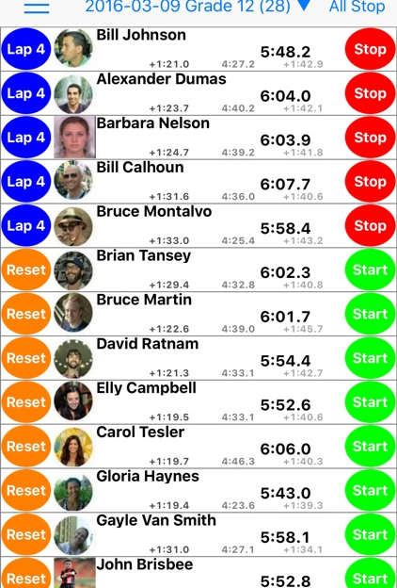
Methods…
We recorded the times (APP) and length of individual study subject contributions and demographics.
Real time, direct observation (2 faculty)
DASH scores from all study subjects and faculty were collated.
Pine-Tree Watches™

Slide 18
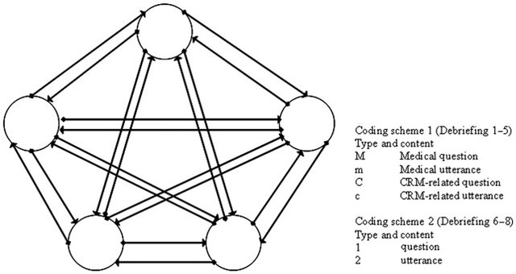

Methods
Conversational diagrams were drawn using an approach described by Dieckmann et al.
For each debriefing, data forms were used as a discussion focus for immediate debriefer feedback.
Likert ratings of each debriefer’s view of the relative ‘usefulness’ of data-driven feedback were recorded.
Notes:
After you’ve done your research, it’s time to put your presentation together. The first step in the process is to introduce the topic. This is a great time to connect your topic to something that your audience can relate. In other words, why should they listen to all the information you will be sharing in your research presentation? What is in it for them? You may also want to include a graphic or image to grab their attention.
Feel free to duplicate this slide by right-clicking on this slide in the slides pane to the left and select Duplicate Slide.
The next step in your presentation is to state your claim or topic clearly. Your teacher may even call this your thesis. As you state your thesis, you may find that this layout is not the best layout for your claim or topic. You can change the layout by clicking the drop-down menu next to the Layout in the Slides menu section. You can choose Two Content, Comparison, or Picture with Caption. Note: A different layout might change the look of the icons on this page.
You will also want to state your facts. You have done the research now share some of the interesting facts with your audience. Facts do not have to be boring; you can communicate facts in a variety of ways by going to the Insert Tab. In the Insert tab you can:
Insert pictures from your computer or online.
Add a chart
Create some SmartArt
Insert a variety of icons to help your facts come to life. Note: You can change the color of the icons by selecting the icon and then click on the Format tab and then Graphics Fill. From there, you will choose a color from the list or choose More Fill Colors to give you more options.
Since this research presentation is a result of your hard work and searching, you want to make sure you support the claims or points in your presentation with facts from your research findings. Make sure you give the author proper credit for helping you share your ideas. If one of your sources has a video that is relevant to your topic, you can add the video as added support. Keep in mind the length of the video and the amount of time you have for your presentation. For a 5 minute speech, the video should be no longer than 30 seconds.
Questions to consider:
How will you state the author of the source?
Will you need to cite the source on the slide?
What are some ways you can engage your audience so they feel like they are a part of the presentation? Some ideas to consider is by taking a quick poll like: by a show of hands, how many of you think school uniforms are a way to cut down on bullying? Another suggestion is to have them hold up a certain number of fingers to see if they agree or disagree. Finally, you can share a story that the audience can relate to that makes them laugh.
After all the applause, your audience may have some questions. Be prepared to answer some of their questions by making a list of questions you think they might ask. You may also want to share the presentation with them by providing the link to your presentation, if they want more information.

Slide 19
Results
12 debriefings were included
  ᘈ=6.5 learners per event.
A high proportion of inexperienced physician learners enrolled (48.7%) with a predominance of females (53.8%).
The 7 debriefers were physicians and nurses with baseline expertise in debriefing and a range of experience.
Notes:
After you’ve done your research, it’s time to put your presentation together. The first step in the process is to introduce the topic. This is a great time to connect your topic to something that your audience can relate. In other words, why should they listen to all the information you will be sharing in your research presentation? What is in it for them? You may also want to include a graphic or image to grab their attention.
Feel free to duplicate this slide by right-clicking on this slide in the slides pane to the left and select Duplicate Slide.
The next step in your presentation is to state your claim or topic clearly. Your teacher may even call this your thesis. As you state your thesis, you may find that this layout is not the best layout for your claim or topic. You can change the layout by clicking the drop-down menu next to the Layout in the Slides menu section. You can choose Two Content, Comparison, or Picture with Caption. Note: A different layout might change the look of the icons on this page.
You will also want to state your facts. You have done the research now share some of the interesting facts with your audience. Facts do not have to be boring; you can communicate facts in a variety of ways by going to the Insert Tab. In the Insert tab you can:
Insert pictures from your computer or online.
Add a chart
Create some SmartArt
Insert a variety of icons to help your facts come to life. Note: You can change the color of the icons by selecting the icon and then click on the Format tab and then Graphics Fill. From there, you will choose a color from the list or choose More Fill Colors to give you more options.
Since this research presentation is a result of your hard work and searching, you want to make sure you support the claims or points in your presentation with facts from your research findings. Make sure you give the author proper credit for helping you share your ideas. If one of your sources has a video that is relevant to your topic, you can add the video as added support. Keep in mind the length of the video and the amount of time you have for your presentation. For a 5 minute speech, the video should be no longer than 30 seconds.
Questions to consider:
How will you state the author of the source?
Will you need to cite the source on the slide?
What are some ways you can engage your audience so they feel like they are a part of the presentation? Some ideas to consider is by taking a quick poll like: by a show of hands, how many of you think school uniforms are a way to cut down on bullying? Another suggestion is to have them hold up a certain number of fingers to see if they agree or disagree. Finally, you can share a story that the audience can relate to that makes them laugh.
After all the applause, your audience may have some questions. Be prepared to answer some of their questions by making a list of questions you think they might ask. You may also want to share the presentation with them by providing the link to your presentation, if they want more information.

Slide 20
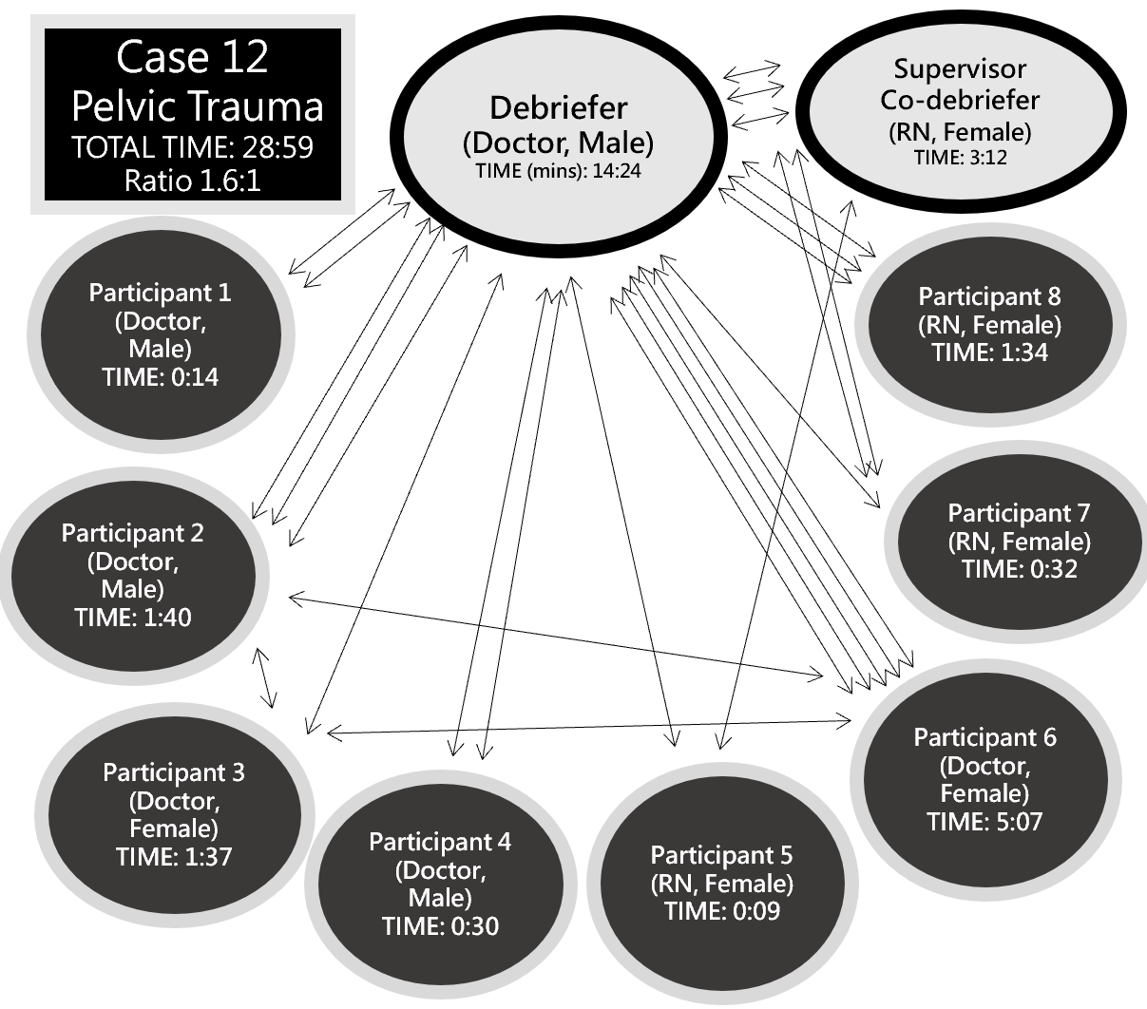
Key Findings
In 9/12 cases debriefers talked for a ratio of ≧1:1versus learner contributions
The conversational diagrams for these debriefings typically resembled a ‘fan-shape’.
Notes:
After you’ve done your research, it’s time to put your presentation together. The first step in the process is to introduce the topic. This is a great time to connect your topic to something that your audience can relate. In other words, why should they listen to all the information you will be sharing in your research presentation? What is in it for them? You may also want to include a graphic or image to grab their attention.
Feel free to duplicate this slide by right-clicking on this slide in the slides pane to the left and select Duplicate Slide.
The next step in your presentation is to state your claim or topic clearly. Your teacher may even call this your thesis. As you state your thesis, you may find that this layout is not the best layout for your claim or topic. You can change the layout by clicking the drop-down menu next to the Layout in the Slides menu section. You can choose Two Content, Comparison, or Picture with Caption. Note: A different layout might change the look of the icons on this page.
You will also want to state your facts. You have done the research now share some of the interesting facts with your audience. Facts do not have to be boring; you can communicate facts in a variety of ways by going to the Insert Tab. In the Insert tab you can:
Insert pictures from your computer or online.
Add a chart
Create some SmartArt
Insert a variety of icons to help your facts come to life. Note: You can change the color of the icons by selecting the icon and then click on the Format tab and then Graphics Fill. From there, you will choose a color from the list or choose More Fill Colors to give you more options.
Since this research presentation is a result of your hard work and searching, you want to make sure you support the claims or points in your presentation with facts from your research findings. Make sure you give the author proper credit for helping you share your ideas. If one of your sources has a video that is relevant to your topic, you can add the video as added support. Keep in mind the length of the video and the amount of time you have for your presentation. For a 5 minute speech, the video should be no longer than 30 seconds.
Questions to consider:
How will you state the author of the source?
Will you need to cite the source on the slide?
What are some ways you can engage your audience so they feel like they are a part of the presentation? Some ideas to consider is by taking a quick poll like: by a show of hands, how many of you think school uniforms are a way to cut down on bullying? Another suggestion is to have them hold up a certain number of fingers to see if they agree or disagree. Finally, you can share a story that the audience can relate to that makes them laugh.
After all the applause, your audience may have some questions. Be prepared to answer some of their questions by making a list of questions you think they might ask. You may also want to share the presentation with them by providing the link to your presentation, if they want more information.

Slide 21
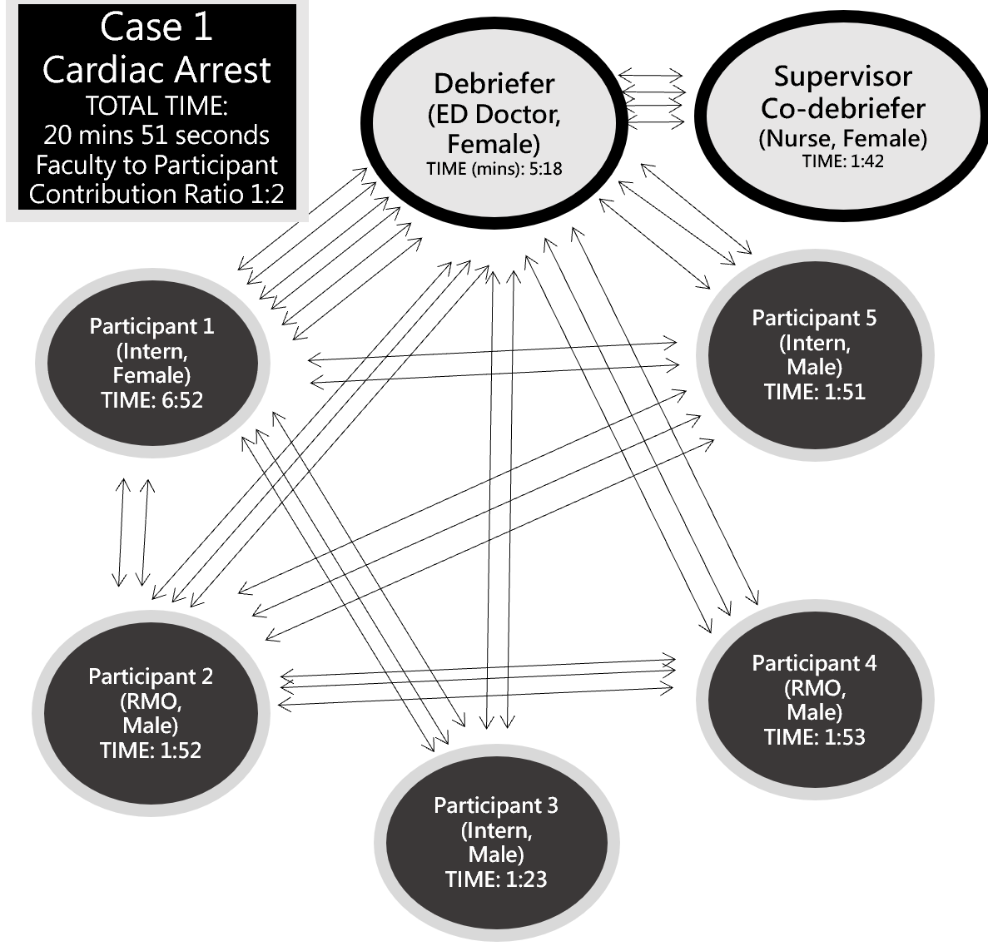
Key Findings
3 debriefings had a ratio of <1:1) – these resembled a star shape
We compared <1:1 and >1:1 using an an a priori plan
Debriefers with a ratio of <1:1 generated ‘star-shaped’ diagrams and achieved higher DASH ratings compared with the ≧1:1 group (p=0.038).
Notes:
After you’ve done your research, it’s time to put your presentation together. The first step in the process is to introduce the topic. This is a great time to connect your topic to something that your audience can relate. In other words, why should they listen to all the information you will be sharing in your research presentation? What is in it for them? You may also want to include a graphic or image to grab their attention.
Feel free to duplicate this slide by right-clicking on this slide in the slides pane to the left and select Duplicate Slide.
The next step in your presentation is to state your claim or topic clearly. Your teacher may even call this your thesis. As you state your thesis, you may find that this layout is not the best layout for your claim or topic. You can change the layout by clicking the drop-down menu next to the Layout in the Slides menu section. You can choose Two Content, Comparison, or Picture with Caption. Note: A different layout might change the look of the icons on this page.
You will also want to state your facts. You have done the research now share some of the interesting facts with your audience. Facts do not have to be boring; you can communicate facts in a variety of ways by going to the Insert Tab. In the Insert tab you can:
Insert pictures from your computer or online.
Add a chart
Create some SmartArt
Insert a variety of icons to help your facts come to life. Note: You can change the color of the icons by selecting the icon and then click on the Format tab and then Graphics Fill. From there, you will choose a color from the list or choose More Fill Colors to give you more options.
Since this research presentation is a result of your hard work and searching, you want to make sure you support the claims or points in your presentation with facts from your research findings. Make sure you give the author proper credit for helping you share your ideas. If one of your sources has a video that is relevant to your topic, you can add the video as added support. Keep in mind the length of the video and the amount of time you have for your presentation. For a 5 minute speech, the video should be no longer than 30 seconds.
Questions to consider:
How will you state the author of the source?
Will you need to cite the source on the slide?
What are some ways you can engage your audience so they feel like they are a part of the presentation? Some ideas to consider is by taking a quick poll like: by a show of hands, how many of you think school uniforms are a way to cut down on bullying? Another suggestion is to have them hold up a certain number of fingers to see if they agree or disagree. Finally, you can share a story that the audience can relate to that makes them laugh.
After all the applause, your audience may have some questions. Be prepared to answer some of their questions by making a list of questions you think they might ask. You may also want to share the presentation with them by providing the link to your presentation, if they want more information.

Slide 22
Secondary Outcomes
Debriefer self-rated DASH scores (ᘈ=5.08/7.0) were significantly lower than study subject ratings (ᘈ=6.50/7.0).
  These differences reached statistical significance for all DASH elements.
Debriefers evaluated the ‘usefulness’ of data and feedback provided and found it high (ᘈ=4.6/5).

Slide 23
EXAMPLE CASES | Study Subject Characteristics** |  | Study Subject Characteristics** | DASH Scores
 |  |  |  | DASH Element 1 Mean (SD) | DASH Element 2 Mean (SD) | DASH Element 3 Mean (SD) | DASH Element 4 Mean (SD) | DASH Element 5 Mean (SD) | DASH Element 6 Mean (SD)
Case Adult Cardiac Arrest |  | 5 Study Subjects: 5 Junior Doctors (4 male; 1 female) | 5 Study Subjects: 5 Junior Doctors (4 male; 1 female) | 6.6 (0.49) | 6.6 (0.49) | 7 (0) | 6.8 (0.4) | 6 (0.63) | 6.4 (0.49)
 |  | 1 Debriefer: Emergency Registrar A, (Male - Novice*) | 1 Debriefer: Emergency Registrar A, (Male - Novice*) | 5 | 4 | 5 | 4 | 4 | 5
 |  | 1 Supervisor: ICU Nurse A (Female - Experienced*) | 1 Supervisor: ICU Nurse A (Female - Experienced*) | 6 | 6 | 6 | 4 | 4 | 4
Case Airway |  |  | 7 Study Subjects: (5 Junior Doctors (3M; 2F), RN (F) Student (F)) | 6.71 (0.45) | 6.86 (0.35) | 6.71 (0.45 | 6.57 (0.49) | 6.43 (1.05) | 6.57 (0.49)
 |  |  | 1 Debriefer: Emergency Registrar B (Female - Novice*) | 5 | 6 | 4 | 6 | 6 | 5
 |  |  | 1 Supervisor: ICU Nurse B (Male - Experienced*) | 5 | 5 | 5 | 5 | 6 | 6
Case Trauma | 8 Study Subjects: 5 Doctor (3M; 2F), 3 RN (3F) |  |  | 6.13 (0.60) | 6.25 (0.66) | 6.13 (1.05) | 6.38 (0.86) | 5.13 (1.45) | 5.88 (0.93)
 | Debriefer: Emergency Specialist B (Male - Experienced*) |  |  | 5 | 6 | 5 | 6 | 5 | 5
 | Supervisor: Nurse (Female - Experienced*) |  |  | 6 | 6 | 5 | 6 | 5 | 4

Slide 24
Comparing DASH elements
OVERALL DASH SCORES (n=12) | Mean Study Subject DASH Score (n=78) (Mean of Total = 6.50) | 6.50 (0.34) | 6.64 (0.25) | 6.66 (0.37) | 6.63 (0.30) | 6.12 (0.64) | 6.46 (0.45)
 | Mean Self Debriefer DASH Score (n=12) (Mean of Total = 5.01) | 5 (0.58) | 5.17 (0.69) | 4.83 (0.90) | 4.92 (0.86) | 5.08 (0.76) | 5.08 (0.64)
 | p value (t-test) | p = <0.0001 | p = <0.0001 | p = <0.0001 | p = <0.0001 | p = <0.0001 | p = <0.0001

Slide 25
Summary
Notes:
After you’ve done your research, it’s time to put your presentation together. The first step in the process is to introduce the topic. This is a great time to connect your topic to something that your audience can relate. In other words, why should they listen to all the information you will be sharing in your research presentation? What is in it for them? You may also want to include a graphic or image to grab their attention.
Feel free to duplicate this slide by right-clicking on this slide in the slides pane to the left and select Duplicate Slide.
The next step in your presentation is to state your claim or topic clearly. Your teacher may even call this your thesis. As you state your thesis, you may find that this layout is not the best layout for your claim or topic. You can change the layout by clicking the drop-down menu next to the Layout in the Slides menu section. You can choose Two Content, Comparison, or Picture with Caption. Note: A different layout might change the look of the icons on this page.
You will also want to state your facts. You have done the research now share some of the interesting facts with your audience. Facts do not have to be boring; you can communicate facts in a variety of ways by going to the Insert Tab. In the Insert tab you can:
Insert pictures from your computer or online.
Add a chart
Create some SmartArt
Insert a variety of icons to help your facts come to life. Note: You can change the color of the icons by selecting the icon and then click on the Format tab and then Graphics Fill. From there, you will choose a color from the list or choose More Fill Colors to give you more options.
Since this research presentation is a result of your hard work and searching, you want to make sure you support the claims or points in your presentation with facts from your research findings. Make sure you give the author proper credit for helping you share your ideas. If one of your sources has a video that is relevant to your topic, you can add the video as added support. Keep in mind the length of the video and the amount of time you have for your presentation. For a 5 minute speech, the video should be no longer than 30 seconds.
Questions to consider:
How will you state the author of the source?
Will you need to cite the source on the slide?
What are some ways you can engage your audience so they feel like they are a part of the presentation? Some ideas to consider is by taking a quick poll like: by a show of hands, how many of you think school uniforms are a way to cut down on bullying? Another suggestion is to have them hold up a certain number of fingers to see if they agree or disagree. Finally, you can share a story that the audience can relate to that makes them laugh.
After all the applause, your audience may have some questions. Be prepared to answer some of their questions by making a list of questions you think they might ask. You may also want to share the presentation with them by providing the link to your presentation, if they want more information.

Slide 26
Future Steps
Notes:
After you’ve done your research, it’s time to put your presentation together. The first step in the process is to introduce the topic. This is a great time to connect your topic to something that your audience can relate. In other words, why should they listen to all the information you will be sharing in your research presentation? What is in it for them? You may also want to include a graphic or image to grab their attention.
Feel free to duplicate this slide by right-clicking on this slide in the slides pane to the left and select Duplicate Slide.
The next step in your presentation is to state your claim or topic clearly. Your teacher may even call this your thesis. As you state your thesis, you may find that this layout is not the best layout for your claim or topic. You can change the layout by clicking the drop-down menu next to the Layout in the Slides menu section. You can choose Two Content, Comparison, or Picture with Caption. Note: A different layout might change the look of the icons on this page.
You will also want to state your facts. You have done the research now share some of the interesting facts with your audience. Facts do not have to be boring; you can communicate facts in a variety of ways by going to the Insert Tab. In the Insert tab you can:
Insert pictures from your computer or online.
Add a chart
Create some SmartArt
Insert a variety of icons to help your facts come to life. Note: You can change the color of the icons by selecting the icon and then click on the Format tab and then Graphics Fill. From there, you will choose a color from the list or choose More Fill Colors to give you more options.
Since this research presentation is a result of your hard work and searching, you want to make sure you support the claims or points in your presentation with facts from your research findings. Make sure you give the author proper credit for helping you share your ideas. If one of your sources has a video that is relevant to your topic, you can add the video as added support. Keep in mind the length of the video and the amount of time you have for your presentation. For a 5 minute speech, the video should be no longer than 30 seconds.
Questions to consider:
How will you state the author of the source?
Will you need to cite the source on the slide?
What are some ways you can engage your audience so they feel like they are a part of the presentation? Some ideas to consider is by taking a quick poll like: by a show of hands, how many of you think school uniforms are a way to cut down on bullying? Another suggestion is to have them hold up a certain number of fingers to see if they agree or disagree. Finally, you can share a story that the audience can relate to that makes them laugh.
After all the applause, your audience may have some questions. Be prepared to answer some of their questions by making a list of questions you think they might ask. You may also want to share the presentation with them by providing the link to your presentation, if they want more information.

Slide 27
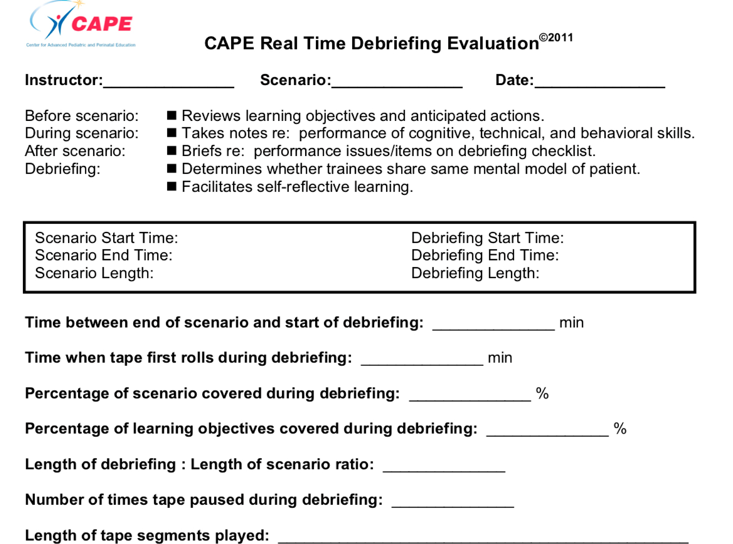

Ref - Arul N, Ahmad I, Hamilton J, Sey R, Tillson P, Hutson S, Narang R, Norgaard J, Lee HC, Bergin J, Quinn J, Halamek LP, Yamada NK, Fuerch J, Chitkara R. Lessons Learned from a Collaborative to Develop a Sustainable Simulation-Based Training Program in Neonatal Resuscitation: Simulating Success. Children (Basel). 2021 Jan 12;8(1):39.

Slide 28
Questions after the next talk welcome
Best Wishes
Notes:
You can use this slide as your opening or closing slide. Should you choose to use it as a closing, make sure you review the main points of your presentation. One creative way to do that is by adding animations to the various graphics on a slide. This slide has 4 different graphics, and, when you view the slideshow, you will see that you can click to reveal the next graphic. Similarly, as you review the main topics in your presentation, you may want each point to show up when you are addressing that topic.
Add animation to images and graphics:
Select your image or graphic.
Click on the Animations tab.
Choose from the options. The animation for this slide is “Split”. The drop-down menu in the Animation section gives even more animations you can use.
If you have multiple graphics or images, you will see a number appear next to it that notes the order of the animations.
Note: You will want to choose the animations carefully. You do not want to make your audience dizzy from your presentation.

