Slide 1
EMIG - Haemorrhage in Trauma
Bleeding, M.T.P. and new tests (TEG/ROTEM) in the Emergency Department
Andrew Coggins ED and Trauma SS, A/Dir Simulation Centre – Sep 2020
Notes:
No dislosures

Slide 2
Embryology
Bleeding is the leading cause of death from trauma
Curry N, Hopewell S, Dorée C, Hyde C, Brohi K, Stanworth S. The acute management of trauma hemorrhage: a systematic review of randomized controlled trials. Crit Care. 2011;15(2):R92. doi:10.1186/cc10096
Massive Transfusion
  A-D approach
Review of new coagulation tests (TEG** and ROTEM)
  What?
  Why?
  How?

Slide 3

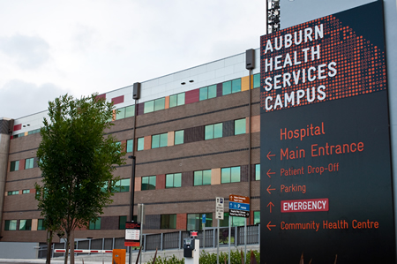
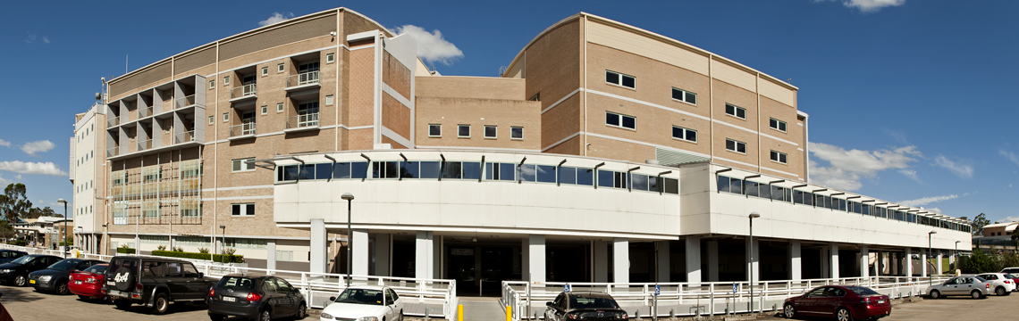
Notes:
Urban Tertiary Setting
Primary site = Emergency Department (adult)
Late adopter of simulation based medical education
Clinical Debriefing
Ad-hoc, mostly cardiac arrests
Consultant dependent

Slide 4
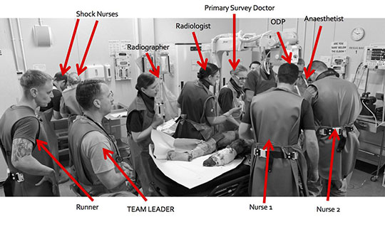
Mercer Simon J, Kingston Elizabeth V, Jones Clinton P L. The trauma call BMJ 2018; 361 :k2272

Slide 5
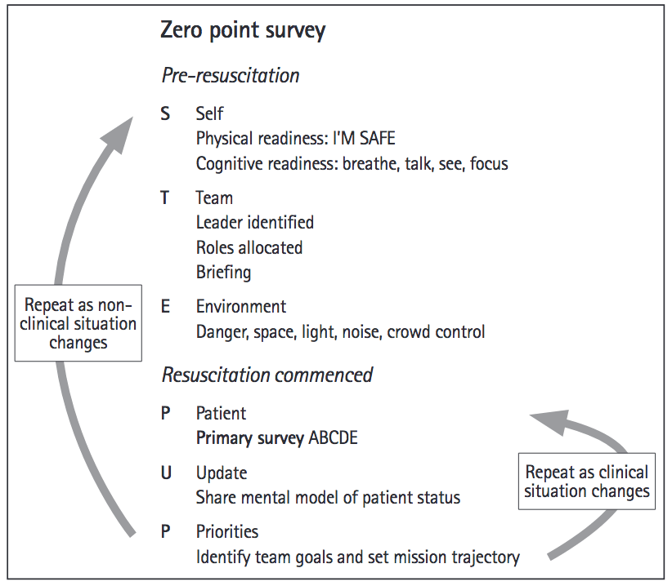
Managing the challenge…
Reid C, Brindley P, Hicks C, et al. Zero point survey: a multidisciplinary idea to STEP UP resuscitation effectiveness. Clin Exp Emerg Med. 2018;5(3):139-143. doi:10.15441/ceem.17.269

Slide 6
Some points in the clinical approach to trauma
Mechanism – Blunt (MVC, MBC, Falls) or Penetrating (GSW, knife)
The ABC becomes – C.A.C.B.C.
  Control Bleeding (external), Airway, C spine, Breathing, Circulation etc
Where is the bleeding – Pelvis, Long Bones, Abdomen, Chest, External, Scalp

Slide 7
Trauma
Bleeding
Mechanism
C-A©BC
P.L.A.C.E.S.
Team/System Factors

Slide 8
Massive Transfusion Protocol (MTP)
When
How
What

Slide 9
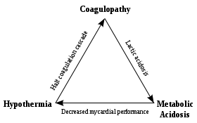
Trauma
Bleeding causes the “Lethal Triad”

Slide 10
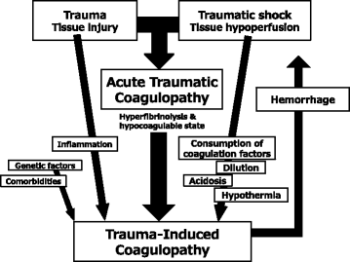
Coagulopathy
Talk on ATC https://smacc.net.au/2014/08/acute-coagulopathy-of-trauma-by-brohi/#:~:text=Karim%20Brohi%20highlights%20the%20pitfalls,of%20coagulopathy%20in%20severe%20trauma.

Slide 11
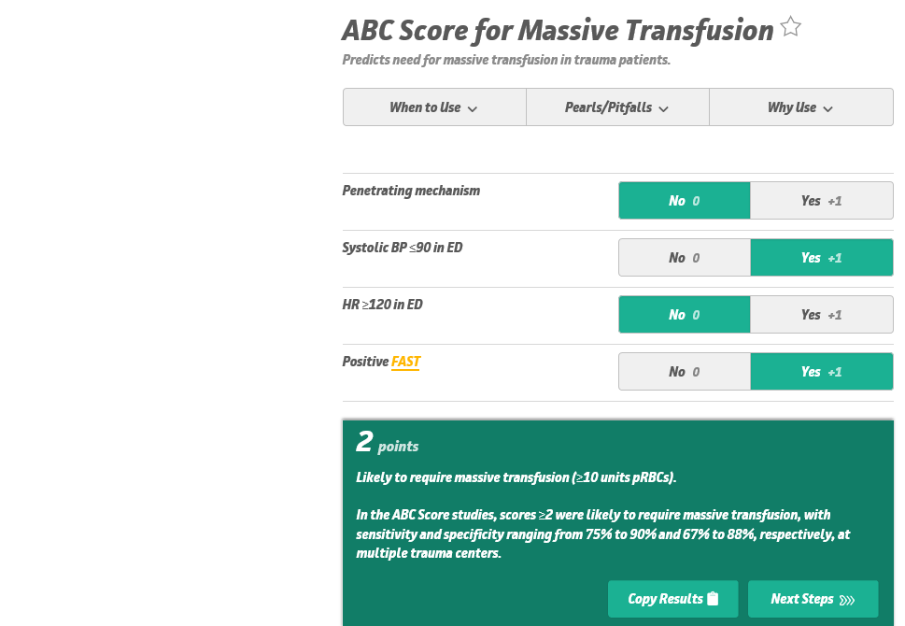
Trauma
ABCD score
ABC score = When
  Penetrating mechanism
  Systolic BP<90
  HR>120
  FAST +VE
  Score of 2 or more predictive
Motameni AT, Hodge RA, McKinley WI, et al. The use of ABC score in activation of massive transfusion: The yin and the yang. J Trauma Acute Care Surg. 2018;85(2):298-302.

Slide 12
What = MTP
The most widely accepted definition of massive transfusion is the administration of ≥10 units of packed RBCs in the first 24 hours.
Critical bleeding: major surgical, traumatic, obstetric or gastrointestinal haemorrhage WITH:
Actual or predicted 4U PRBC transfused in < 1 hour
OR
2. Blood loss > 1000ml/hr

Slide 13
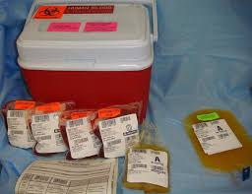
MTP
MTP contents
  Institution-specific, but often are 1:1:1 or 1:1:2 for fresh frozen plasma, platelets, and packed red blood cells
  New things (FC)
Holcomb JB, Tilley BC, Baraniuk S, et al. Transfusion of plasma, platelets, and red blood cells in a 1:1:1 vs a 1:1:2 ratio and mortality in patients with severe trauma: the PROPPR randomized clinical trial. JAMA. 2015;313

Slide 14
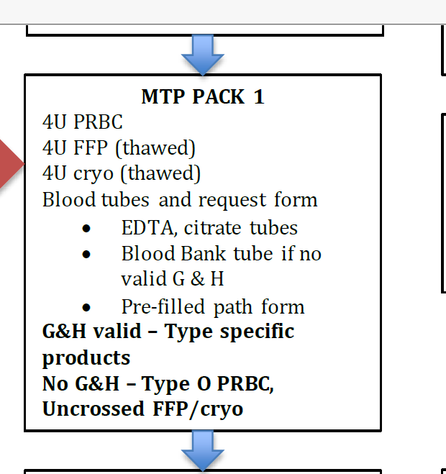
MTP Pack

Slide 15
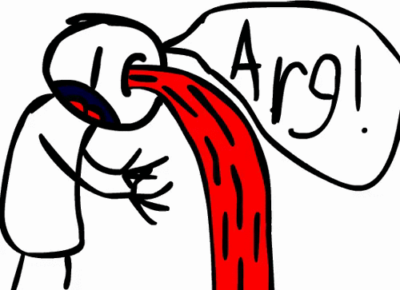
Summary - MTP
Assessment
(out)
Blood
(in)
Complications (L. Triad)
Drugs (Tranexamic Acid)

Slide 17
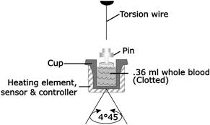
TEG and ROTEM – New Coagulation Tests
Premise dates to 1970s
  Essentially:
    A cup containing whole blood sample oscillates through a shallow angle
    A pin on a torsion wire is suspended in the blood.
    As the viscoelastic strength of the clot increases more rotation is transmitted to the torsion wire and is detected by an electromagnetic transducer
Types of TEG
  TEG6s
  ROTEM
  Theatre TEG

Slide 18
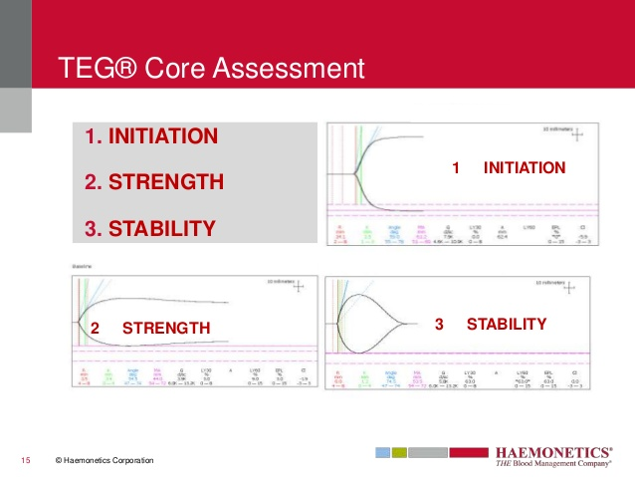

Slide 19
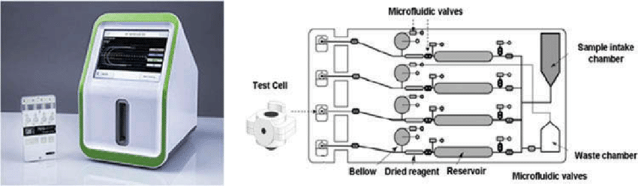
The Westmead machine runs four tests:
  Kaolin TEG (R, K, Angle, MA)
  Kaolin TEG with Heparinase to neutralize heparin (RH)
  Functional Fibrinogen Maximum Amplitude (FFMA)
  Rapid TEG (MA-RT)

Slide 20
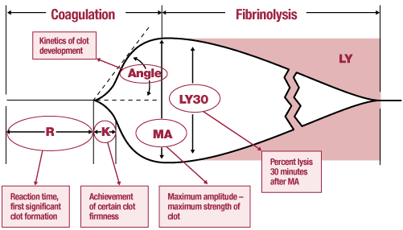

Slide 21
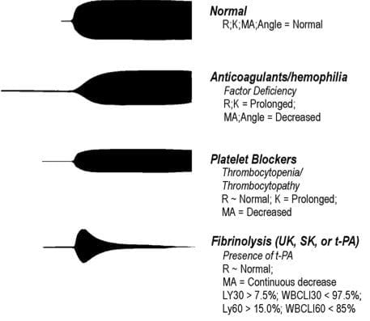
Source https://litfl.com/thromboelastogram-teg

Slide 22


