Slide 1
Nerves and Muscles

Slide 2
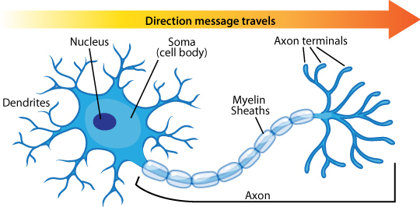
The Nerve
Cell body —> 5 - 7 dendrites —> Long, fibrous axon —> divides into terminal branches —> each ends in a terminal knob.
Myelin sheaths - formed by Oligodendrocytes
4 zones to a nerve fiber
  Receptor (dendritic zone)
  A site where the propogated AP is generated
  An axonal process that transmits impulses to nerve endings
  The nerve endings which cause the release of synaptic transmitters

Slide 3
Some Concepts
Resting Membrane Potential - primarily determined by 2 ions: Na+ and K+
  The membrane is much more permeable to K+ than Na+, therefore the resting membrane potential is closer to the equilibrium potential for K+ (- 70mV)
  If a membrane potential becomes more positive than its resting membrane potential this is called depolarisation, the opposite is called hyperpolarisation
  How is a resting membrane potential formed: https://www.khanacademy.org/science/biology/human-biology/neuron-nervous-system/a/the-membrane-potential

Slide 4
Action Potentials
Generation, transmission and propagation is a 7 step process
  Step 1: Resting Membrane Potential
      - 70mV (close to the K equilibrium potential)
      Threshold of - 55mV is when the AP occurs (all or nothing)
  Step 2: Threshold Potential
      In response to a depolarising stimulus: some voltage gated Na Channels open and reach a threshold potential - at which point the K + Channels are overwhelmed

Slide 5
Step 3: Depolarisation
    The entrance of Na causes a positive feedback loop and opens up more Na channels which generates the rapid upstroke.
Step 4: Equilibrium Potential
    The membrane potential moves towards the equilibrium potential for Na + (+60 mV) but does not reach it during the action potential.
    This increase in Na conductance is short lived, these channels rapidly enter a closed state called the inactivated state and remain in this state for a few milliseconds before they can be reactivated (ABSOLUTE REFRACTORY PERIOD)

Slide 6
Step 5: Repolarisation
    Because of the overshoot the membrane potentials are reversed and so the flow of Na is also reversed.
    Voltage gated K channels open.
    These two factors contribute to repolarisation
    The opening of voltage gated K channels is slower and more prolonged than the opening of the Na + channels and consequently, much of the increase in K conductance comes after the Na conductance.
Step 6: Hyperpolarisation
    The net movement of K out of the cell helps complete the process of repolarisation.
Step 7: Return to Resting Membrane Potential.

Slide 7
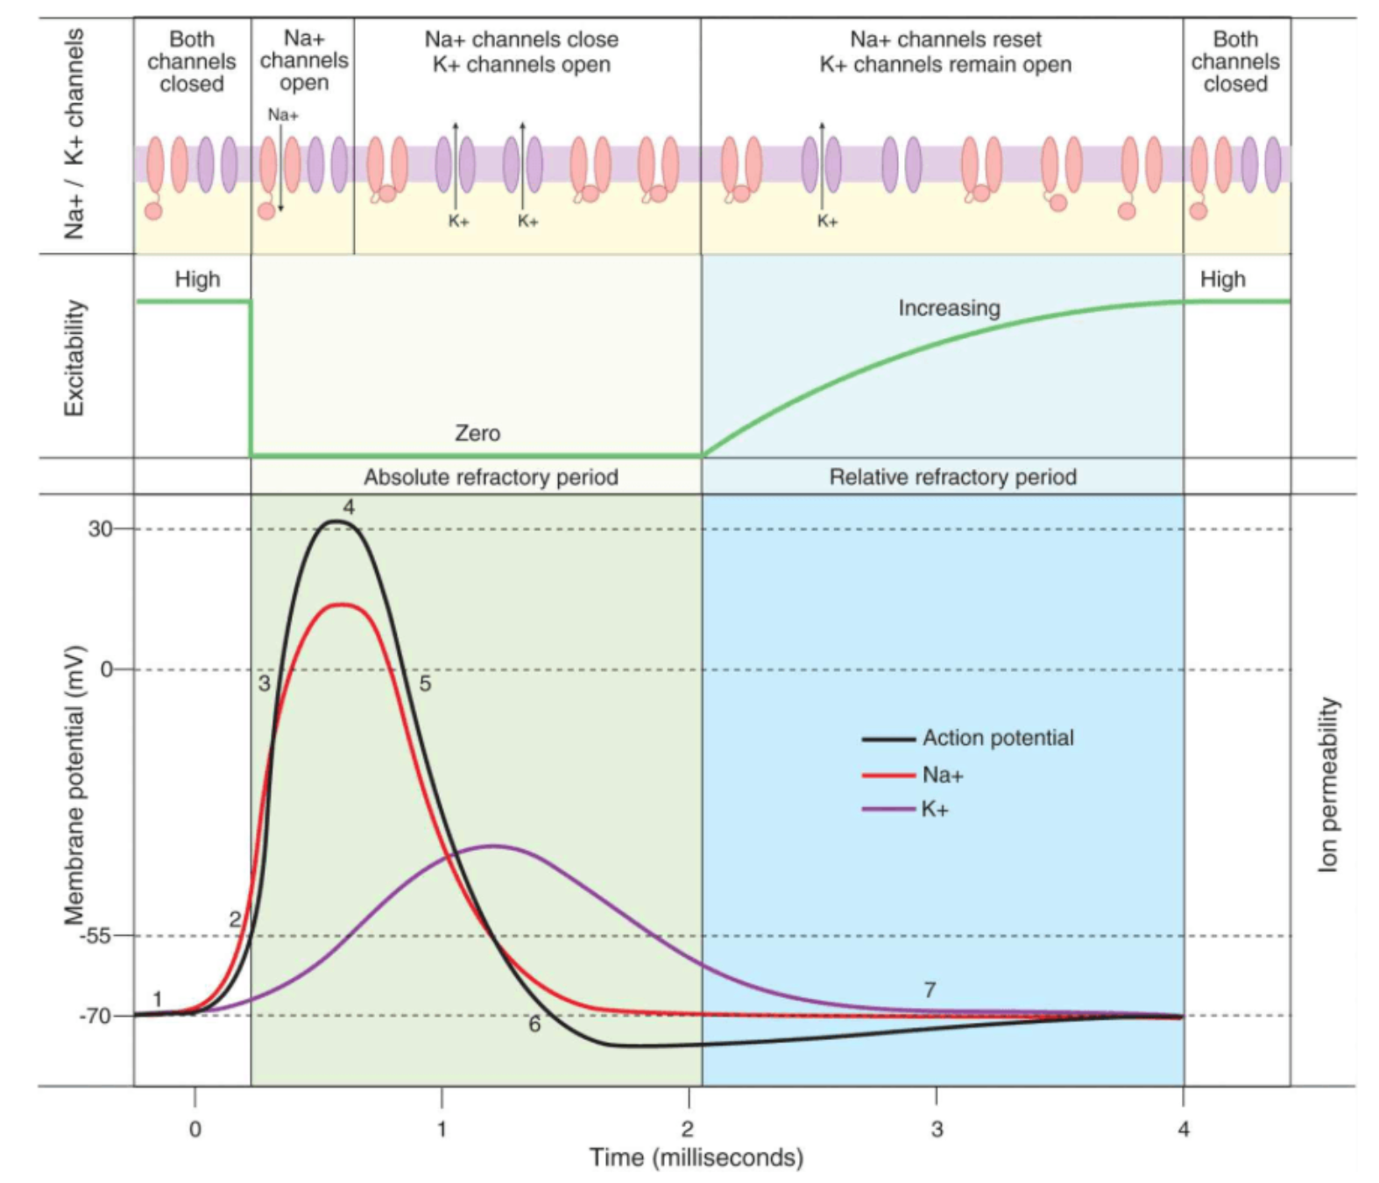

Slide 8
Some Concepts
Refractory Period
  Absolute: from firing until 1/3rd of the way through repolarisation no amount of stimulation will cause an AP to be triggered
  Relative: a stronger than normal stimulus may trigger an AP
All or nothing
  The minimal intensity of stimulating current will elevate the resting membrane potential to a threshold potential
    Once threshold potential is reached further increases in this stimulating potential produce no further increment increases in the AP
    If the stimulating threshold is sub-threshold, there is no AP generated
Electrogenesis of the AP
  The affected cell’s polarity is reversed, so positive charge is on the inside and -ve charge on the outside. The adjacent normal membrane’s positive charge flows into this current sink. This causes depolarisation of the adjacent cells.

Slide 9
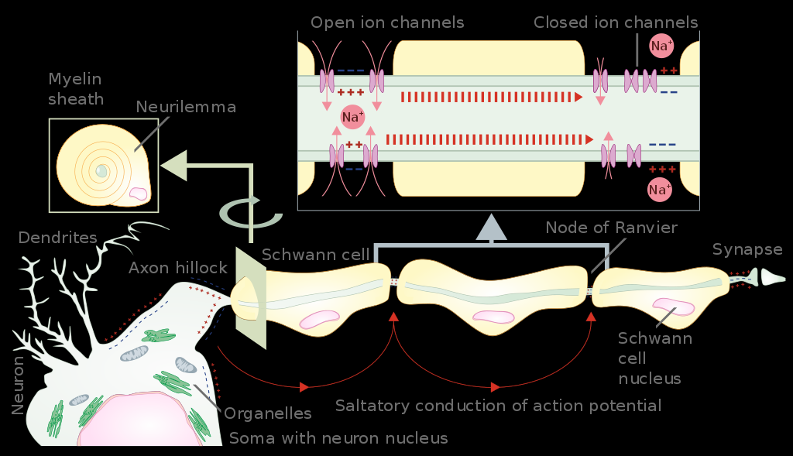
Some Concepts
Saltatory (“to hop/leap”) Conduction: The movement of current from one Node of Ranvier to the next. Occurs due to the myelinated segments between Nodes of Ranvier.
  Allows conduction to move 50 times faster.

Slide 10
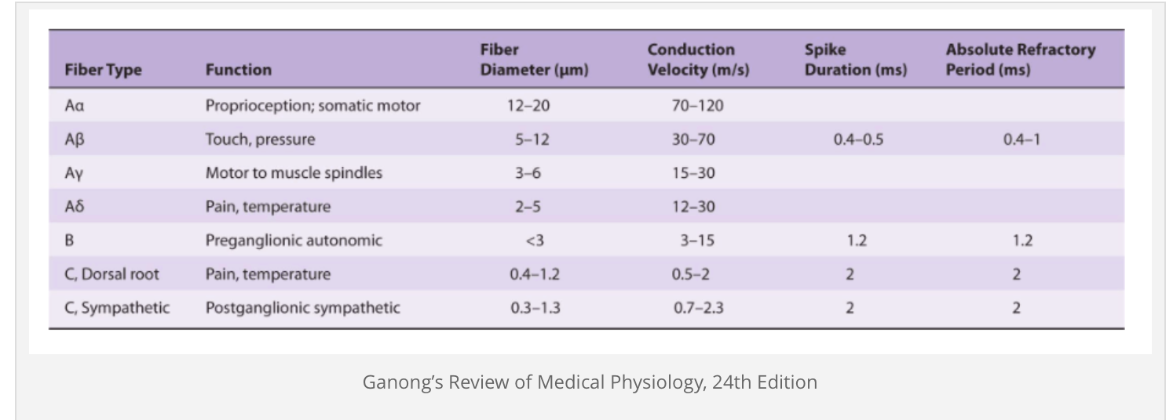
Nerve Fibre Types and Function

Slide 11
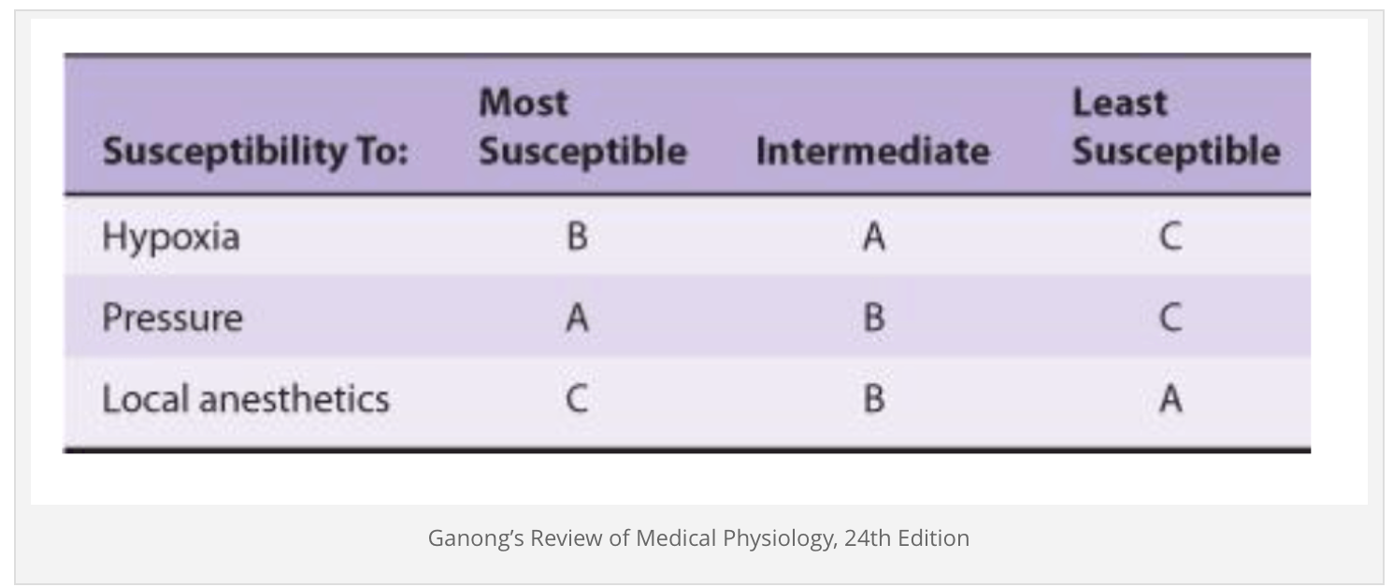
Susceptibility to noxious stimuli

Slide 12
Muscles
3 groups of muscle
  Skeletal
    Large mass
    Cross striations and contains T tubules
    Does not contract in absence of nervous stimulation, under voluntary control
    Type 1 - slow, red; high oxidative capacity Type 2 - fast/white/glycolytic, fast ATPase rate low oxidative capacity
  Cardiac
    Cross striations
    Functionally syncytial
    Contracts rhythmically in the absence of external innervation due to the presence of pacemaker cells
  Smooth
    Lacks cross striations
    Found in hollow viscera
    Functionally syncyitical and contains pace makers that discharge irregularly
    Can remain in continuously contracted ie. “latched” state without energy requirement

Slide 13
Skeletal Muscle
Shortening of contractile elements in muscle is brought about by a sliding of thin filaments over thick filaments.
Depolarisation is due to Na influx and repolarisation is due to K efflux which occurs from a release of Ach at the motor end plate which binds to nicotinic receptors on the post synaptic junction.
T tubules propagate the action potential into the muscle fibers.
Sacroplasmic Reticulum releases Ca 2+
  Calcium binds troponin C, uncovering the myosin binding site on the actin.
  Actin and myosin bind, thick and thin filaments move- there is a power stroke.
  ATP binds and the actin/myosin detach and as ATP turns to ADP the myosin returns to its original position.
  Ca is pumped back into the cell using an ATP driven mechanism.

Slide 14
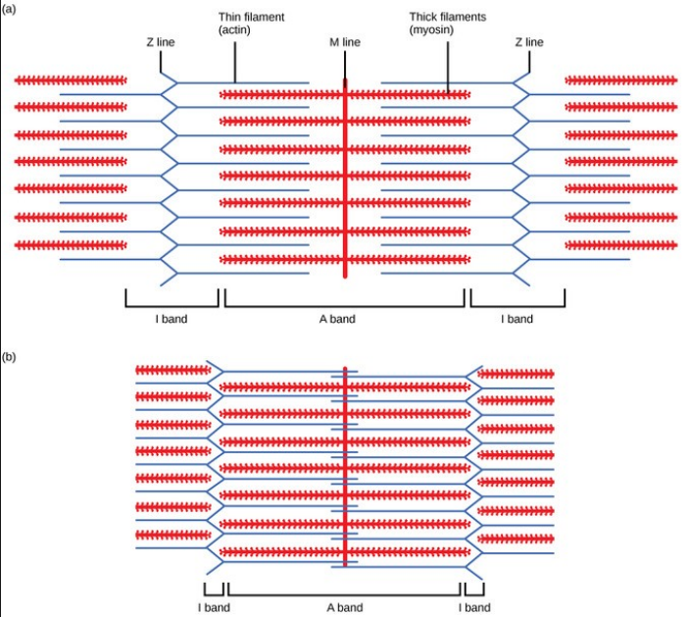

Slide 15
Cardiac Muscle
Muscle fibers branch and interdigitate but is each complete unit
One nucleus
The cell borders are held by intercalated discs - these provide a strong union between fibres, and good force transmission
Along the side of fibres there are GAP JUNCTIONS which provide low resistance bridges for the spread of excitation to contract as though they were a SYNCYTIUM

Slide 16
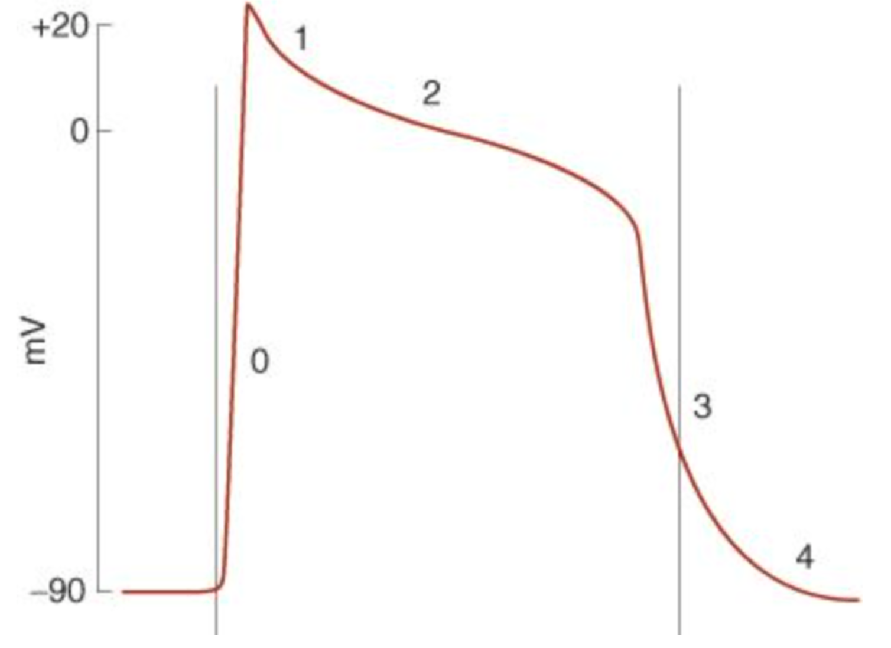
Cardiac Muscle Action Potential

Slide 17
Cardiac Muscle
Correlation between length and strength
  In the heart the degree of stretch is determined by the diastolic filling.
  The pressure developed in the ventricle is proportional to the total tension developed. This is due to the fibers moving apart creating active tension. This is STARLING’S LAW.
  The developed tension increases as volume increases up to a certain point and then begins to decrease due to a disruption of cardiac muscle fibers.
Force contraction is also increased by catecholamines mediated by beta 1 receptors and cAMP —> essentially leads to phosphorylation of Ca channels allowing them to be open for a greater period of time.

Slide 18
Cardiac Muscle
Metabolism - largely reliant of aerobic metabolism
  Under basal conditions
    35% carbs
    5% ketones and amino acids
    60% fat

Slide 19
Cardiac Pacemaker
Characterised by absence of Na channels so that membrane potentials slowly, rather than rapidly, rise as voltage gated Ca channels are activated
At the peak of depolarisation K begins to flow out causing depolarisation. The K current begins to slow as the cell becomes hyper polarised
This triggers the funny (H) channel which is a Na/K channel and this starts the pre potential
The Ca channels then open, at first a transient (T) channel completes the pre potential and then an L channel opens causing the depolarisation

Slide 20
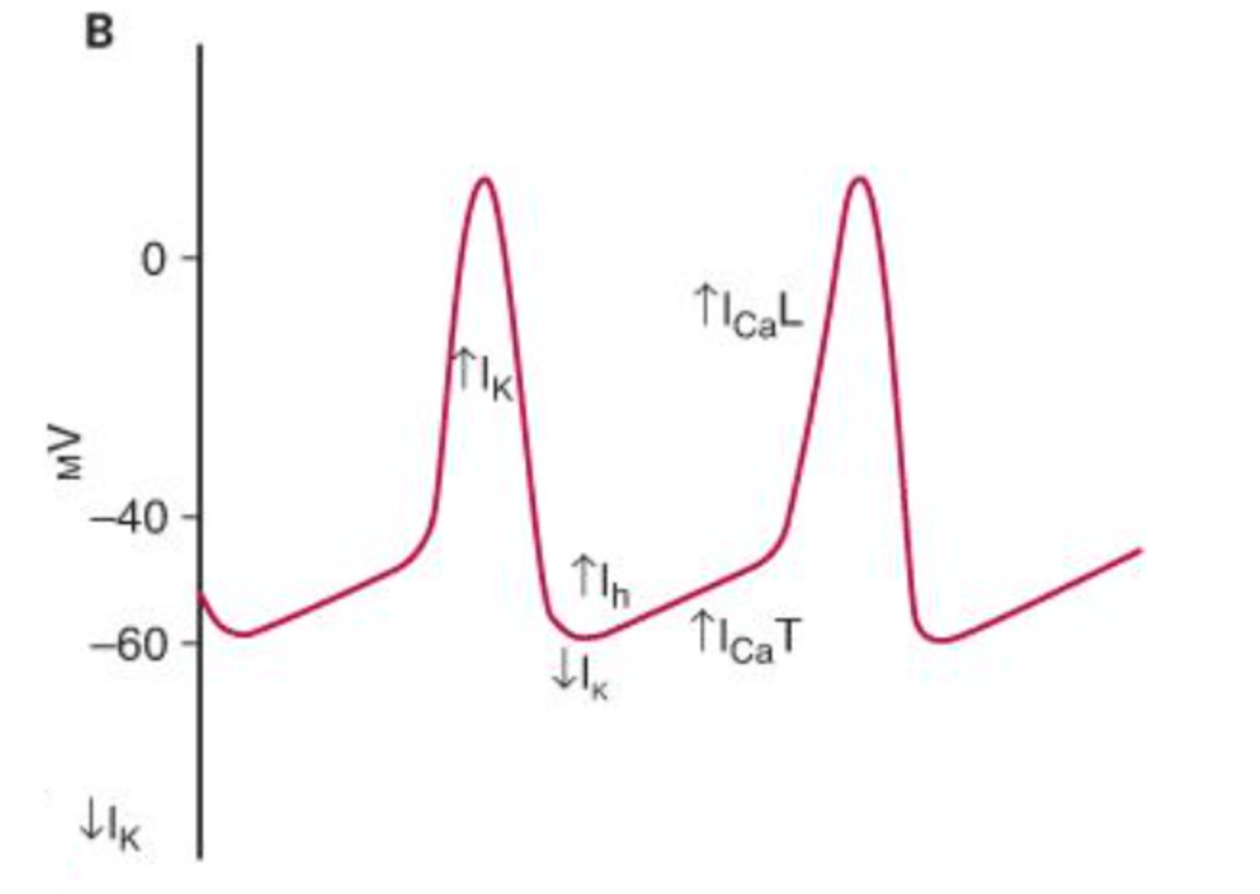

Slide 21
Pacemaker AP
Characterised by automaticity
  SA node
  AV node
  Bundle of HiS

Slide 22
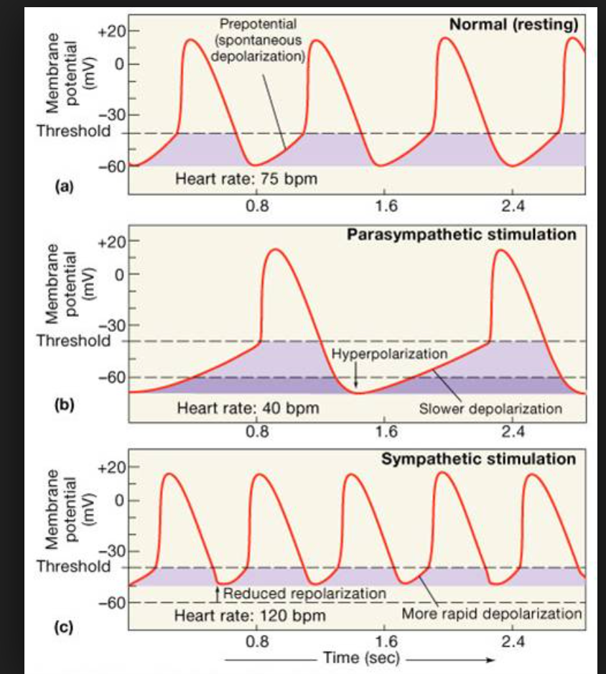

Slide 23
Nervous system and the cardiac action potential
Parasympathetic - increased Ach, opens K channels and slows opening of Ca channels causing hyperpolarisation of the membrane and a decrease in the AP slope.
Sympathetic - via increased noradrenaline (acting on beta receptors) increases opening of funny (H) channels and L type Ca channels therefore speeds up both the depolarisation of the pre-potential and increases the firing rate and rate of the depolarisation impulse too.

Slide 24
Smooth Muscle
No striations
Glycolysis mainly for energy
Spontaneous activity in absence of nervous stimulation
Initiation of contraction is due to Ca influx
Unstable membrane potential causing continuous irregular contraction independent of nerve supply
In visceral smooth muscle stretch triggers depolarisation and contraction

Slide 25
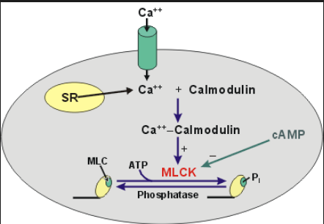
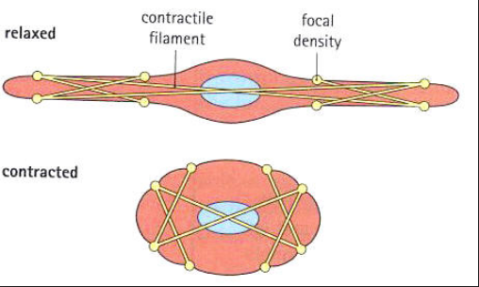
Ca2+ binds calmodulin which activates calmodulin dependent myosin light chain kinase which phosphorylates myosin light chains. This allows for myosin crosslinking bridges to form with actin.

Slide 27
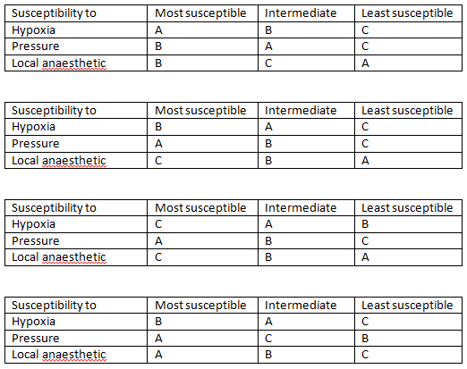
Viva 2015 | Define the resting membrane potential. Explain how the resting membrane potential is created. Why is a cell more excitable in hyperkalaemia?
Viva 2007 | Draw and label the action potential of a neuron
MCQ 2017 | Arrange the following nerve fibers from most susceptible to least susceptible to pressure A B C D

