Slide 1
Westmead Hospital
Primary teaching series

Slide 2
Physiology lecture 1 Principles of Cellular Function
Primary Exam Teaching
By Vincent Tsui
Written by Pramod Chandru

Slide 3
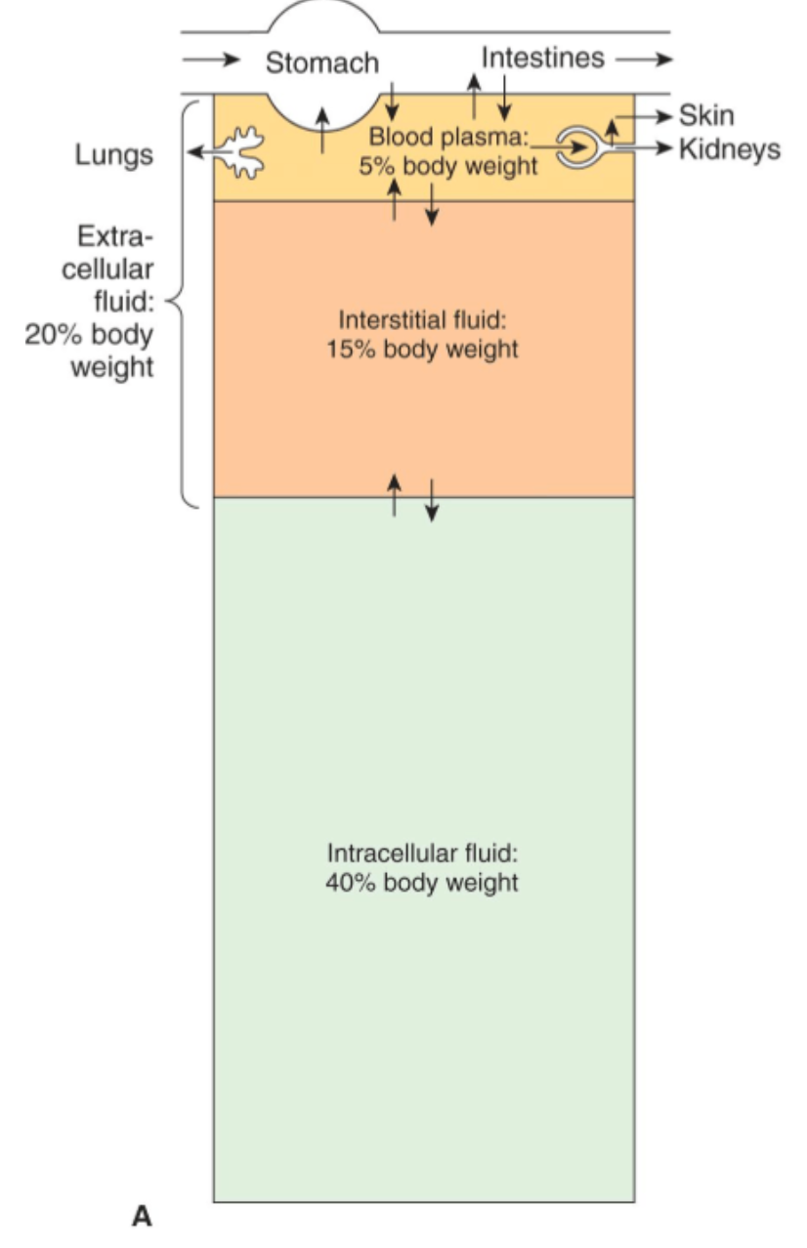
Body Composition
Total Body Weight - 100kg
Total body fluids- 60 kg (2/3)
  ECF (Extracellular) - 1/3 of total body fluids (20kg)
    Intravascular - 1/4 of ECF (5kg)
    Interstitial - 3/4 of ECF (15kg)
  ICF (Intracellular) - 2/3 of total body fluids (40kg)

Slide 4
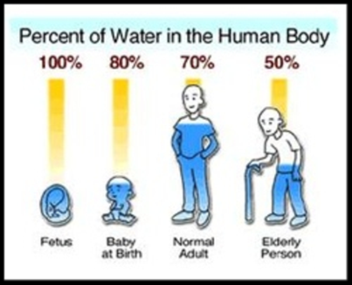
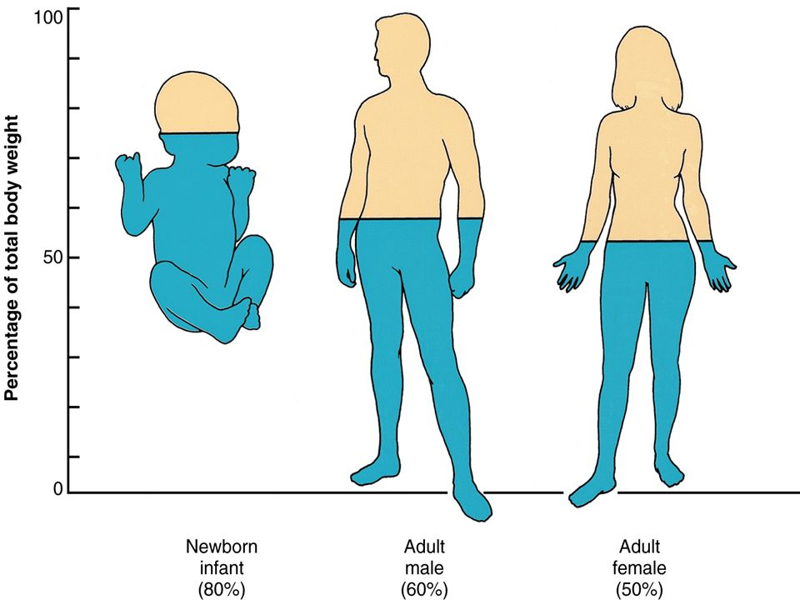

Slide 5
Composition of Body Fluids
Solute | Plasma | Interstitial fluid | Intracellular fluid
Cations
Sodium | 153 | 145 | 12
Potassium | 4.3 | 4.1 | 150
Calcium | 3.8 | 3.4 | 4
Magnesium | 1.4 | 1.3 | 34
Anions
Chloride | 111.5 | 118 | 4
Bicarbonate | 25.7 | 27 | 12
Phosphate | 2.2 | 2.3 | 40
Protein | 17 | 6.6 | 90
Summary
  ECF = (Plasma + ISF) = High in Na + and Cl -
  ICF = High in K+ , Mg 2+, PO4, Protein

Slide 6
The movement of molecules
How can molecules move across membranes?
  Passive transport
    Diffusion - small molecules O2, N2, CO2
    Osmosis - movement of water across semi permeable membrane
    Facilitated diffusion - does not require ATP but does utilise cell membrane protein
  Active Transport
    Endocytosis - Invagination of the cell membrane (CLATHRIN MEDIATED)
    Exocytosis - vesicles containing molecules are fused to the cell membrane and transported out (v-SNARE/t-SNARE process)
    Transport proteins
      Gated - Voltage gated, Ligand gated, Stretch triggered
      Non Gated

Slide 7
Methods of transport across cell membranes
Transport | Mechanism of Action | Example
Passive diffusions down electrochemical gradient | Movement from high concentration to lower concentration across membrane | Movement of oxygen across the alveolar membrane
Active Transport | Uses energy to transport molecules across a membrane | Na+/K+ ATPase (removes 3 Na from the cell and puts 2 K into the cell converting ATP —> ADP). Na binds to alpha subunit with ATP causes conformational change in protein. K binds the beta until extracellularly
Secondary Active Transport | The active transport of Na is coupled to the transport of other substances | Glucose and Na in the GIT (SGLT1 small intestine) Na and Ca in cardiac muscle
Co-transport | The favourable movement of one molecule down in concentration gradient to transport another against | Na and Ca in Muscle Tissue

Slide 8
Movement of molecules
Molecules move by their
  Chemical gradient (high concentration to low concentration)
  Electrical gradient (cations move to negatively charged areas)
  When carriers move chemicals in the direction of their gradient this is called FACILITATED DIFFUSION
  If it is going against the gradient then this is called ACTIVE TRANSPORT

Slide 9
Diffusion
The process by which a substance in solutions expands because of the motion of its particles to fit all of the available volume
The particles of a given substance are equally likely to move into or out of an area in which it is present in high concentration
However, since there are more particles in the area of high concentration the total number of particles moving into an area of lower concentration is greater
The time to reach an equilibrium across a membrane is - SQAURE OF THE DIFFUSION DISTANCE
The magnitude of the diffusing tendency is directly proportional to the cross sectional area across which the diffusion is taking place AND the concentration or chemical gradient - FICK’S LAW OF DIFFUSION

Slide 10
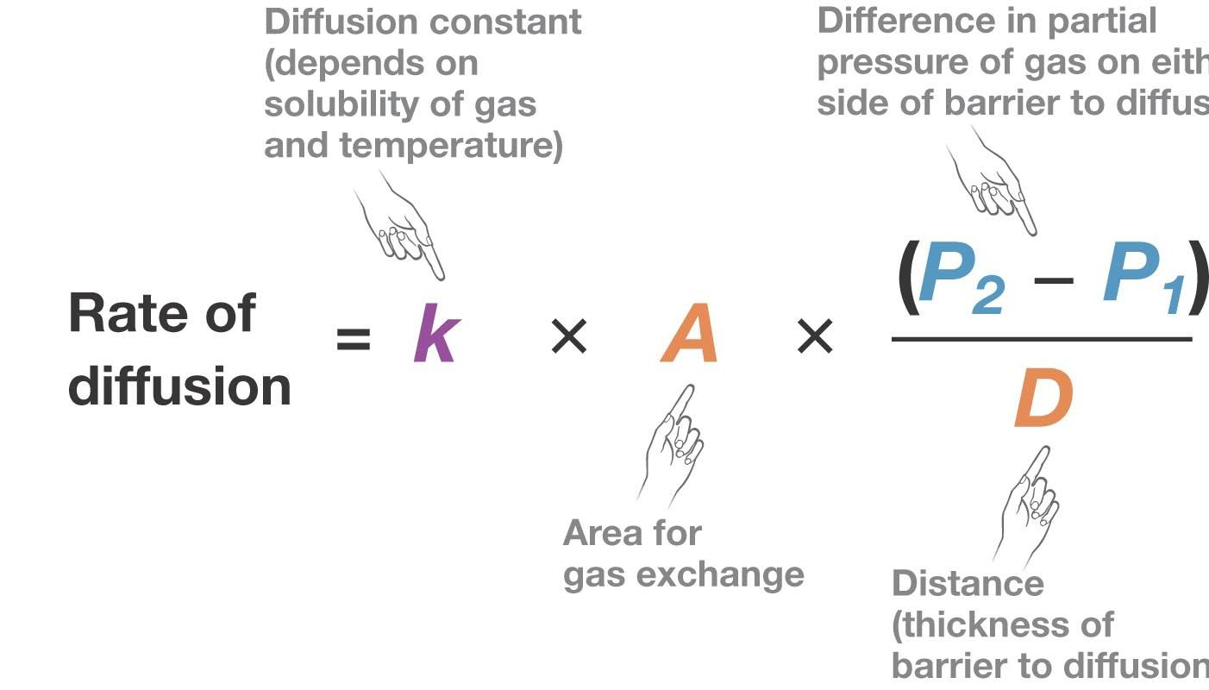
Diffusion

Slide 11
Diffusion
How substances diffuse across a cell membrane depends on their molecular characteristics
O2 can diffuse through the extracellular and intracellular space and cell membrane at a similar rate
Ions on the other hand require channels to pass

Slide 12
Osmosis
The diffusion of water across a membrane
When a substance (solute) is dissolved in water (solvent) the concentration of water molecules is less in the solution than in pure water (low water potential vs high water potential)
If the solution is placed on one side of a membrane permeable to water but not to solute (semi-permeable) and an equal volume of water is placed on the other side - water molecules will diffuse down a concentration gradient. OSMOSIS
The pressure necessary to prevent this solvent migration is known as the OSMOTIC PRESSURE

Slide 13
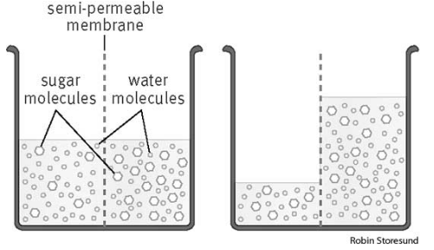

Slide 14
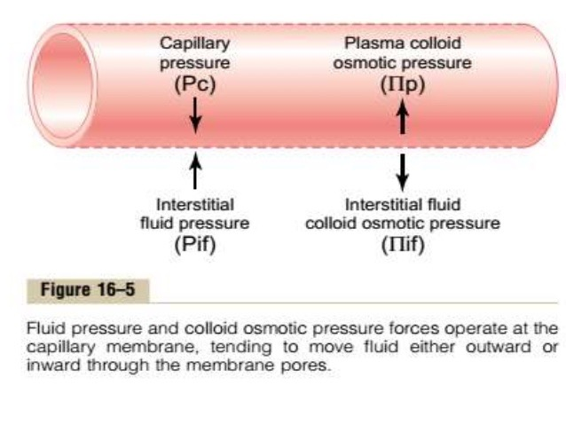
Pressures across a semi permeable membrane

Slide 15
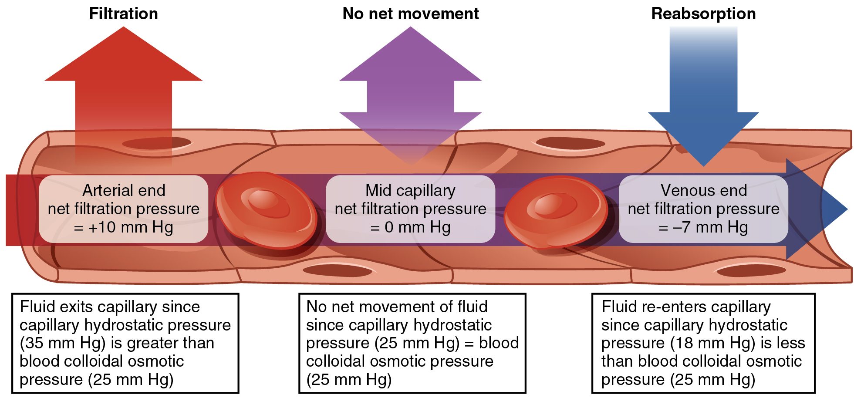
Osmotic/Hydrostatic pressure
Summary: Fluid moves out on the arterial end and in on the capillary end. The net filtration is OUT of the blood vessel. This is collected by lymphatics.

Slide 16
The Gibbs-Donan Effect
Governs the behavior of charged particles near a semi permeable membrane
Some charged molecules (ie. Large proteins) can’t cross capillary wall
An equilibrium is formed between the electrostatic and osmotic forces that affect the ions
Uneven electrical charge creates MEMBRANE POTENTIAL
https://www.youtube.com/watch?v=MhSfQio8mp0

Slide 17
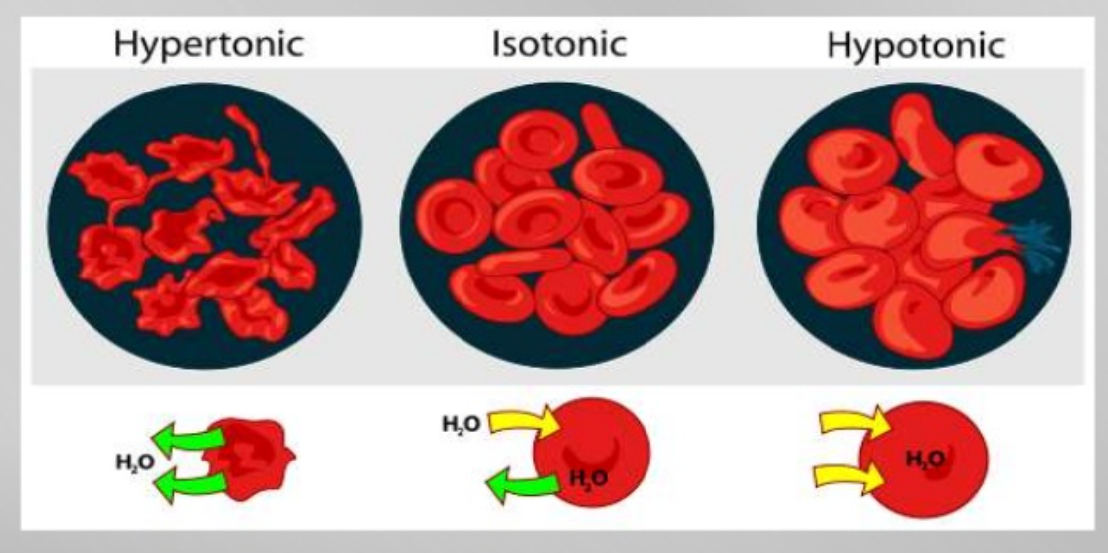
Tonicity
The ability of a solution to move water in and out of a cell.
Allows us to determine the direction of osmosis

Slide 18
Normal Saline
Consider the infusion of 1L Normal Saline
  150 mmol of Na and 150 mmol of Cl
  Distributes rapidly (in 15-20min) from intravascular to interstitial
  Cells have active pumps to move the ions as the membrane is impermeable to Na and Cl
  Normal saline is ISO-OSMOTIC with the ECF water. It has no incentive to shift and so distributes about 25% intravascular and 75% interstitial (proportional to distribution of Na)
  There is NO change in plasma osmolality
  Intravascular volume is increased by 250mL (5%), this change is outside the baroreceptor threshold (8-10%)
  There is a decrease in intravascular protein concentration, decreases oncotic pressures, which increases renal free water excretion (intrinsic renal tubular mechanism)
  Volume expansion does not act for very long, causes NO change in Na and increases Cl by a total 3mmol/L

Slide 19
Osmolality vs Osmolarity
Refer to 1 solution
Osmolality (Osmoles/1kg solvent) – lab based
Osmolarity (Osmoles/1L solution) – clinically based
- The difference between the two is the osmolar gap

Slide 20
Quiz
2012 Viva | What is normal serum osmolality? What substances contibute to serum osmolality? How does plasma differ in composition to intracellular fluid
2007 Viva | How is water distributed through the body compartments? How does age and gender affect total body water?
MCQ | Which of the following is equal to the osmoles of a solute divided by 1L of solvent Molarity Tonicity Osmolarity Osmolality

Slide 21
Answers
Vivas: 2007 Body composition, 2012 Osmolality
http://www.edvivas.com/physiology/principles-of-cellular-function/
MCQ: C

