Slide 1
Physiology lecture 1 – part 2
Cellular transport and signaling
Primary Exam Teaching
By Pramod Chandru

Slide 2
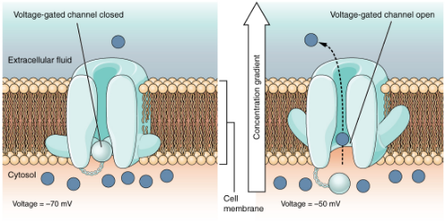
Channels
Characterisied by their ionic permeability ie. Na+ and by their gating mechanism:
Voltage sensitive
Ligand gated
Phosphorylation gated
Stretch
Temperature

Slide 3
Channels
Type | Function
Voltage sensitive | Na+, Ca+, K+, CL- channels. Basis of nerve and muscle excitability
Gap Junction | Channels between cells that allow free passage of ions and current between cells ie. Smooth muscles and cardiac muscle
Aquaporins | Specialised channels mainly permeable to water and are always open

Slide 4
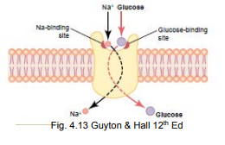
Transporters
Proteins that span the membrane which allow the passive movement of one or more ions/molecules across
A passive process that uses the electrochemical gradient of one ion (normally Na+) to move another ion or molecule against its electrochemical gradient

Slide 5
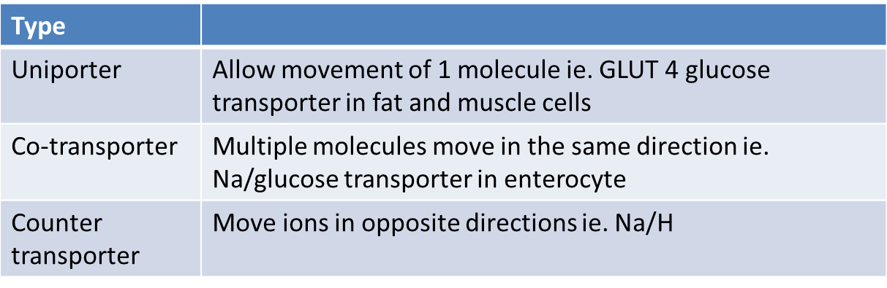
Transporters

Slide 6
Pumps
These proteins span the membrane and move ions/molecules against their electrochemical gradient by using ATP (active transport)
Example. Na/K Atpase pump. This moves 3 Na+ out of the cell in exchange for 2 K+ ions. 1 ATP molecule is exchanged for this.

Slide 7
Intracellular Communication
Neural Communication - Neurotransmitters across a synaptic junction ie. Ach
Endocrine Communication - Hormones and growth factors reach cells via the circulating blood ie. Cortisol
Paracrine Communication - Products of cells diffuse in the ECF to affect neighbouring cells ie. Insulin

Slide 8
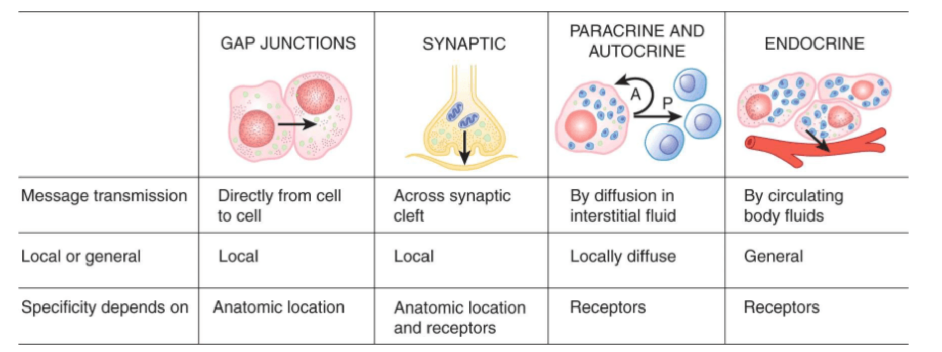
Intracellular Communication

Slide 9
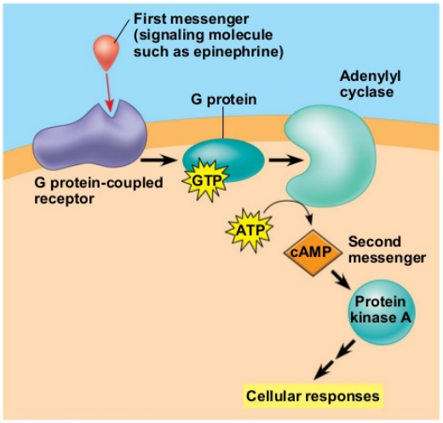
Second messenger systems
What happens once communication is initiated at the surface of a cell?
  These extracellular ligands are called FIRST MESSENGERS, and the intracellular mediators they trigger are called SECOND MESSENGERS
  Therefore an extracellular ligand binds to the external part of a receptor, causes a conformational change in internal part of the receptor, this then activates an enzyme which has further downstream effects (G protein activations, cAMP increase).

Slide 10
Second messenger systems
Type | Function
IP3 | the second messenger link between ligand binding and release of intracellular calcium stores form the ER (Endoplasmic reticulum)
G proteins (trans- membrane) | - G proteins break down GTP —> GDP and activating secondary intracellular messenger
cAMP | formed by cleaving ATP (used to mediate actions of adrenaline and other hormones)

Slide 11
Thank you

