Slide 1
Cardiac Physiology Pt 2
Pramod Chandru

Slide 2
Cardiac Physiology
Electrical Conducting System
  Spread of Excitation
  Understanding an ECG
  Revision of Electrical Potentials – pacemaker and action potentials
The Mechanical Pump
  The Cardiac Cycle
  Pressure and Volume Relationships
  Cardiac Output and Haemodynamic parameters
  Frank Starling Curves
The Vascular Plumbing
  Blood supply and anatomy

Slide 3
Viva Questions
What is cardiac output?
What factors determine cardiac output?
What methods can be used to measure cardiac output?

Slide 4
Cardiac Output
Cardiac output – the quantity of blood pumped into the aorta each minute by the heart (normal value = 5L/min)
Stroke volume = 70 – 90mL
Venous return – the quantity of blood flowing from the veins into the right atrium each minute (must equal cardiac output)
Cardiac index – Cardiac output increases proportionally in relation to the surface area of the body – cardiac index is cardiac output per square meter of BSA (3.2L/min/m2)

Slide 5
Cardiac Output:
CO = HR x SV
How to measure it:
  Echocardiogram + Doppler flow
  Fick’s method:
    Principle: amount of substance taken up by an organ = (the amount of substance in arterial blood – amount of substance in venous blood) X blood flow when the artery is the sole source of the substance
  Indicator dilution method:
    Known amount of substance is injected into a vein and serial measurements are taken from an artery. Cardiac output is measured by measuring the amount injected divided by the concentration in the arterial blood after a single circulation time e.g. thermodilution

Slide 6
Cardiac Output
Factors controlling CONTRACTILITY
  Increase: anxiety, pregnancy, high external temperature, adrenaline
  Decrease: heart disease, arrhythmias, changes in posture
Cardiac output is also controlled by
Venous return PRELOAD
  Venous return to the heart is the sum of all local blood flow through all tissue segments (effects stroke volume)
  Also inversely related to the blood pressure (AFTERLOAD)
  Related to direct contractility of the heart
  AFTERLOAD
  Outflow obstruction (AS, HCM)
  HTN

Slide 7
Viva Questions
Please draw the Frank Starling Curve
What factors influence myocardial contractility
How do changes in myocardial contractility alter the relationship between end diastolic volume and stroke volume

Slide 8
Frank Starling Mechanism
Frank Starling Law:
  Increased quantity of blood stretches the walls of the heart chambers, as a result of this stretch the cardiac muscle contracts with increased force (improved mechanical advantage between actin and myosin fibres)
  Stretching of the RA also has an indirect stimulatory effect on the SA node and causes and rise in HR –Bainbridge reflex
  Synchronisation of increased VR with increased CO
  Only three things that will effect the stroke volume – PRELOAD, AFTERLOAD AND CONTRACTILITY

Slide 9
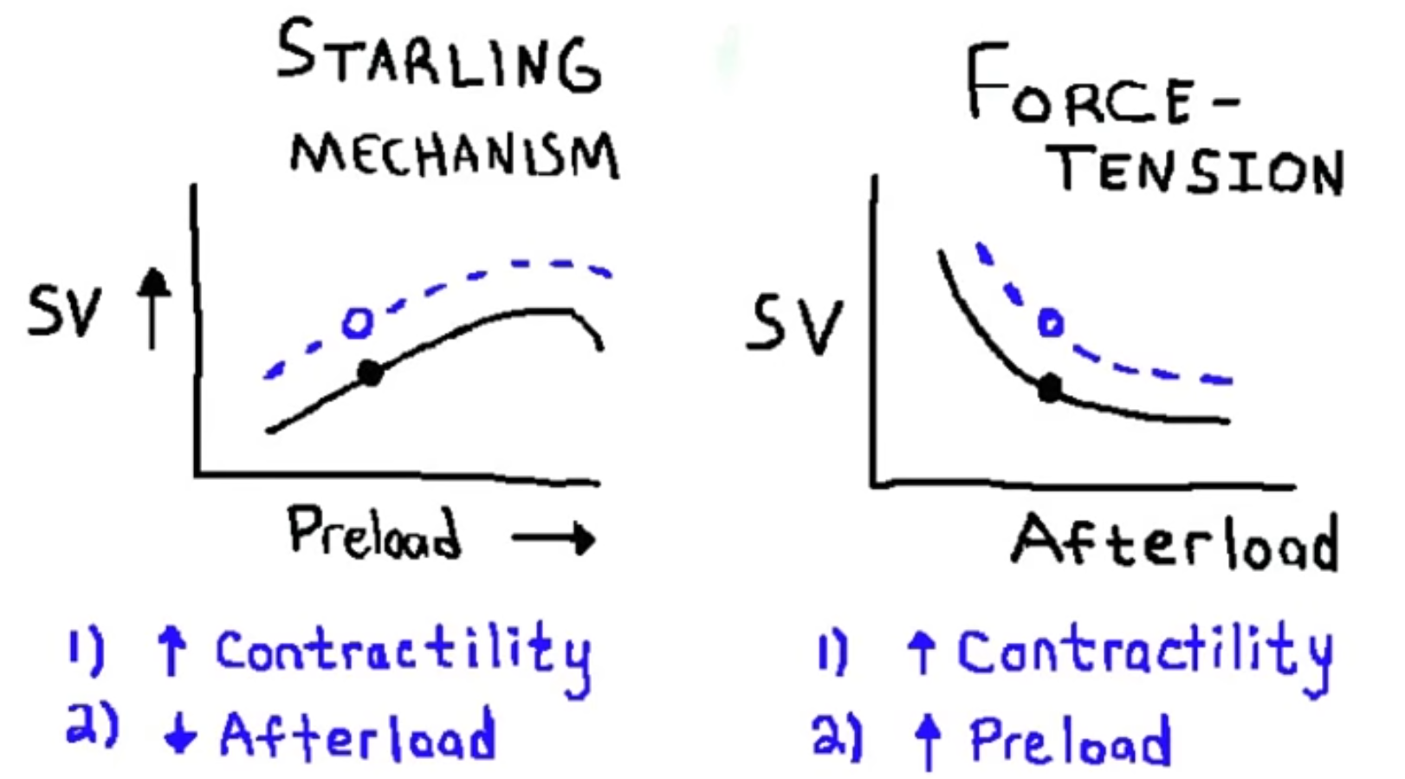

Slide 10
Force tension curve – afterload and SV are inversely related
Aside from afterload and preload there is one more variable that can effect cardiac output/stroke volume and that is contractility (see previous curve) – through β1 stimulation
CO = HR x SV
  SV → Preload + Afterload + Contractility

Slide 11
Preload
Preload is determined by
  Venous return
  Heart rate
  Atrial contraction
  Atrial and ventricular pressures during diastole
  Compliance of the ventricle
It is the LV wall stress at End Diastole
Wall stress = (Pressure x Radius)/2 x Wall thickness
  The wall stress is a force exerted over a given area stretching the wall apart.
  Directly proportional to radius and this stress increases as an aneurysm increases in size

Slide 12
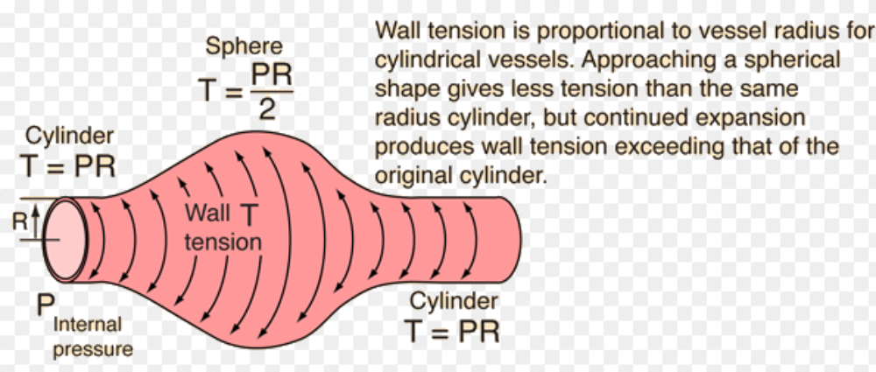
Wall thickness not taken into consideration here*

Slide 13
Afterload
Afterload is determined by:
  SVR
  Aortic compliance
  Wall thickness
  Chamber radius
  Ventricular size
  Ventricular volume
Definition afterload: LV wall stress during systole
This can be calculated using La Place’s law – however this will only be calculated at a single point in time – but afterload is over a period of time
So how do you calculate afterload for a patient?
  (P x R)/2 x W → Wall tension divided by wall thickness
  Assume W (wall thickness) to be unchanged over time
  The R is a cube root and so can be ignored
  So they look at only the pressure – and so they assume that wall stress is proportional to pressure, and therefore afterload is proportional to pressure during ejection
  Pressure during ejection in LV is equal to pressure in aorta which is equal to blood pressure

Slide 14
Contractility
Contractility is determined by
  Muscle properties
    Substrate supply, integrity of myofilaments
    Metabolic and electrolyte homeostasis: ie. hypoxia, severe metabolic acidosis and hypercarbia will reduce contractility
    Functional muscle mass
  Vascular properties
    Coronary blood flow
  Neural properties:
    Autonomic tone
    Hormones

Slide 15
Viva Questions
Please draw and label a diagram of the jugular venous pressure wave.
Explain the fluctuations in this wave.
How does the ECG relate to the jugular venous pressure wave.

Slide 16
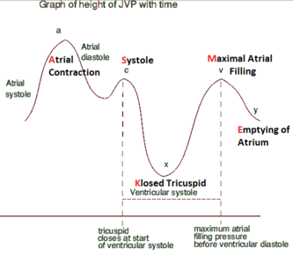
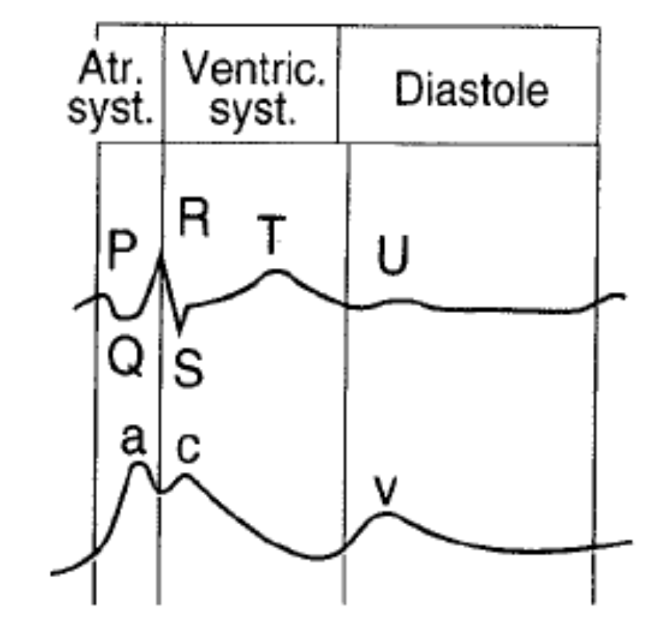

Slide 17
Clinical Correlations
JVP waves
  A wave – atrial systole, vein back flow into great veins
  C wave – tricuspid valve bulge back into atrium during isovolumetric contraction
  V wave – rise in atrial pressure just before tricuspid valve opens.
  X descent - increased atrial volume as tricuspid valve pulled distally during systole
  Y descent - emptying of the atrium after tricuspid opening during diastole

Slide 18
Heart sounds
  S1 – closure of AV valves
  S2 – closure of aortic and pulmonary valves
  S3 – heard 1/3 of way through diastole – thought to be due to rapid ventricular filling
  S4 – heard just prior to S1, when atrial pressure is high or ventricles are stiff, rarely heard in normal adults
Expiration – aortic and pulmonary close together. During inspiration there is lower pressure in the pulmonary vasculature so pulm valve closes later.

