Slide 1
Anti - arrhythmicS
Westmead Primary Teaching

Slide 2
2015 viva – Draw and label the membrane potential of normal pacemaker tissue.
2015 viva – What mechanisms can tachyarrythmias be generated?

Slide 3
Cardiac action potential
Physiology

Slide 4
Cardiac pacemaker potential
Text

Slide 5
cardiac conduction system
Text
SA node
AV bundles
AV node - slows conduction, allowing the atria to contract prior to ventricular contraction
His - Purkinje system - depolarisation starts at the endocardial surface of the apex and ends at the epicardial surface near the base of the ventricles
Arrythmias occur when there is a deviation from this conduction path
Can occur due to:
  Site of origin
  Rate or regularity of impulse
  Conduction

Slide 6
Arrythmias
Text
  Disturbances in impulse formation at the site of origin or rate and regularity of impulse formation
    Increased pacemaker rate by either shortening the systolic interval or diastolic interval (The diastolic interval is most important).
    Abnormal pacemakers: Increased automaticity (AT, VT); Ectopics; Pacemaker failure
    Conduction delays: Heart blocks and Conduction blocks
    Re-entry loops (VT)
    Accessory pathways (WPW)
    After-depolarisations - abnormal depolarisations that occurs in phase 2, 3 or 4 of the cardiac cycle and disturb the conduction
      Early after-depolarisations
      Delayed after-depolarisations

Slide 7
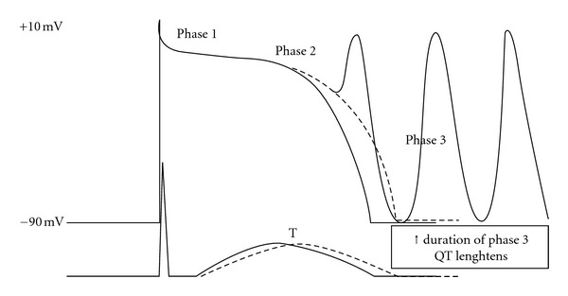
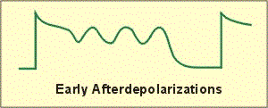
EAD – Early After depolarisation
Text
Depolarization that occurs early and during late phase 2 (Ca channels) or 3 (K channels).
Mediated by prolonged action potential duration (APD) ie. QT prolongation. This increases the relative refractory period too.
Cause Torsades and are potentiated by type III antiarrythmics and hypokalemia
Drugs that decrease APD (ie. Lignocaine) can counteract this.

Slide 8
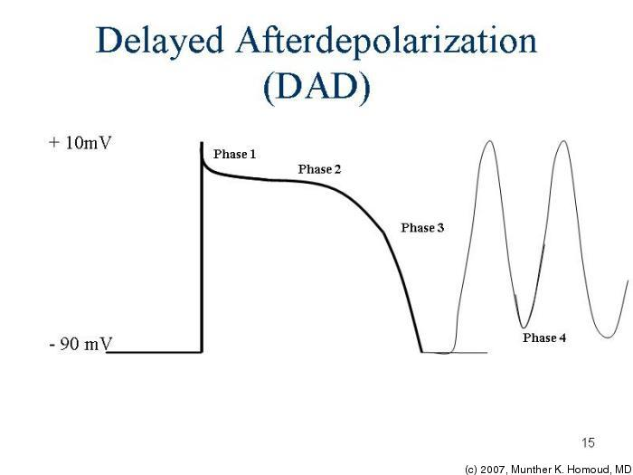
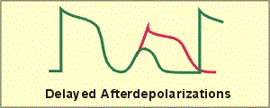
DAD – Delayed after depolarisation
Text
Occur in phase 3 and early 4 (before another AP starts)
Associated with intracellular hypercalcemia (Dig toxicity) and excessive catecholamines
      Excess calcium is excreted by the 3Na/Ca transporter - this causes a net inward current of Na which triggers a depolarisation and causes the bidirectional VT seen in Digoxin toxicity
Causes tachyarrythmias

Slide 9
ARrythmias
Text
Disturbances in impulse conduction
  Severely depressed conduction - conductions block (AV blocks, BBB)
  Reentry circuits - reentrance of an electrical stimulus which excites a part of the heart that has already been excited
    Need 3 conditions
      Obstacle to homogenous conduction
      Unidirectional block
      Conduction time around the circuit must be long enough that the retrograde impulse does not enter refractory tissue
    Drugs that abolish re-entry act by further depressing the current and causing a bidirectional block

Slide 10
ANTI ARRYTHMIC AGENTS
Pharmacology
Aim of therapy is to reduce ectopic pacemaker activity and rectify conduction or increase refractoriness in reentry circuits to disable circus movements.
4 Major mechanisms
  Na Channel blockade (Class I)
  Sympathetic blockade of the heart (Class II)
  Prolongation of the effective refractory period (Class III)
  Calcium channel blockade (Class IV)

Slide 11
Describe the mechanism of action of lignocaine on the heart. What features distinguish lignocaine from other Class 1 antiarrythmics?
What is flecanide’s MOA? Describe flecanide’s pharmacokinetics.

Slide 12
Anti arrhythmic agents - class 1 agents
Text
Sodium Channel blocking agents - the different subclasses reflect the effects on the action potential duration and the kinetics of Na channel blockade
  Class 1a - prolong the APD and dissociate from the channel the intermediate kinetics
  Class 1b shorten the APD and dissociate with rapid kinetics
  Class 1c have minimal effects on the APD and dissociate with slow kinetics
Block fast depolarisation (phase 0) in cardiac action potentials - this type of AP is found in NON-NODAL cardiac myocytes
Because phase 0 is dependent on Na entry, blocking these channels will decrease the slope of phase 0 which also leads to a decrease in the amplitude of the AP (recall that nodal tissue phase 0 is negotiated by Ca channels and so there is no effect on nodal tissue with Na channel blockers)
The principle effect of all of this is that there is a decrease in the conduction velocity in non-nodal tissue - this depressed conduction can be useful in controlling re-entry mechanisms

Slide 13
Class 1 agents
Text
The difference between 1a/b/c agents lies in their ability to alter action potential duration (APD) and effective refractory period (ERP) - this is done by their variable effect on K channels.
The different subclasses also effect Na channels with varying efficacy
  Na channel blockade 1C > 1A > 1B
  ERP: 1A > 1C > 1B
Increasing ERP will increase the duration that a normal tissue is unexcitable (its refractory period) - this can prevent re-entry currents from re-exciting tissue. Increasing APD can precipitate torsades.

Slide 14
class 1 agents
Text

Slide 15
Na Class 1A
Text
Procanamide - 1A
  Slows the upstroke of phase 0, slows conduction and prolongs the QRS
  Direct depression on SA and AV nodes
    Extracardiac effects: ganglion blocking properties > reduced PVR —> Hypotension
  Pharmacokinetics:
    A: IV or IM
    D: Low Vd ~140L
    M: Important metabolite NAPA has class 3 action (can cause torsades.). Eliminated hepatically to NAPA which is then renal excreted
    Renally excreted —> dose adjustment required
  Clinical use: Most atrial and ventricular arrythmia
  Toxicity: Lupus like effect in up to 30% of users, n/v/d, rash, fever, excessive AP prolongation —> torsades

Slide 16
Na Class 1b
Text
Lidocaine - 1B
  Low incidence of toxicity
  High degree of efficacy for arrhythmias - especially those associated with AMI - blocks activated and inactivated channels with rapid kinetics - the inactivated cell block ensures greater effect on cells with longer refractory periods (Purkinje fibers) and ventricular cells - NO EFFECT ON AV AND SA NODE CONDUCTION
    Pharmacokinetics:
      A: IV administration preferred - only 3% bioavailability with oral preparations, and extensive first pass metabolism
      D: Vd ~70L but may be effected by conditions such as shock and heart failure
      M: Hepatic. Half life of 1 - 2 hours - therefore drugs that decrease liver blood flow (propranolol) will markedly increase systemic levels (High extraction ratio)
      E: GIT
    Clinical use: VT and VF, no evidence for use in prophylaxis
    Toxicity:
      Cardiac - minimal - SA arrest, Ventricular arrhythmias
      Extra cardiac - Neurological - parasthesia, tremor, n/v, tinnitus, slurred speech

Slide 17
Na class 1c
Text
Flecanide 1C agent
  Potent blocker of Na and K channels with slow unblocking kinetics
  For use in patients with an otherwise normal heart who have a supreventrivcular arrhythmia (AF)
  Pharmacokinetics:
    A: Good PO Absorption
    D: Well distributed. Vd ~540L
    M: Hepatic
    E: Renal and Hepatic clearance
  Toxicity: may cause exacerbation of arrhythmias, esp. VT and VF in patients with pre existing VT and those with previous AMI
  - Contraindicated in people with structural heart disease – increased risk of sudden death

Slide 18
Class II agents - beta blockers
Text
Have anti arrythmic properties by virtue of their beta receptor blocking action and direct membrane effects
Good evidence that these agents can prevent recurrent infarction and sudden death in patient recovering from AMI

Slide 19
Viva questions
What are the effects of amiodarone on the heart? What other arrythmias is amiodarone used for? What arrhythmias may amiodarone cause?
Describe the pharmacodymamics of sotalol. List the main side effects
What drug interactions with sotalol prolong the QT?

Slide 20
Class III anti arrhythmic
Text
Prolong refractory period of the AP by blocking K Channel re entry
Action prolongation of these drugs demonstrates REVERSE USE DEPENDENCE - where the AP prolongation is least marked at fast rates and more marked at slow rates - and so it contributes to torsades

Slide 21
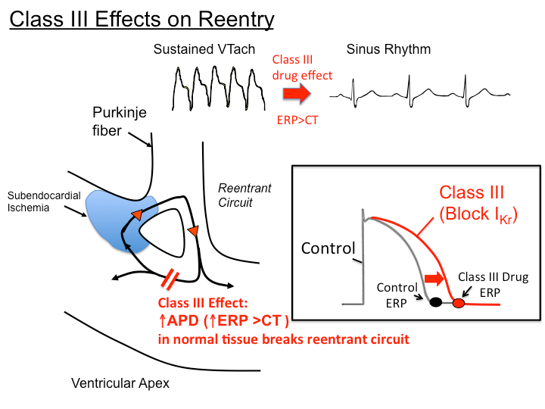
Text

Slide 22
Text
Amiodarone
  Markedly prolongs the action potential duration (and the QT interval) by blockade of rapidly inward rectifying potassium channel
  AP is prolonged over a wide range of heart rates and demonstrates reverse use dependence
  Also has weak Class II and Class IV properties - this may explain slowing of heart rate and AV nodal conduction
  Pharmacokinetics:
    A: Bioavailability between 35 - 60%
    D: Large volume of distribution 50 – 150L/kg
    M: Hepatic metabolism with active metabolite
    E: Elimination half life is complex -
      Rapid component (3 - 10 days for 50%)
      Slower component over several weeks
      Following discontinuation, drug effects continue for 1 - 3 months (100 days)
  Drug interactions - substrate of CYP34A and its levels are increased by drugs that inhibit this enzyme (cimetidine) and drugs that induce the enzyme decrease substrate levels when co administered. Amioderone may also inhibit other liver metabolising enzymes and result in high levels of substrates for these enzymes - Digoxin

Slide 23
Text
Therapeutic uses:
  Low doses to maintain sinus rhythm in patients with AF
  Recurrent VT
  Not associated with increased mortality in patients with IHD and CHF
  Can be used as adjutant therapy to decrease AICD firing rate
Toxicity:
  Cardiac - symptomatic bradycardia and HB
  Extra cardiac - Accumulates in many tissues (heart, lung, liver, skin); Dose related pulmonary toxicity - fatal fibrosis in 1% of patients
  Blocks peripheral conversion of T4 to T3 and is also a large source of inorganic iodine so may result in hyper or hypothyroidism

Slide 24
Text
Sotalol -
  Has both Class II and Class III properties
  Racemic mixture - beta blocking properties reside in L isomer, D and L isomers are responsible for the AP prolongation properties
  NOT cardio selective
  Pharmacokinetics:
    A: PO bioavailibility of around 100%
    D: Vd 1.6-2.5L/kg
    M: NOT metabolised in liver or bound to plasma proteins . Half life 8 hours
    E: Predominantly renal in UNCHANGED form (75%)

Slide 25
Viva questions
Describe the effects of verapamil on the heart.
What are the indications for verapamil?
Name some clinical adverse effects

Slide 26
Class IV Anti arrythmics
Text
Verapamil
  Blocks both activated and in activated L type calcium channels - and so more marked in tissues that fire rapidly (SA and AV node) - AV node conduction time and refractory period are invariably prolonged by therapeutic considerations
  Extracardiac effects: Peripheral vasodilation
  Pharmacokinetics:
    A: PO bioavailability is around 20% - administer in caution in hepatic dysfunction
    D: Vd – 2.5 – 6.5kg/L 90% protein bound
    M: Extensively metabolised in the liver. Half life of single dose 6 hours
    E: Renal 70% and GIT 15%
  Therapeutic use: SVT is the main arrhythmia
    Toxicity: Cardiac arrest - most common issue is administering it to patents in VT mistaking it for AF
      Extra cardiac: Constipation, lassitude, nervousness

Slide 27
Viva questions
What are the indications for adenosine use? How does it work? How do the specific pharmacokinetic properties of adenosine influence the method of administration?

Slide 28
Miscellaneous anti arrythmics
Text
Adenosine:
  Activation of inward rectifier potassium channels and inhibition of calcium current
  Causes marked HYPERpolarisation and suppression of calcium dependent action potentials - inhibits AV nodal conduction and increases AV nodal refractory period
  Pharmacokinetics:
    A: IV
    D: Low Vd. Absorbed by most cells.
    M: Metabolised by RBC esterases
    E: Very short half life (< 10 seconds)
  Less effective in presence of adenosine receptor blocking agents such as theophylline or caffeine
  Toxicity causes flushing, SOB, sense of doom

Slide 29
Miscellaneous
Text
Magnesium
  Infusion has been found to have antiarrythmic properties even in patients with normal magnesium
  Indicated in patients with digoxin induced arrhythmia IF hypomag. is present
  Used in torsades (5mmol over 10 minutes)
  Usual dose in 1g
Potassium
  Increasing serum K causes:
    Resting potential depolarisation action
    Membrane potential stabilising action
  Hypokalemia - increases risk of early and delayed after depolarisations and ectopic pacemaker activity (esp. in presence of digoxin)
  Hyperkalemia depresses ectopic pacemakers and slows conduction

Slide 30
Cardiac glycosides
Text
Digoxin is the prototype
Pharmacokinetics
  A: 65 - 80% absorbed after PO administration
  D: Widely distributed with highest conc. heart, liver and kidney. 20 – 40% protein bound
  M: Not extensively metabolised. Half life: 40 hours
  E: 2/3rds excreted by kidney unchanged - renal clearance is proportional to Cr clearance - dose adjustment is necessary
Pharmacodynamics:
  Has both direct and indirect cardiac effects
  At the molecular level - inhibition of the Na/K ATPase is crucial
  CARDIAC EFFECTS:
    Mechanical effets: increases contraction by increasing intracellular free Ca - blocking Na/K ATPase —> increases intracellular Na —> decreases expulsion of Ca via Na/Ca transporter —> increased intracellular Ca
    Electrical effects: Decreases SA node firing, decreases conduction velocity in AV node, decreased refractory period for atrial muscle, increase PR and decrease QT interval

Slide 31
Viva Questions
What is digoxin’s MOA in heart failure?
Why are patients in heart failure prone to digoxin toxicity?
What are the features of digoxin toxicity?

Slide 32
Text
At higher concentrations the RMP is reduced - this causes after depolarizations which appear following normally evoked potentials - when these afterpotentials reach threshold they cause ectopic beats
With further intoxication each after potential evoked AP will in itself generate more after potentials and so a self sustaining tachycardia develops
At low doses - cardio selective parasympathomimmetic effects predominate via central vagal stimulation
Effects on other organs:
  Affect all excitable tissue - including SM and CNS
  GI effects
    Anorexia, N/V/D
  CNS
    Disorientation, hallucinations, visual disturbances, aberrations of colour perception (Xanthopsia- yellowing)

Slide 33
Text
Interactions with K, Ca and Digoxin
K and Digoxin act in two ways
    Inhibit each others binding to Na/K, therefore: hyperkalemia reduces the effect of digoxin and hypokalemia increases
    Abnormal cardiac automaticity in inhibited by hyperkalemia
  Calcium ion facilitates the toxic actions of cardiac glycosides by accelerating the overloading of intracellular calcium stores - hypercalcemia therefore increases the risk of digoxin cardiac toxicity
  However no strong evidence for IV calcium causing “stone heart”

