Slide 1
Neck Trauma
Andrew Coggins
Emergency Physician
www.emergencypedia.com

Slide 2
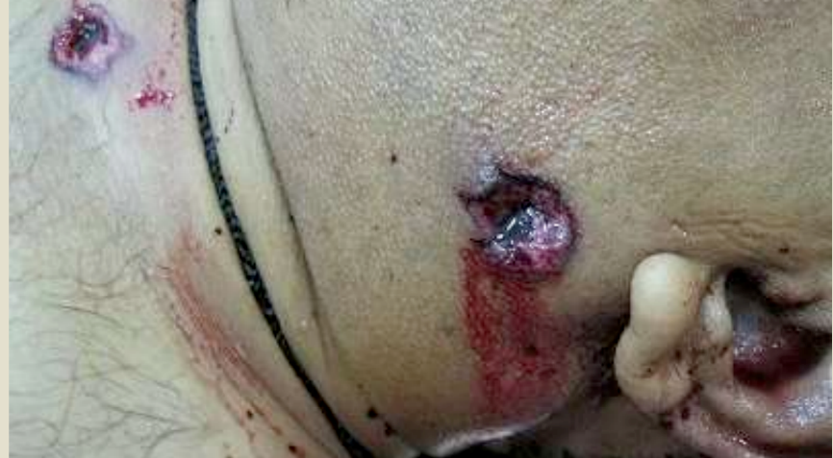
Penetrating

Slide 3
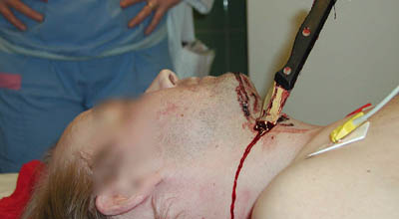
Penetrating

Slide 4
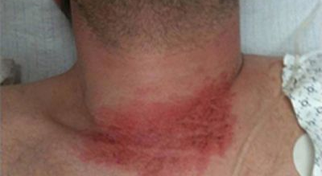
Blunt

Slide 5


Slide 6
37 year old man

Slide 7
BAT Phone
Handover

Slide 8

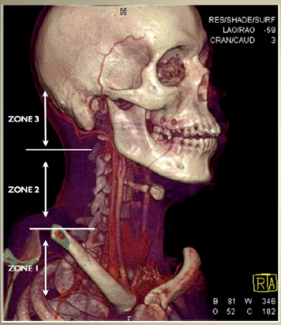
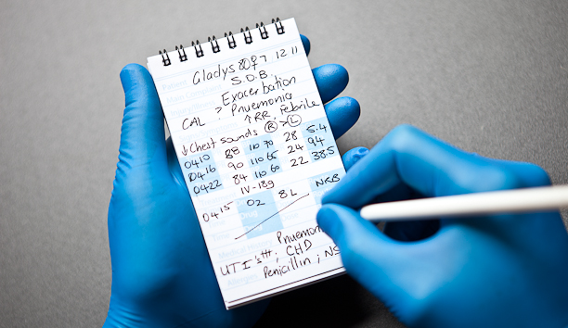

Slide 9
M – Stabbing to the ‘neck’

Slide 10
I – Single Stab wound to the left anterior neck

Slide 11
S - Swelling Left Neck, Bloody ooze with direct pressure, BP 100/50,
HR 125, Saturation 92 on O2
Resp. Rate 20
Nausea +

Slide 12
T - IVC, Morphine 5mg, Ondansetron 4mg,
500ml Hartmann’s

Slide 13
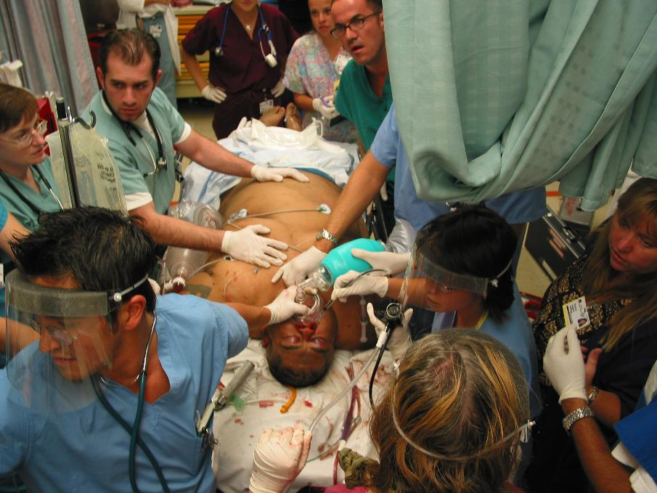

Slide 14

Preparation

Slide 15
P.A.E.D.S. Prep
People
  Brief Trauma Team
Equipment
  ETT, Dressings, Catheter
Area
  NUM to free Resuscitation Bay, Assemble Team
Drugs
  RSI, Analgesia, Antibiotics, ADT
Send for Help - 111
  Surgical, Vascular, Theatres, Blood Bank, Cardiothoracic

Slide 16
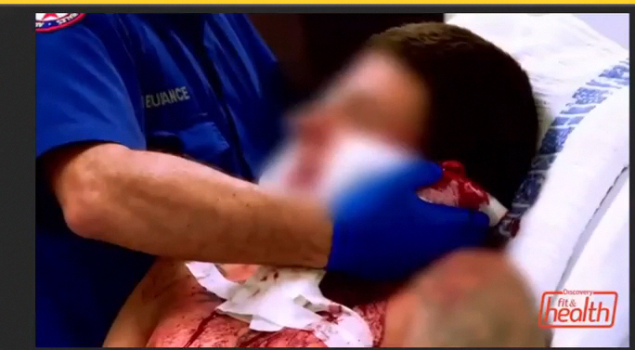

Slide 17


Slide 18
Patient Arrives
C-A.B.C.
A-E assessment
Stable or Unstable?
Superficial v Breach
How Many Wounds?
Where are the Wounds?
Hard Signs?
Soft Signs?

Slide 19
Penetrating Neck Trauma
Not frequently seen but can be an absolute disaster...
What is penetrating neck trauma?
  An injury that goes through the platysma muscle

Slide 20
Initial Approach
Control Hemorrhage
Direct Pressure
Primary

Slide 22
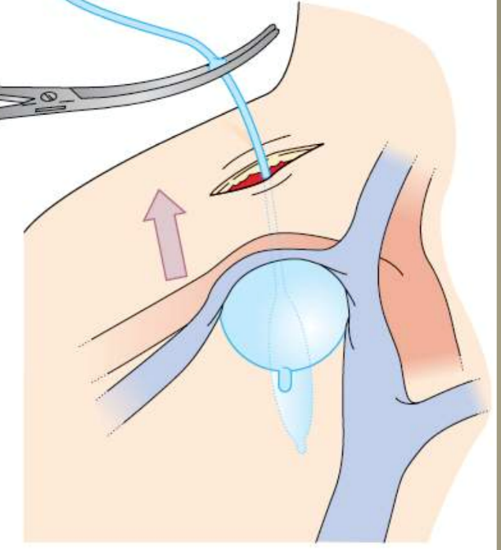

Slide 23
Primary Survey Issues
Airway
  Expectant
  Immediate
  Observe
C Spine
  Zone 1 Chest, Trachea etc.
  http://www.ncbi.nlm.nih.gov/pubmed/19934139
Neurological Signs

Slide 24
Airway
Mondavia et al:
  748 penetrating neck injuries
  11% needed emergent airway
Traditionally ¼ need Emergent Airway (USA)

Slide 25
Neck
Specific Issues

Slide 26
Specific Approach
Stability
Platysma
Zone
Hard Signs

Slide 27
Unstable
Theatre
Now
!

Slide 28
Stable
Zone
CT
Hard Signs

Slide 29
Location

Slide 30
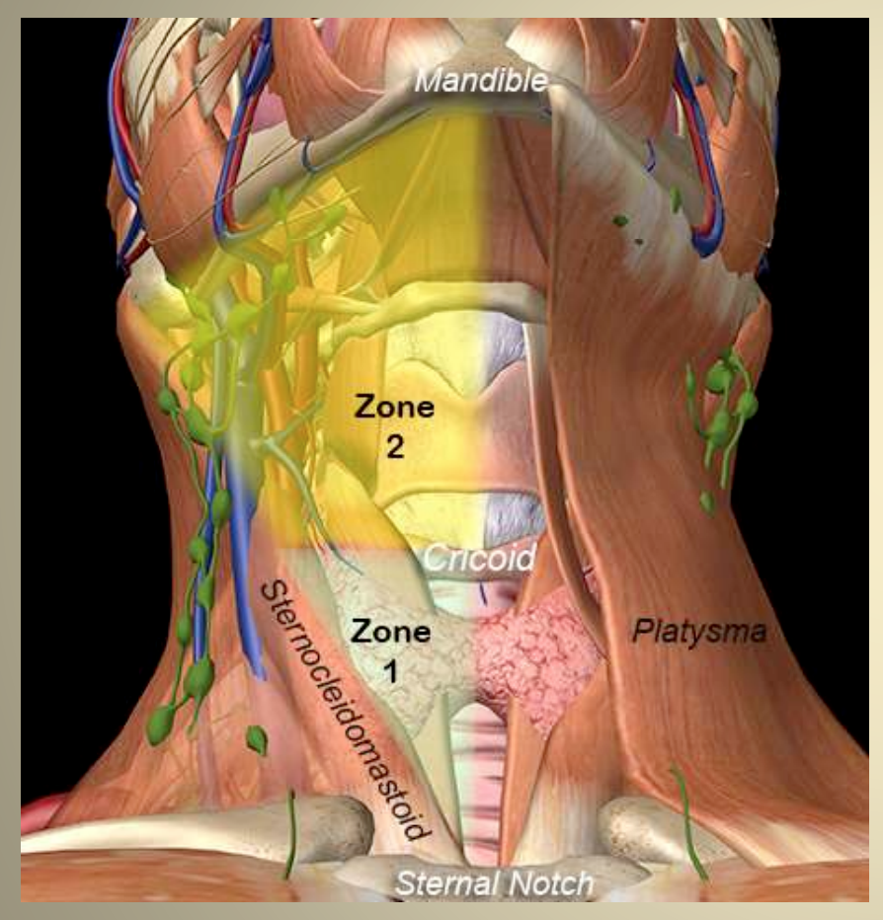

Slide 31
Zone III, II or I
Anterior v Posterior

Slide 32
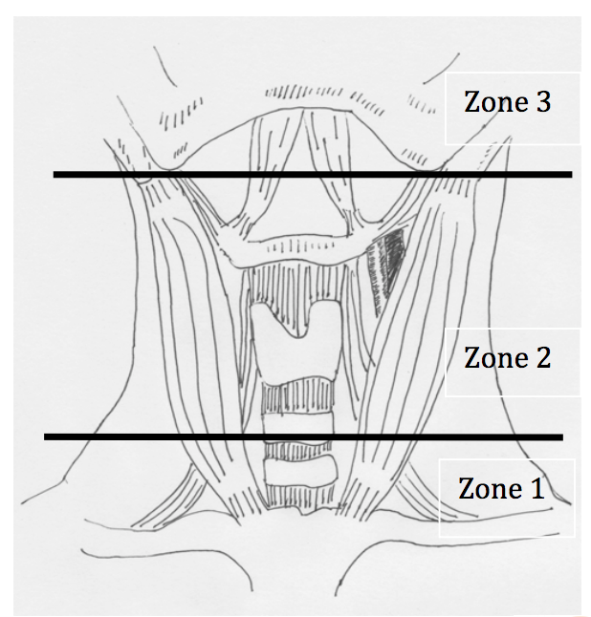
Zones I, II, III

Slide 33
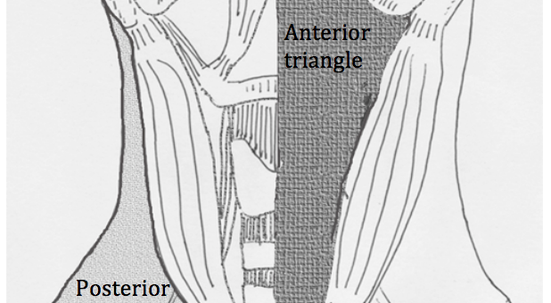
Anterior v Posterior

Slide 34
Zone 1
Chest
  Lungs
  Aorta
  Subclavian

Slide 35
Zone 2
Carotid
IJ
Trachea
Oesophagus
Sympathetic

Slide 36
Hard Signs

Slide 37
Massive Haemorrhage
Expanding hematoma
Thrill, Bruit, Absent Pulses
Haemothorax
Shock / On-going Bleeding
Stroke-like symptoms

Slide 38
Zone 3
Base of Skull
  C-spine / Vertebral Artery

Slide 39
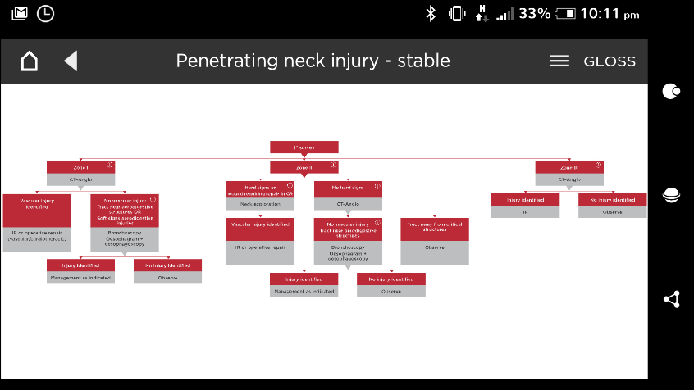
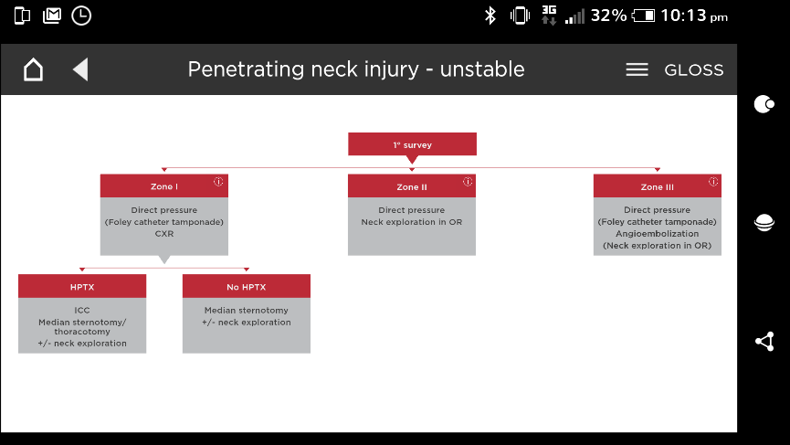
Local ‘app’ Algorithms

Slide 41
Soft Signs

Slide 42
CT Angiogram

Slide 43
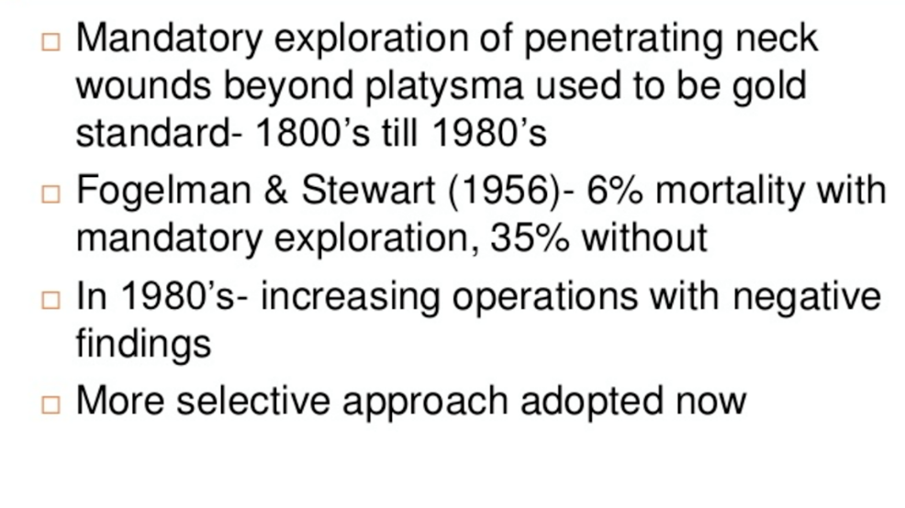

Slide 44
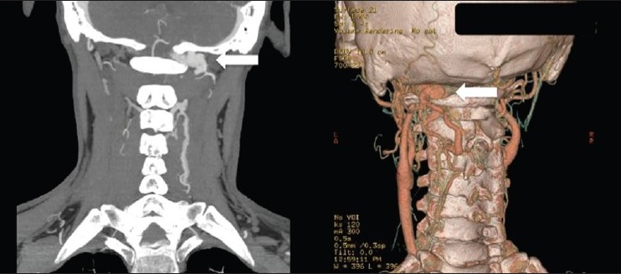

Slide 45
Blunt Cases

Slide 46
Examples
C1-C3 #
C Spine Subluxation
Vertebral Artery Injury
Hanging
Mandible Fracture

Slide 47
A 40 year-old man is brought to your tertiary ED after being found unconscious in a police watch-house cell.
It appears he hanged himself with a belt, tied to a ceiling beam

Slide 48
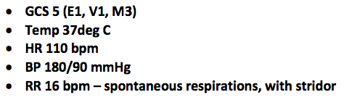
Ambulance Assessment

Slide 49
Ligature bruising / oedema around neck. Some ventilation assistance provided with bag/valve/mask device.
Hard cervical collar applied.

Slide 50
What are the issues?

Slide 51
Issues
Blunt Trauma
C Spine - ?Collar
Airway - Tracheal Injury, Hoarseness
  When should you intubate?
Neuro Exam – generally reliable to exclude (e.g. seat belt sign)
Carotid Injury
Vertebral Artery
Other Injuries

Slide 52
Take Homes
Unstable to Theatre
Control Haemorrhage
Intubate Judiciously
C spine
CT if Stable

