Slide 1
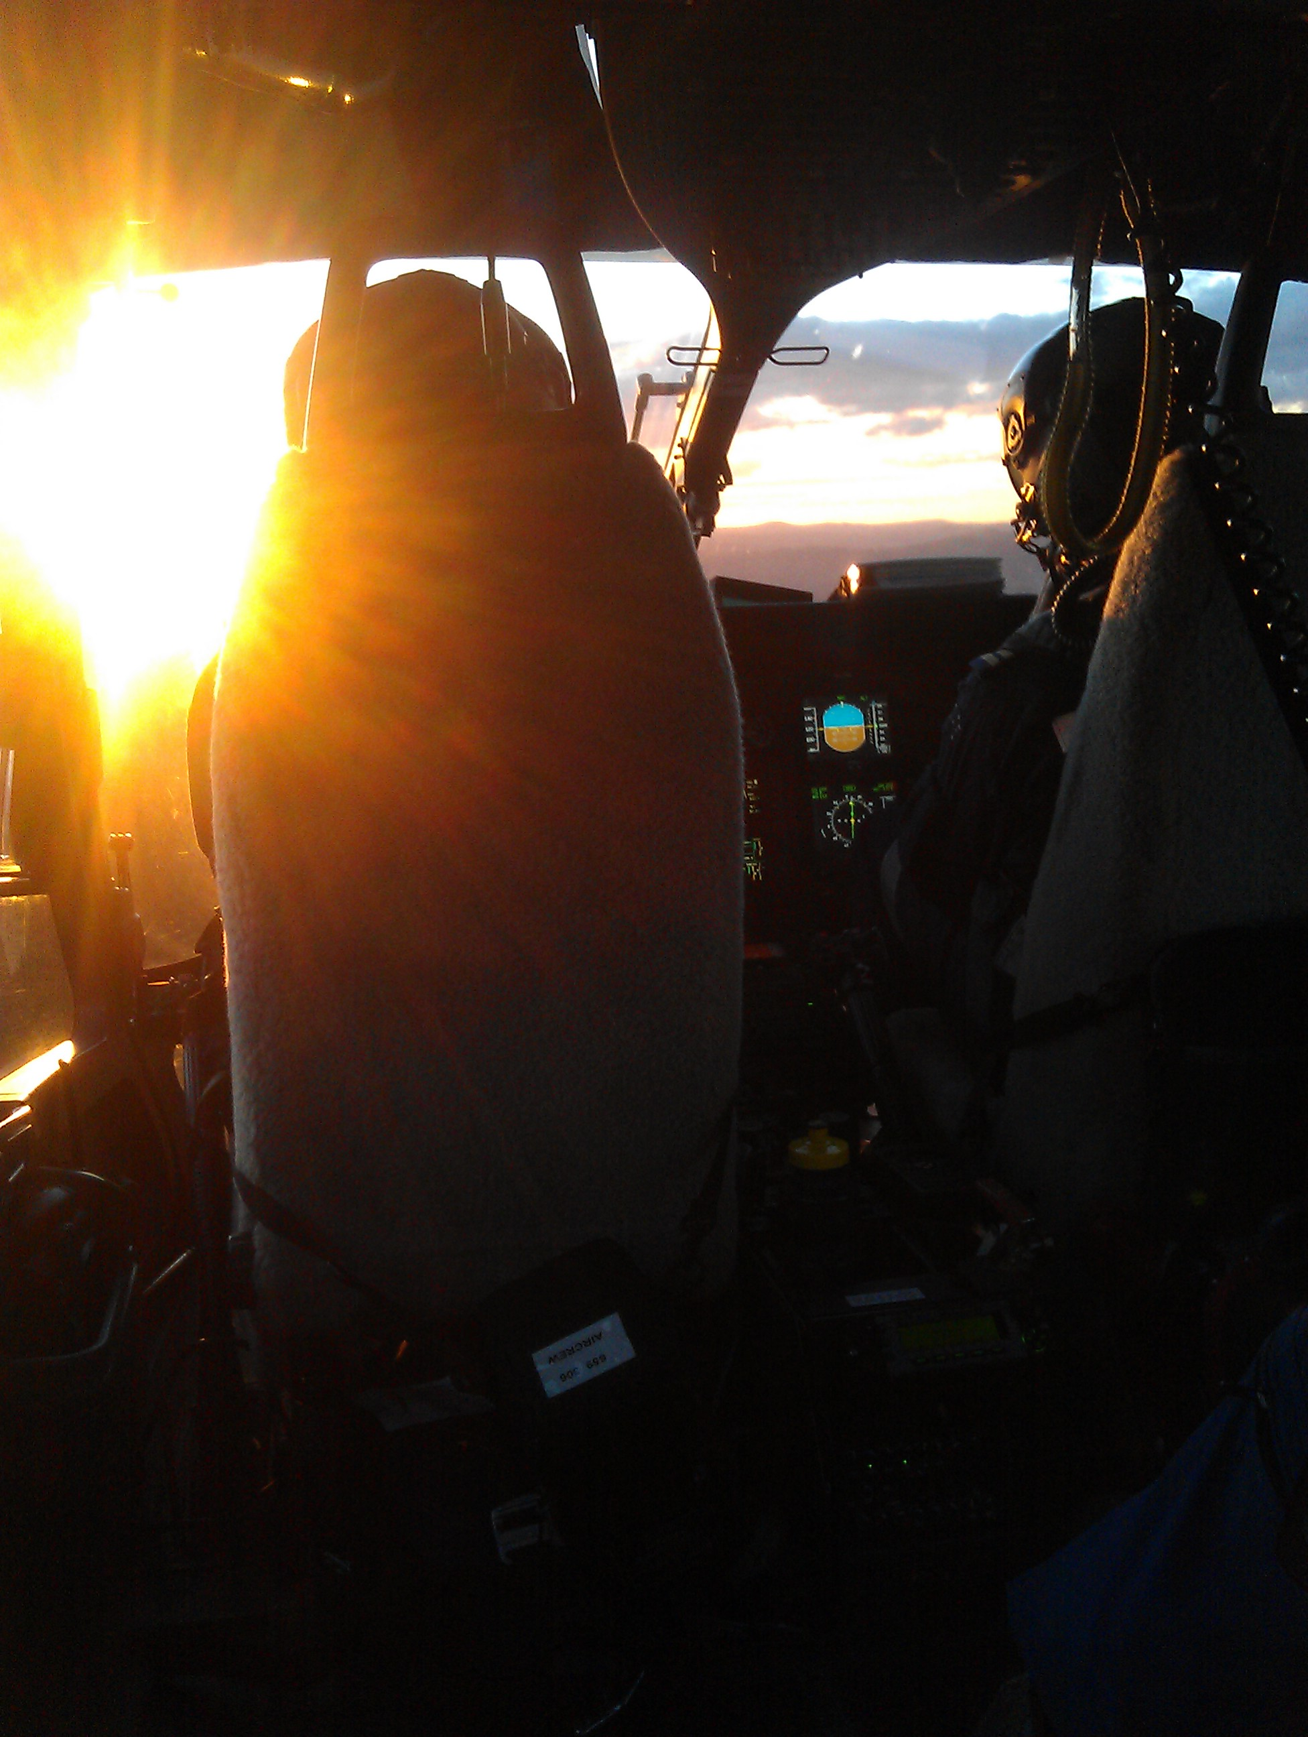
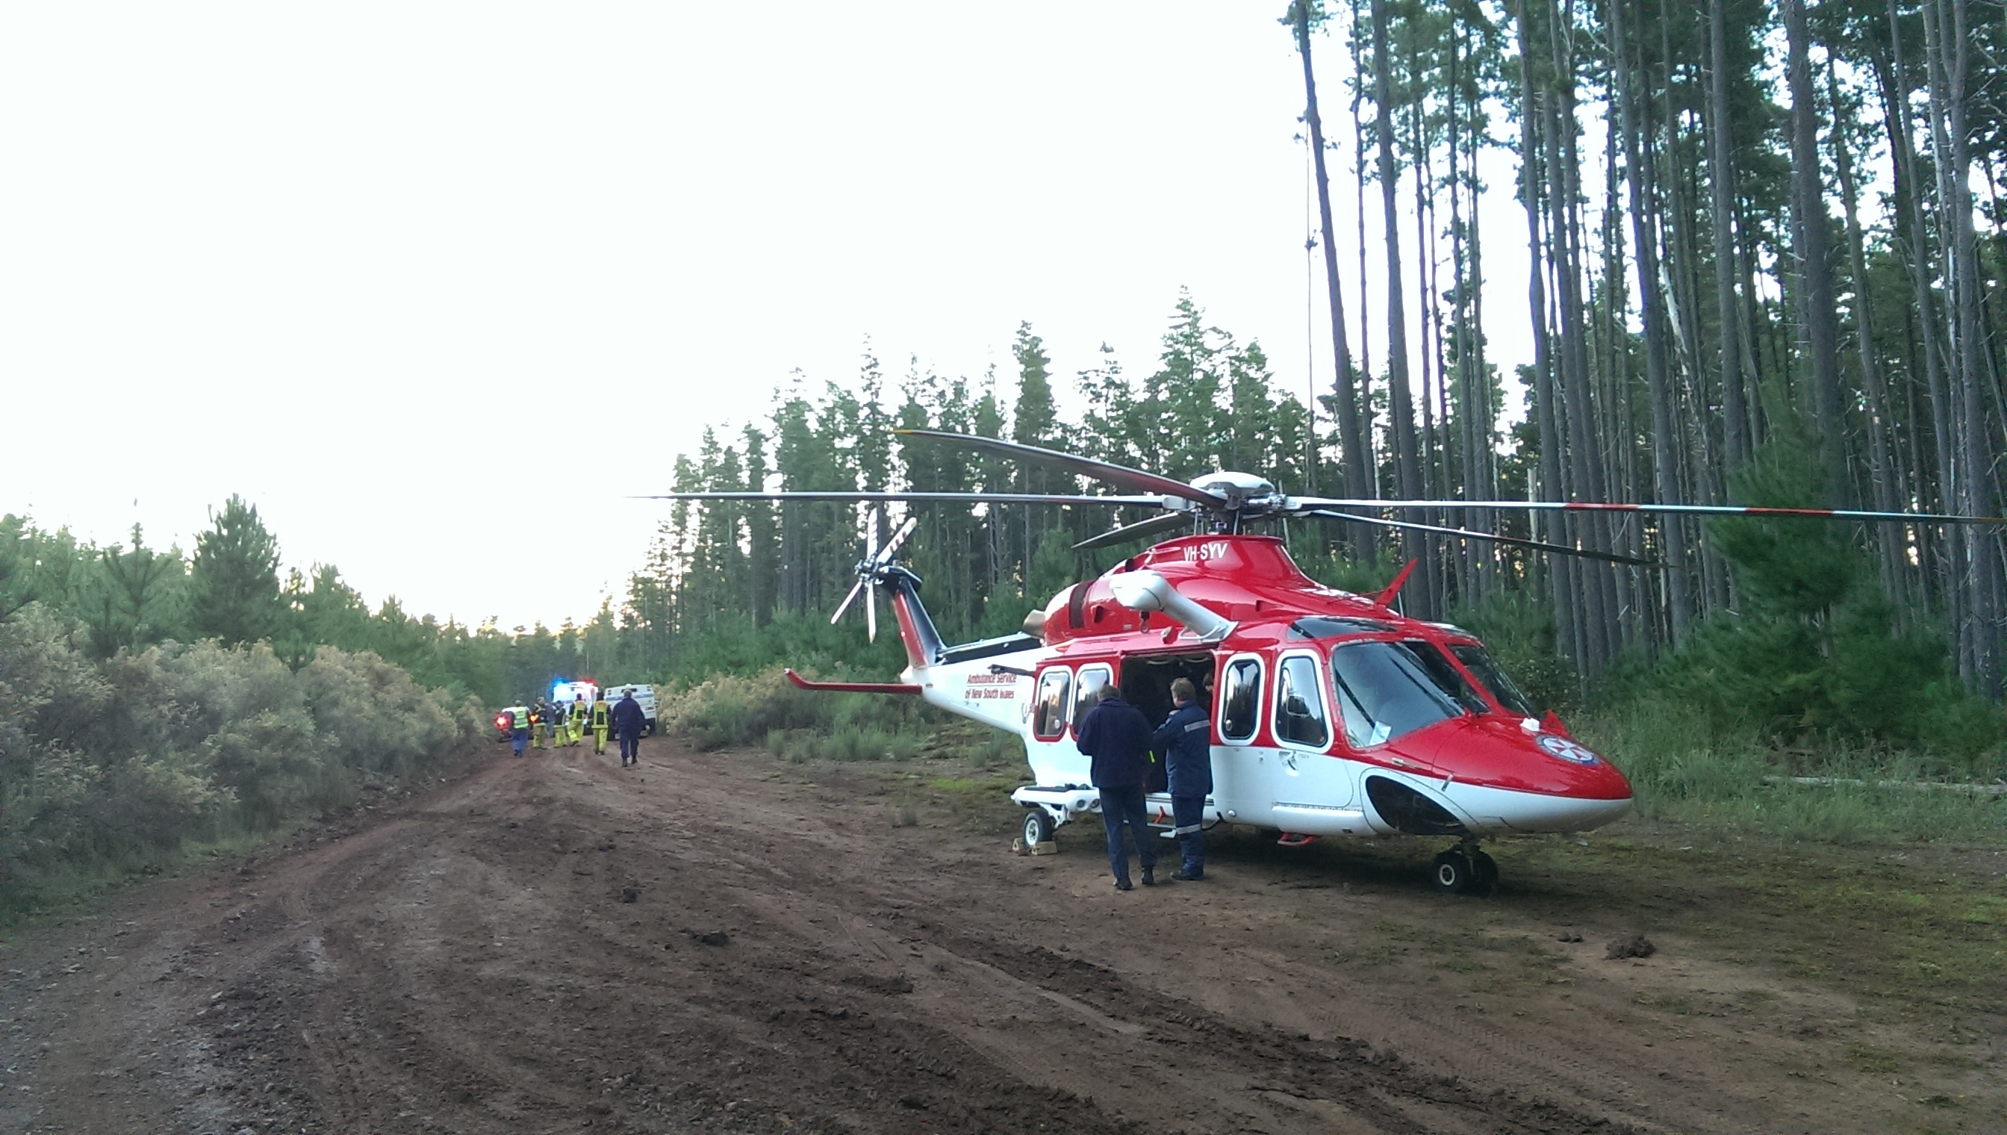
An Introduction to Retrieval Medicine and Scene Management - EMIG

Slide 2
What we will cover in 15 minutes
Overview of the Pre-hospital Environment
Scene Safety
Risk Assessment and Hazards
Typical NSW Scene
4 Phases of Scene Extrication
Take Home Points

Slide 3
Safety
Yourself
Others
Patients

Slide 4
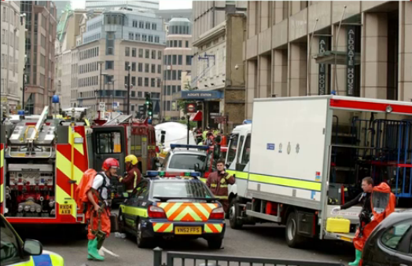

Slide 5
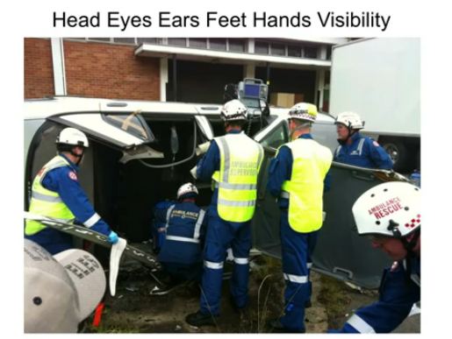
Notes:
Highly Visible
PPD is mandatory
Need to be compliant to avoid a fine of 1000s of dollars

Slide 6
Safety
Not entering a dangerous environment until it has been declared safe (if possible)
Wearing personal protective equipment
Being aware of and communicating dangers with team mates
Following instructions of police, fire, and ambulance scene commanders
Avoiding fatigue and distraction that decrease situational awareness.

Slide 7
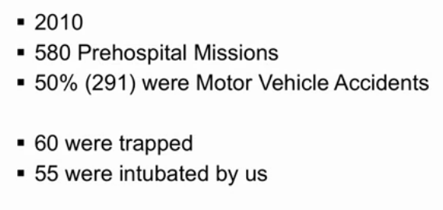
Retrieval and Rescues in NSW

Slide 8
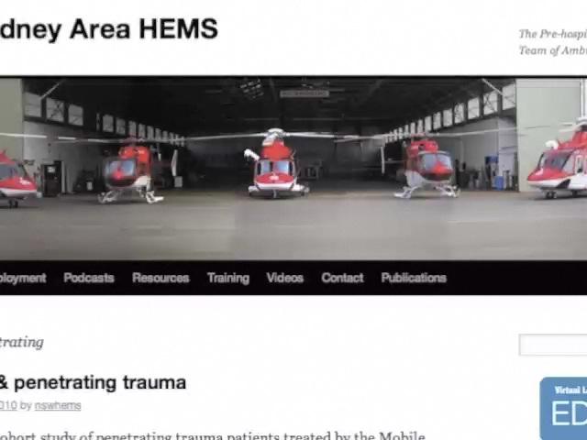

Slide 9
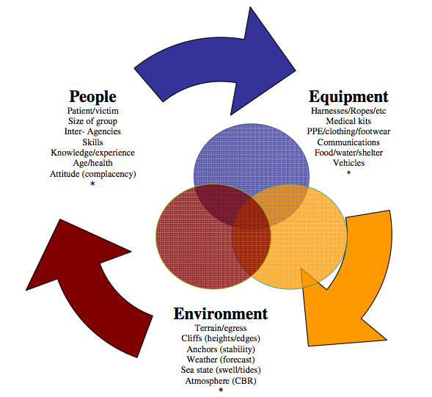
Hazards on the Scene of a Retrieval

Slide 10
Risk Assessment - People
Patient/victim
Size of group
Inter-Agencies
Skills
Knowledge/experience
Age/health
Attitude (complacency)

Slide 11
Risk Assessment - Environment
Terrain/egress Cliffs (heights/edges)
Anchors (stability)
Weather (forecast)
Sea state (swell/tides)
Atmosphere (CBRN)
Roads
Railway

Slide 12
Risk Assessment - Equipment
Harnesses/Ropes/etc
Medical kits
PPE/clothing/footwear
Communications
Food/water/shelter
Vehicles

Slide 13
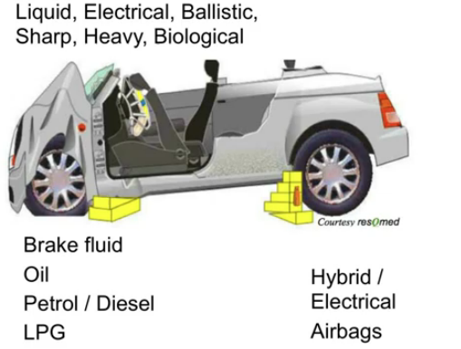

Slide 14
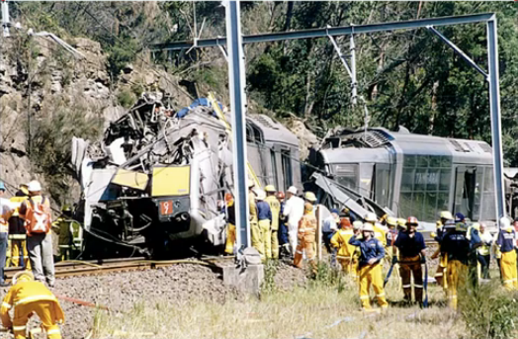
Case 1
What are the Hazards on this Scene

Slide 16
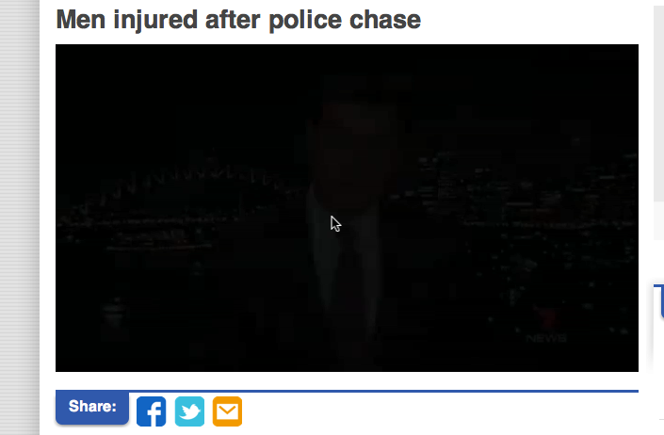
Case 2

Slide 17
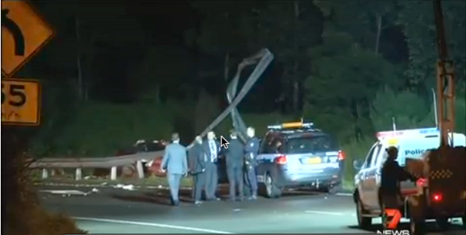
Case 2 – What are the potential dangers in this Scene??

Slide 18
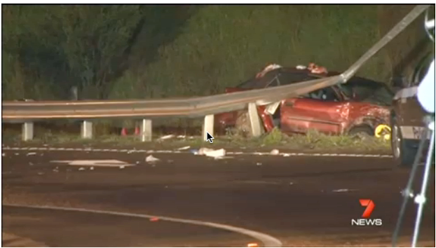

Slide 19
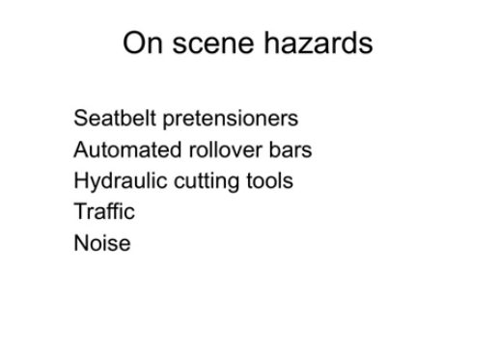

Slide 20
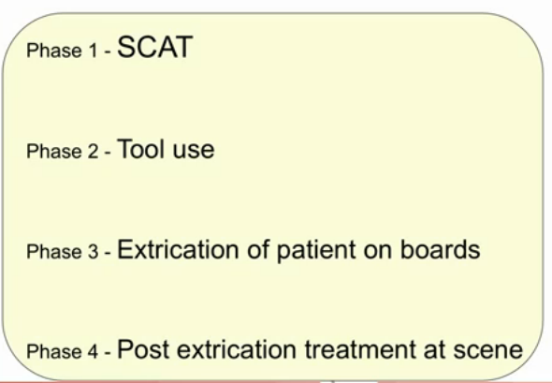
Extrication

Slide 21
SCAT
Safety
Command and Communication
Assessment
Triage, Treatment and Transport

Slide 22
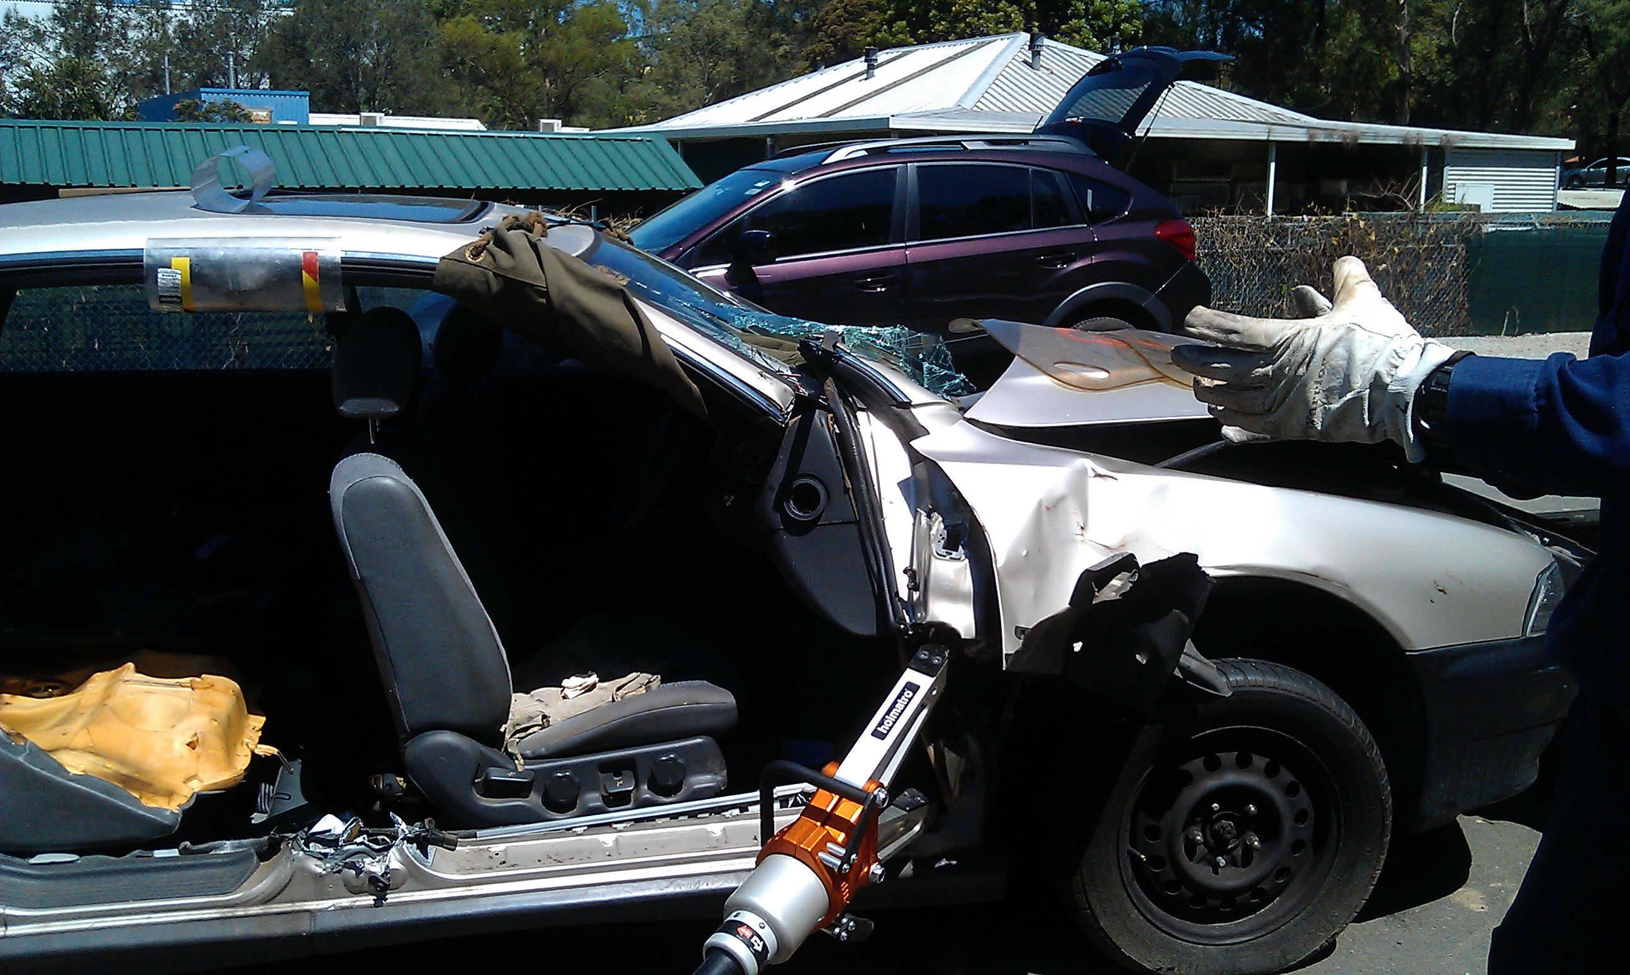
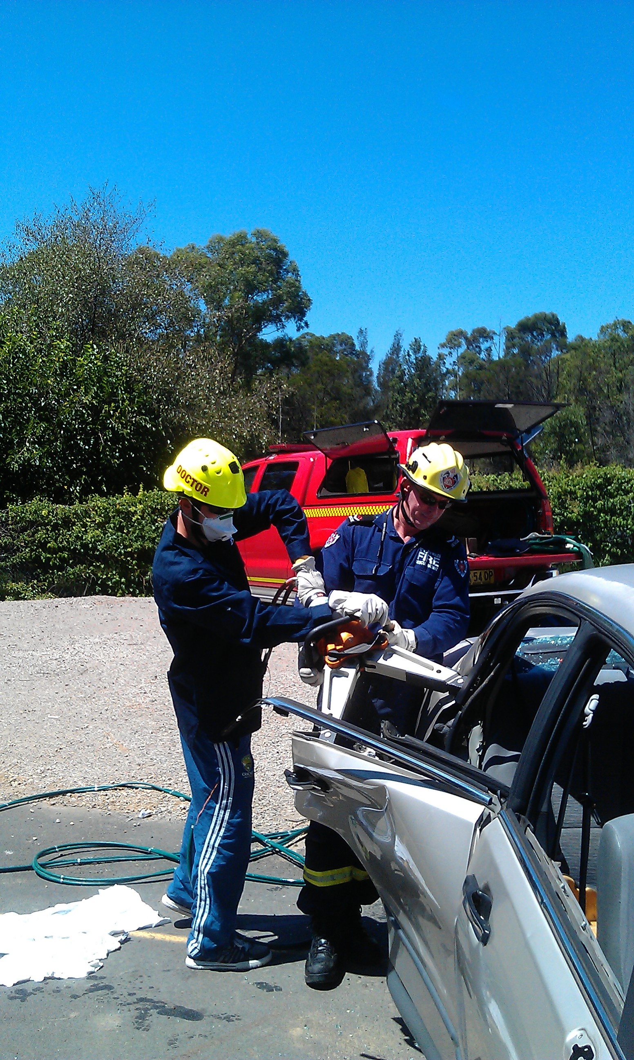
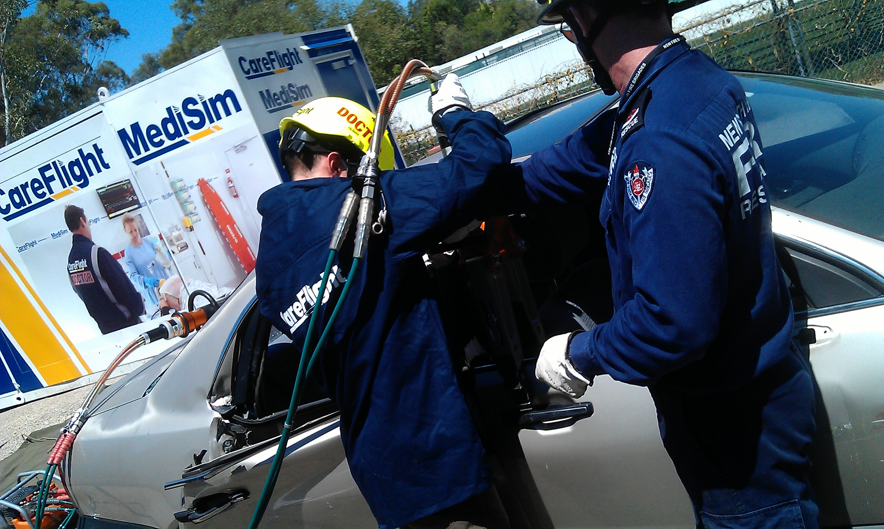

Slide 23
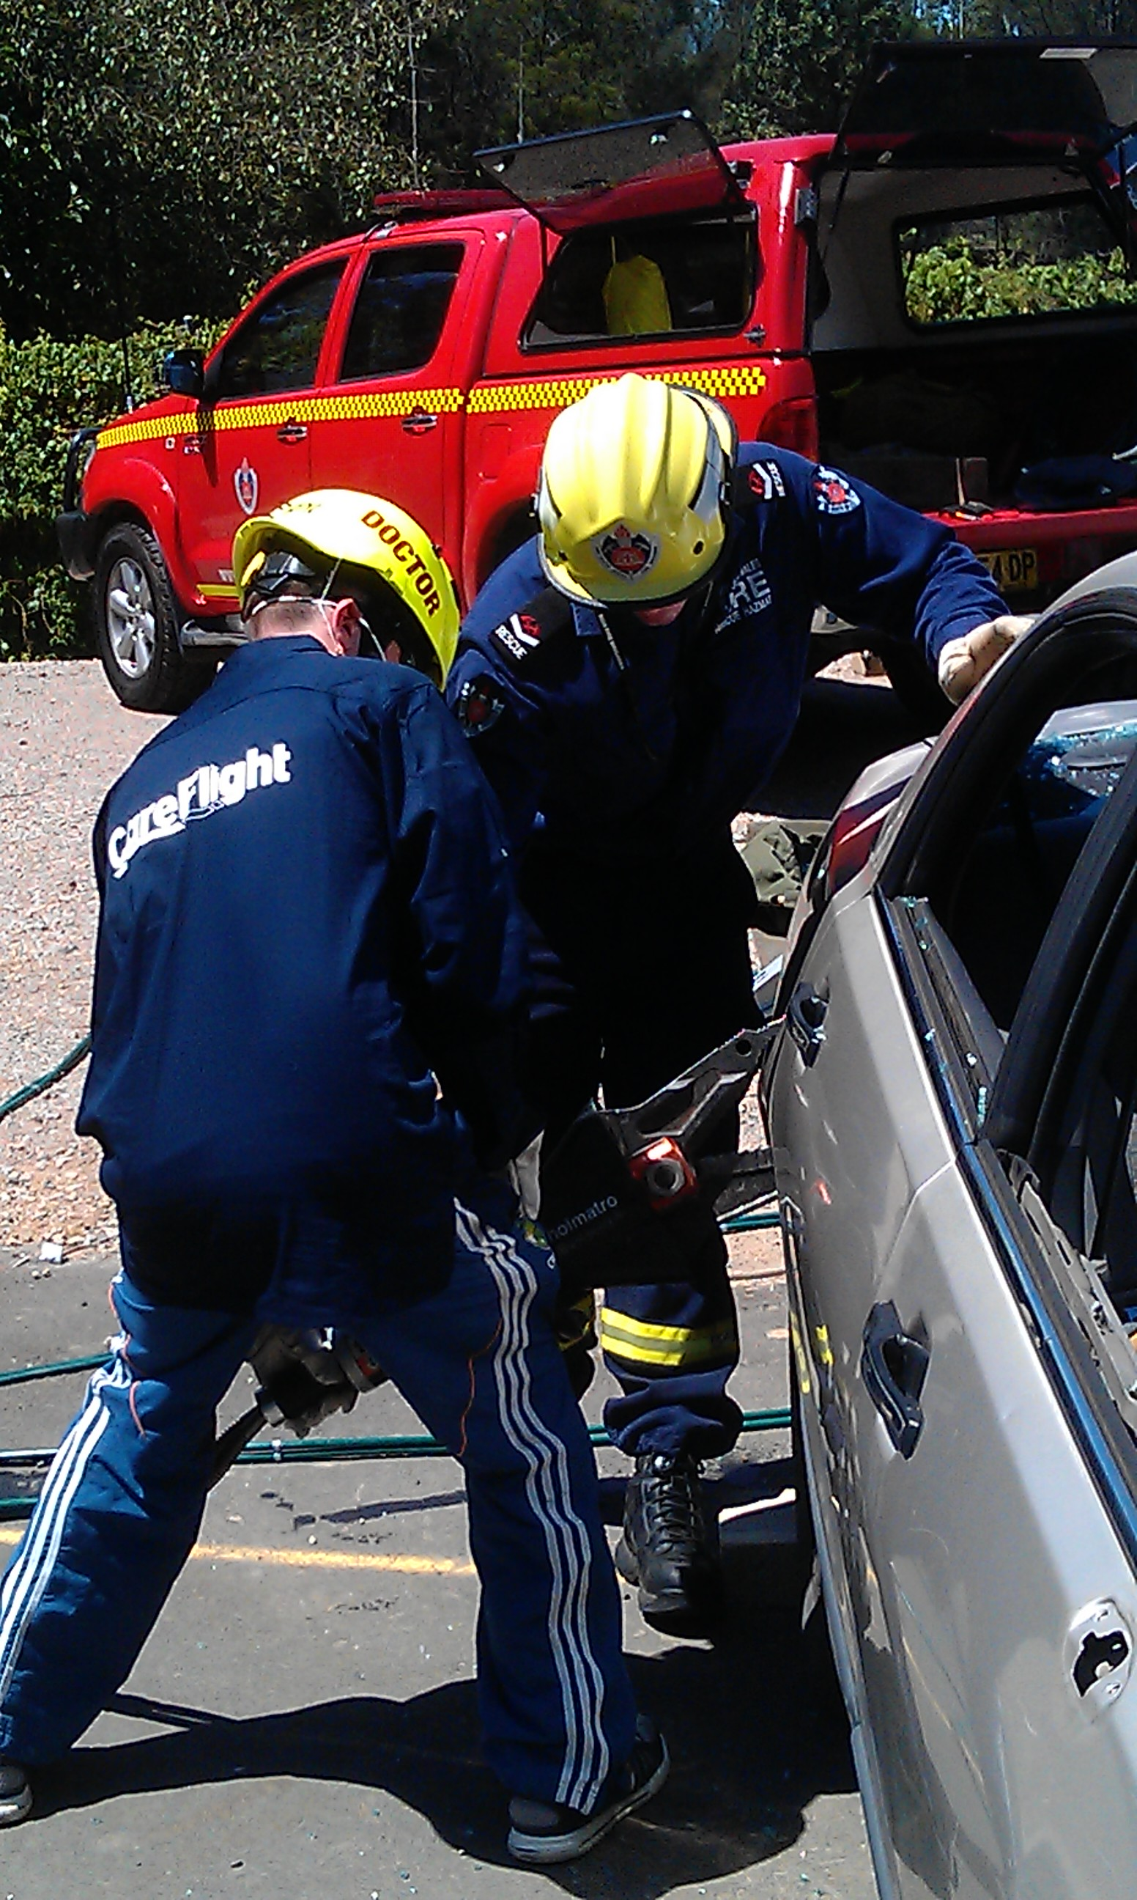
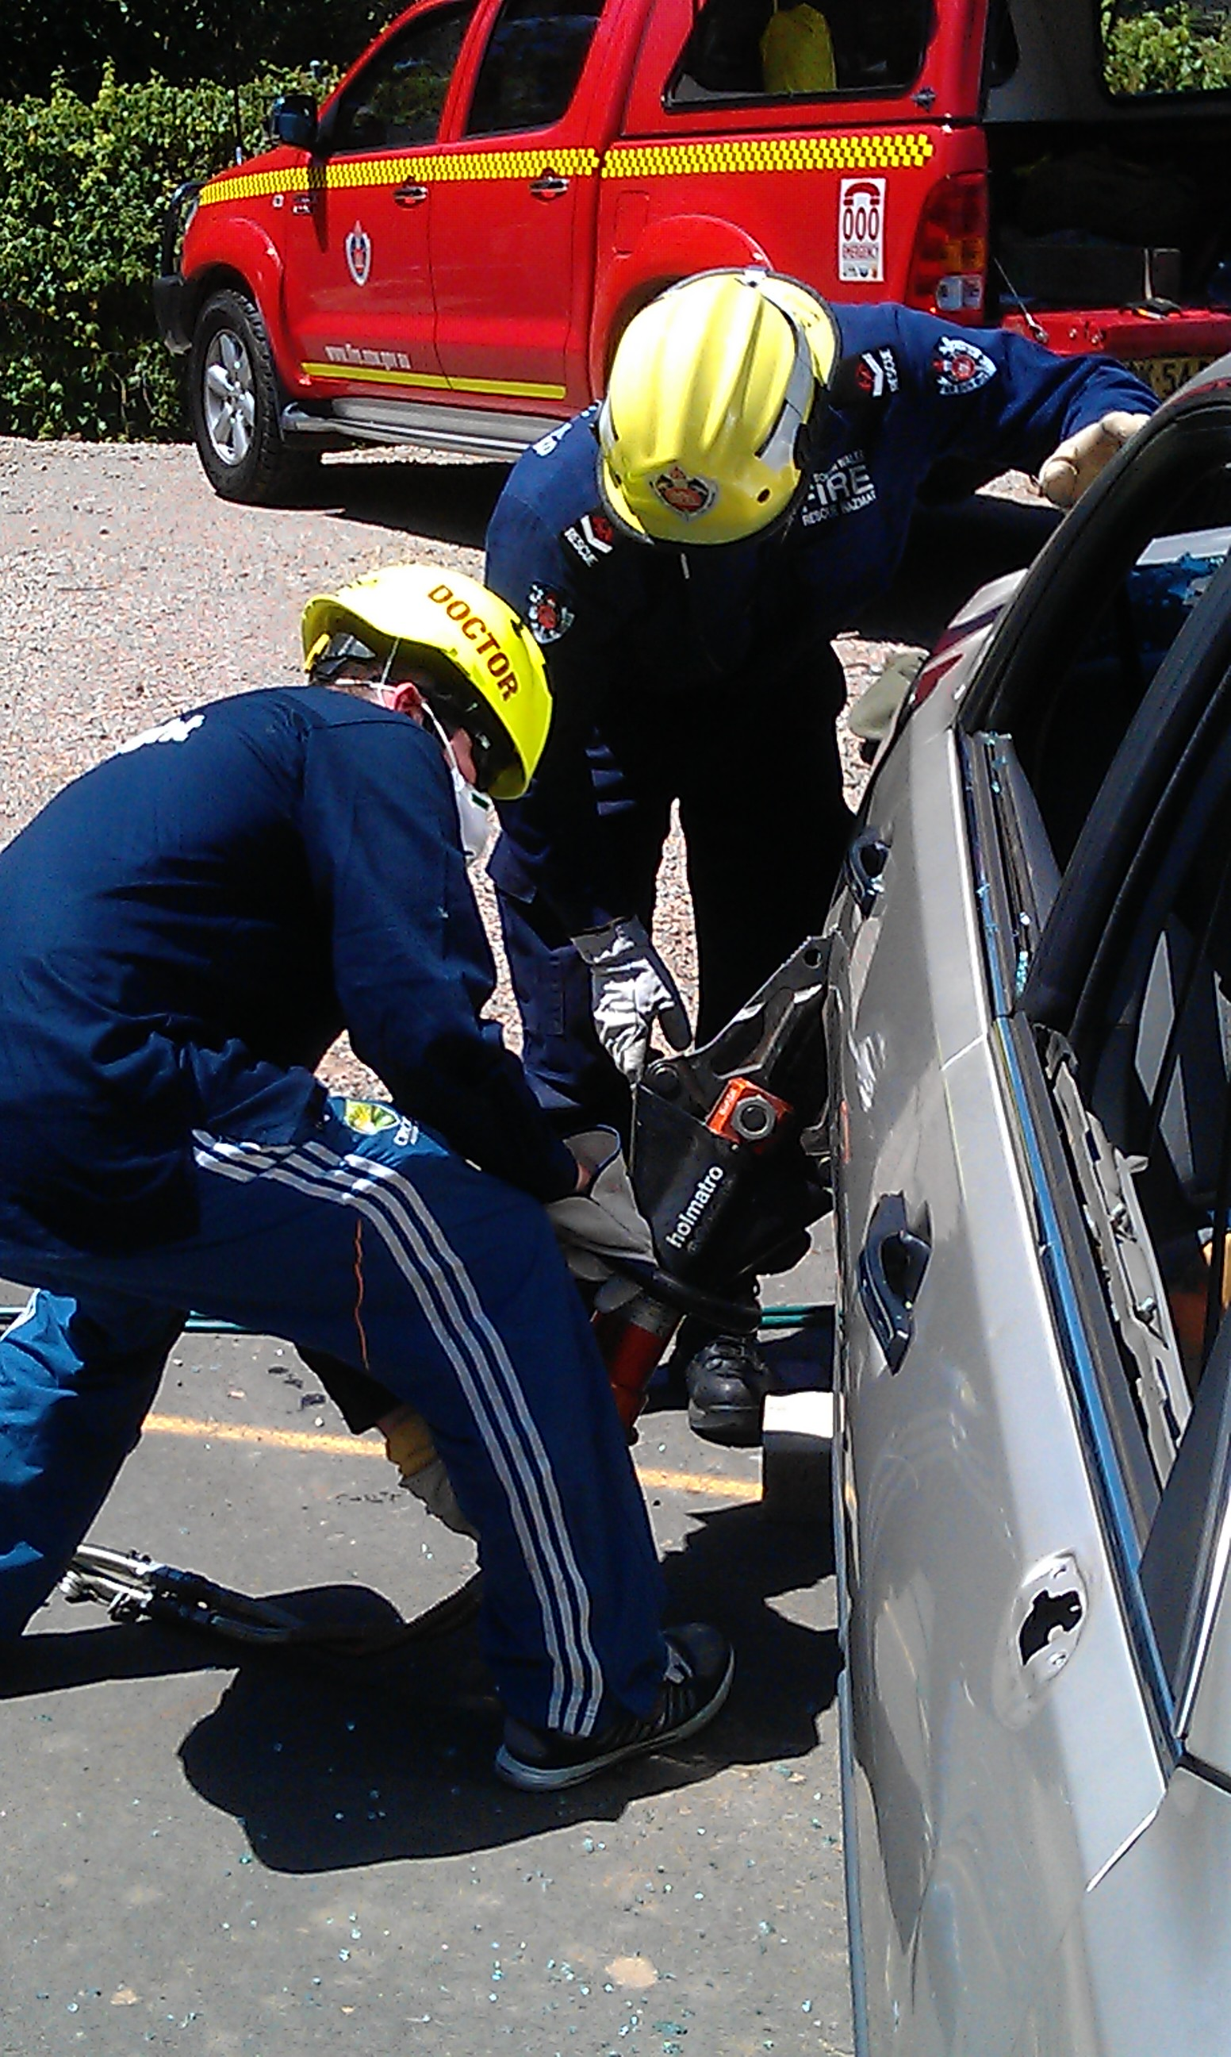
Tools

Slide 24
Tools

Slide 25
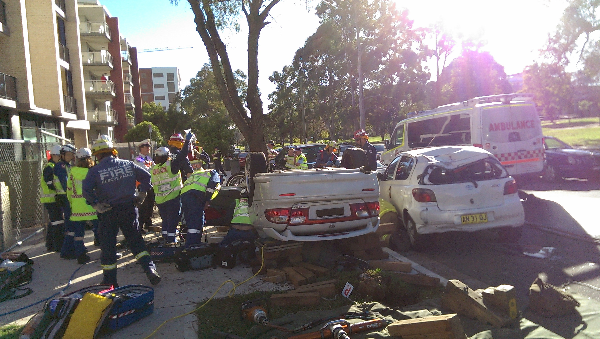
Extrication

Slide 26
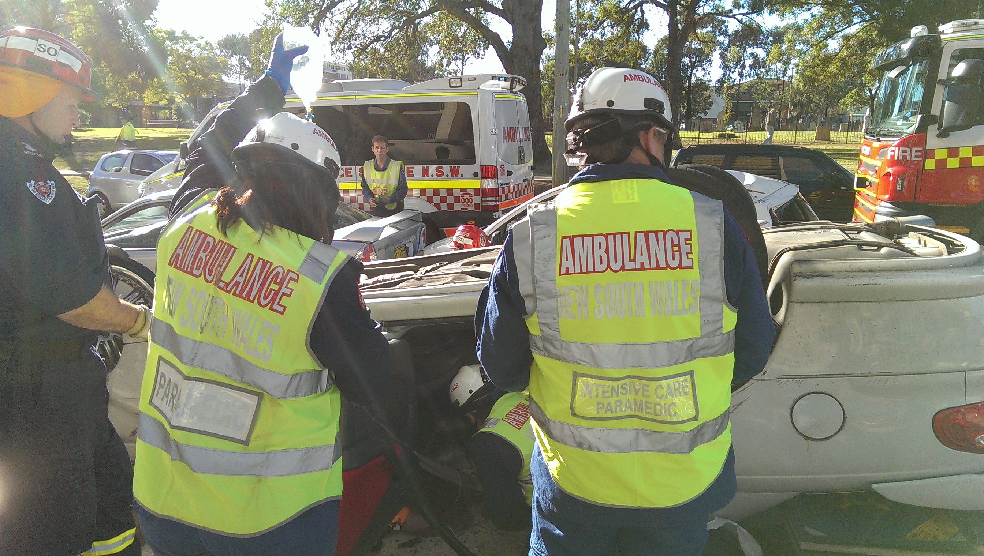
Case 3

Slide 27
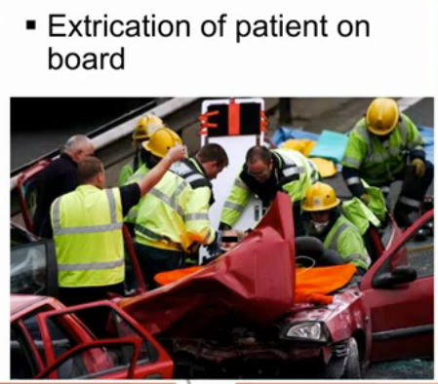

Slide 28
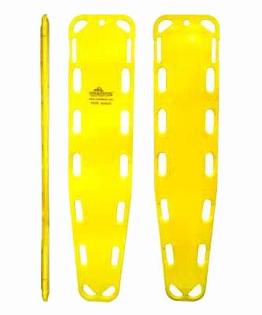
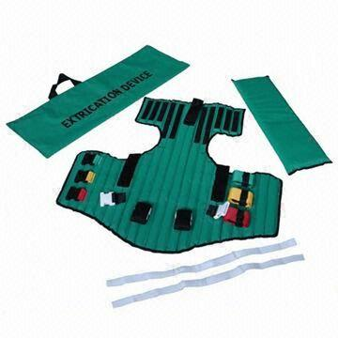

Slide 29
Post Extrication Treatment On Scene
‘Meaningful Interventions’ are the Priority
Will Depend on
  Clinical Assessment
  Distance from Hospital
  Skill set and Resources

Slide 30
Take Home Points
Personal Safety is a Priority
Hazards (Potential and Actual) are a real danger in the Pre-hospital Environment

Slide 31
